Slide 2
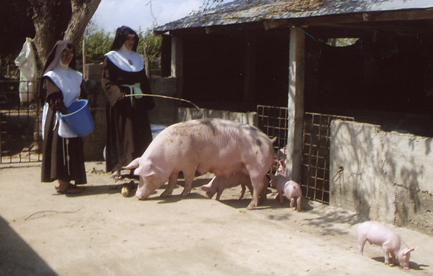
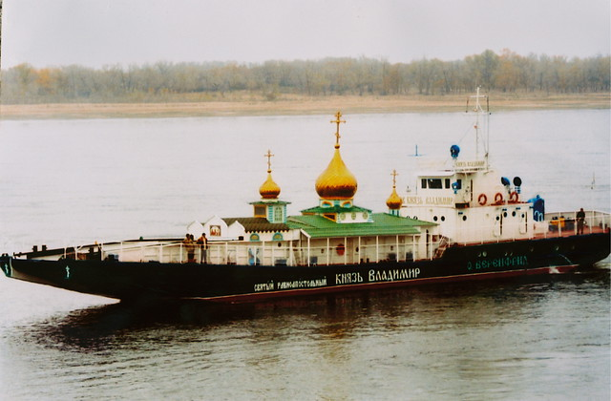
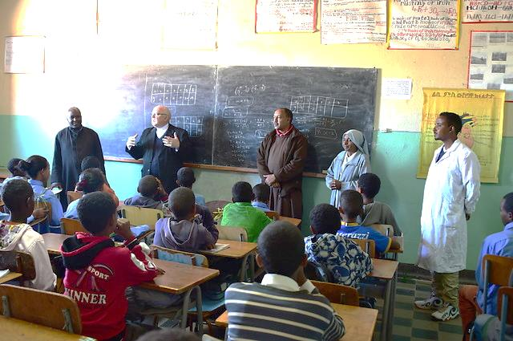
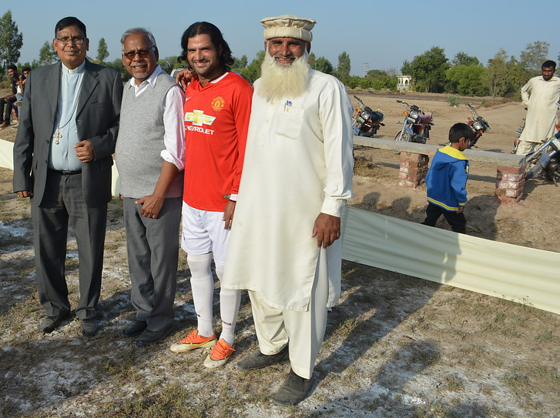
WHAT IS ACN?
©ACN
©ACN
©ACN
©ACN
Notes:
Aid to the Church in Need (ACN) supports the Church wherever Christians are suffering because of crippling poverty; extreme isolation or persecution (remember to ask what persecution means and make sure that they understand). These pictures are some of our favourite examples of how ACN helps: we support communities of religious sisters who run schools, hospitals and orphanages (we supply funds so that they can set up income-generating projects to go on helping Christians in their area); build churches, like this boat church in Russia (if you can’t get to church, ACN helps church come to you!); build bridges between different communities by supporting projects like this Interfaith football league in Pakistan (helps young people of all faiths come together and get to know and understand each other through playing as a team); schools (we help schools all over the world provide a good education; we want every child to be able to attend a school as wonderful as yours!)

Slide 3
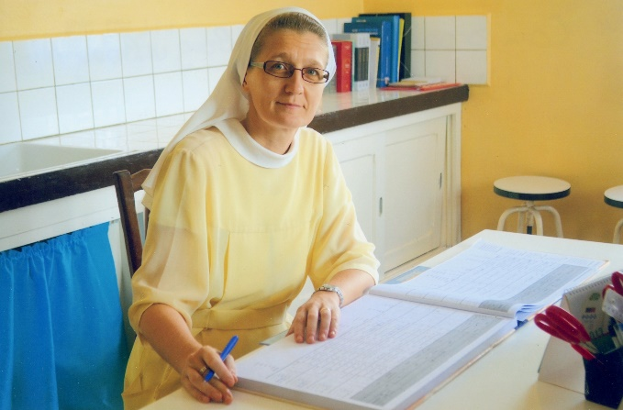
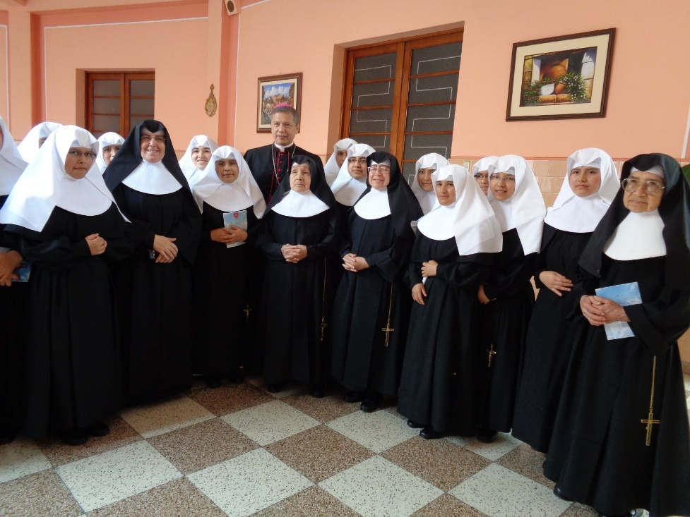
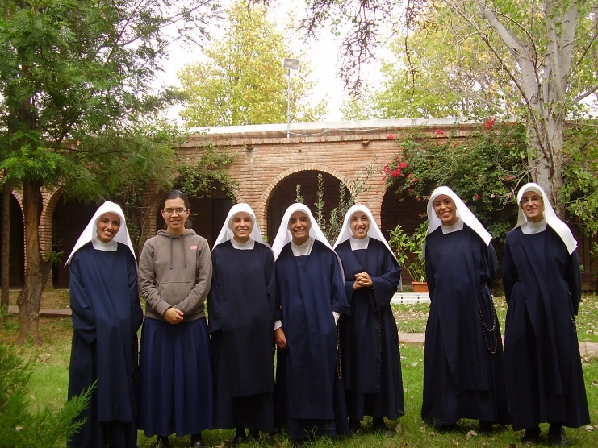
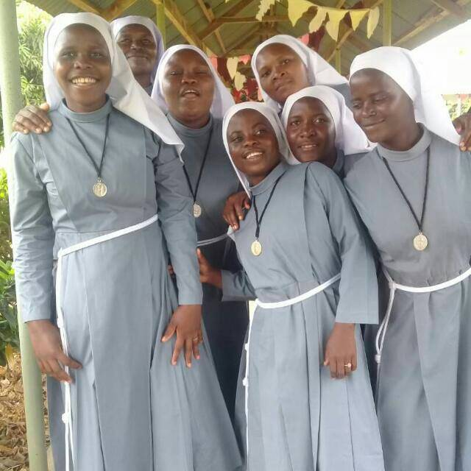
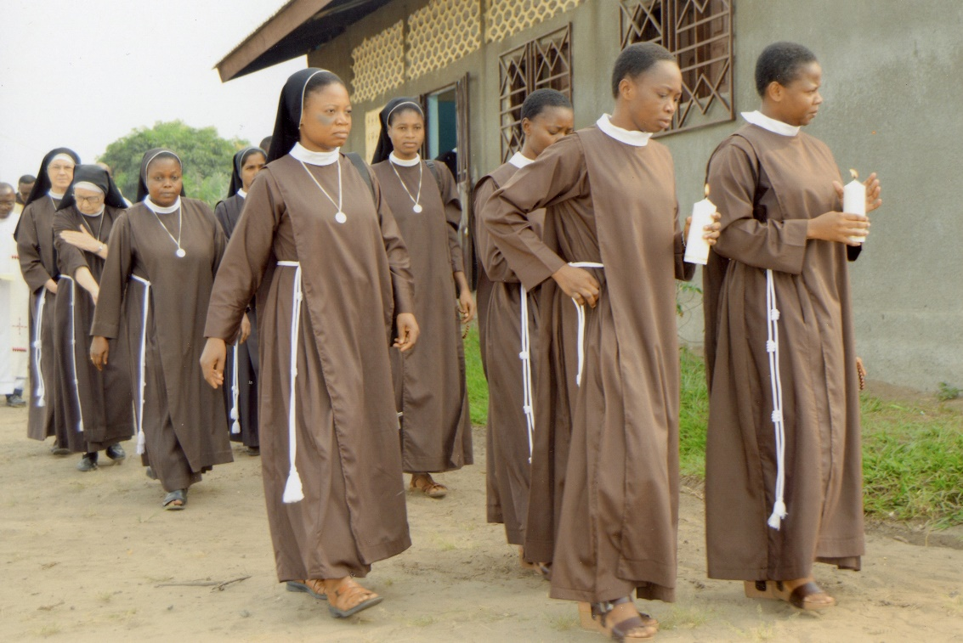
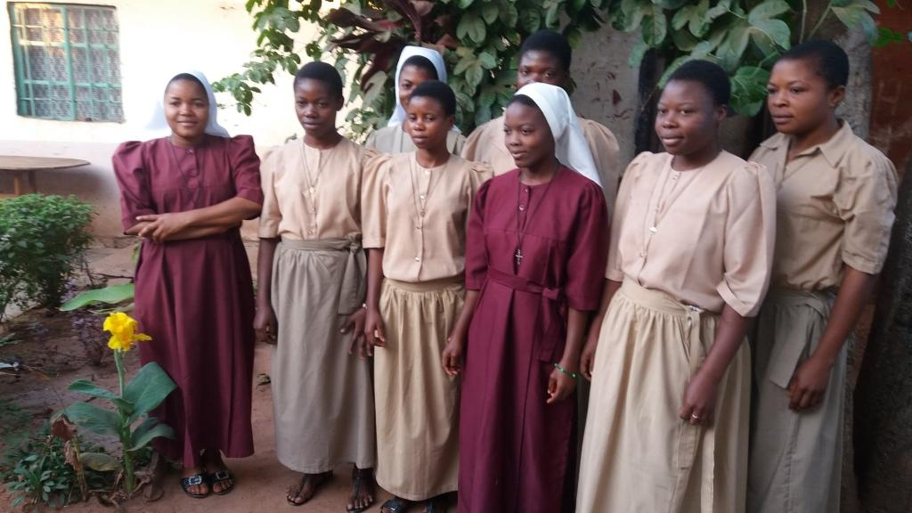
©ACN
©ACN
©ACN
©ACN
©ACN
©ACN
Religious Sisters around the World
Notes:
Today we’re going to focus on learning about religious sisters and what they do for all kinds of people all over the world. Religious sisters, who are sometimes called ‘nuns’ come in all shapes and sizes and from all walks of life. They are young and old, tall and short; loud and funny or quiet and shy. They are all different, but each Sister has chosen to follow her deep love for Jesus and give her life to God through prayers and good works. Some sisters wear regular clothes, but lots choose to wear long robes called habits and veils to cover cover their hair. Here are some examples of religious sisters from all over the world. How many colours can you spot? (click 4 times to change the images and ask how many colours the sisters are wearing—the answer is 7 (not including the white veils). Maybe ask why the final images has sisters wearing two different colours-=this is is usually because younger sisters (novices) often wear a different colour to set them apart from the more senior Sisters—just like different school uniforms for older and younger pupils).

Slide 4
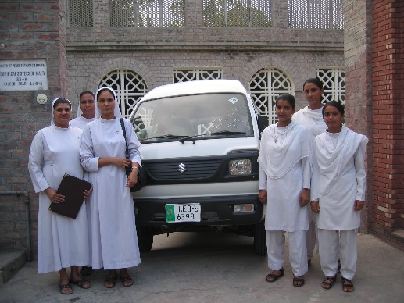
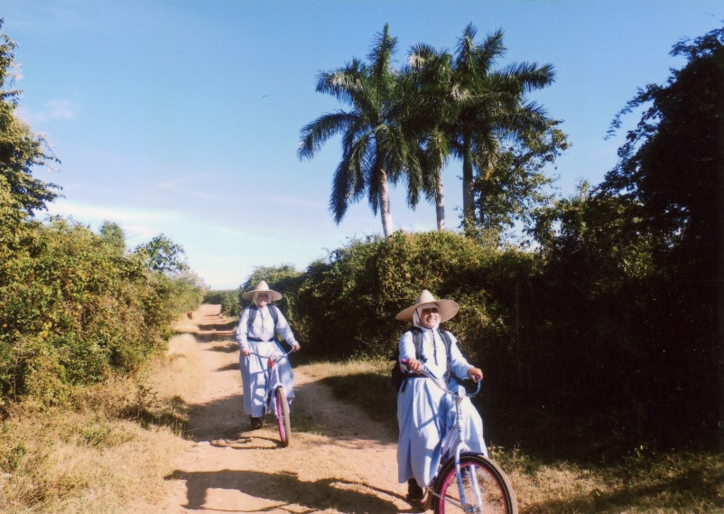
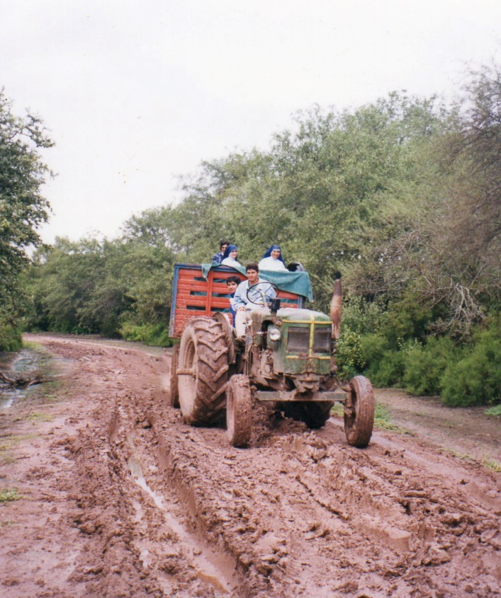
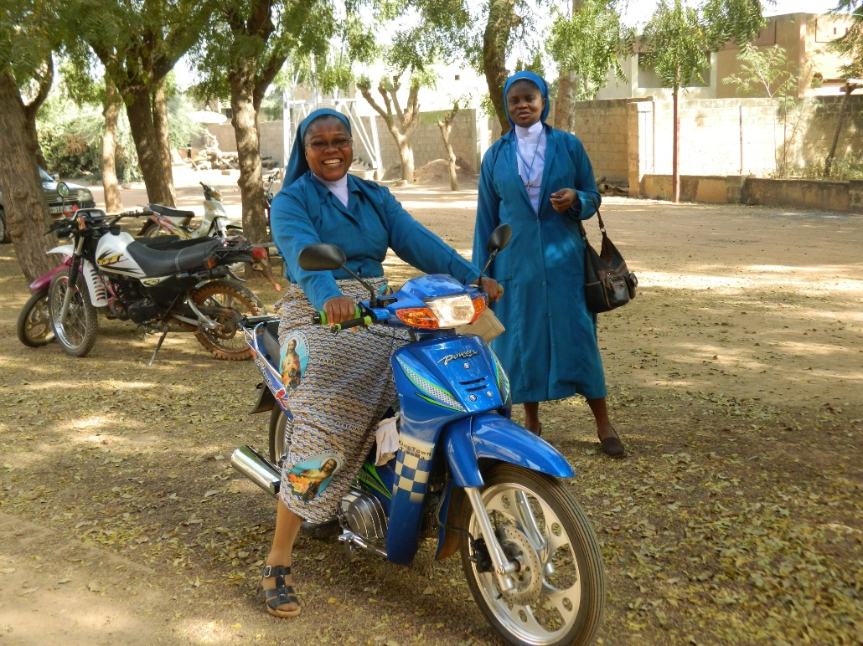
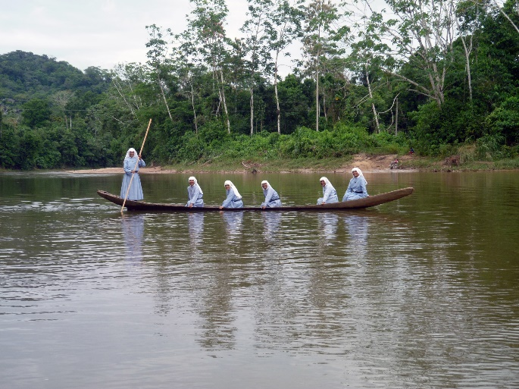
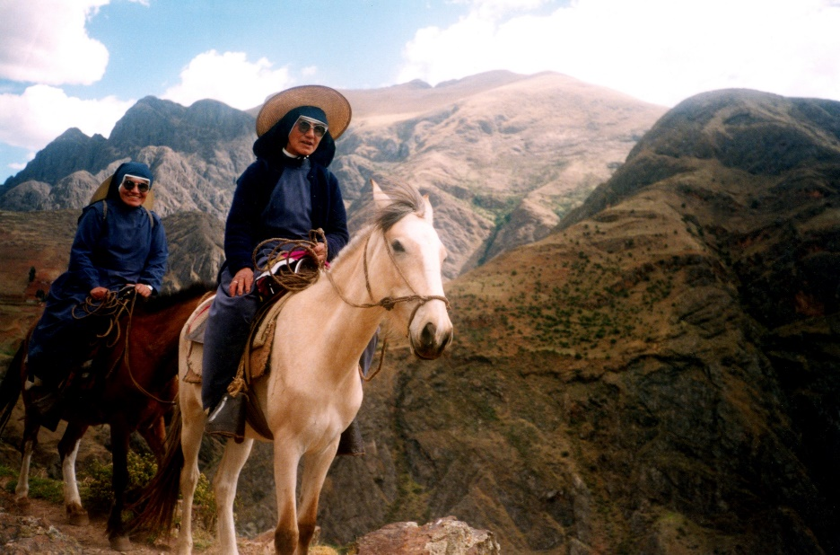
©ACN
©ACN
©ACN
©ACN
©ACN
©ACN
Religious Sisters on the go
Notes:
Getting around: Religious Sisters work hard to help people. They need to be able to reach everyone, no matter where people might live. ACN makes it easier for Religious Sisters to get from place to place by providing them with all sorts of types of transport. Here are just a few—which is your favourite?

Slide 5
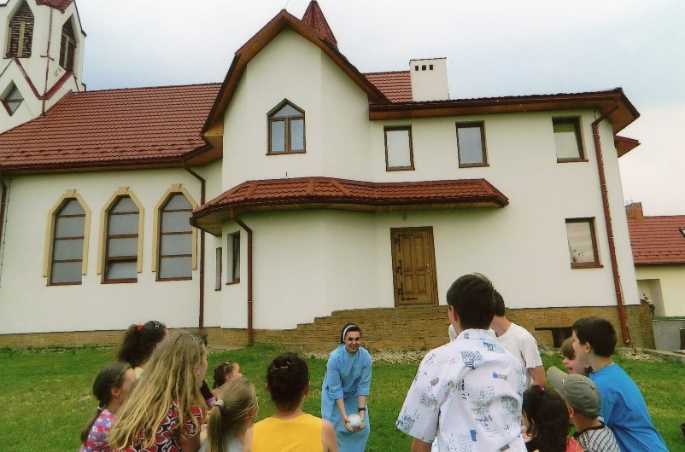
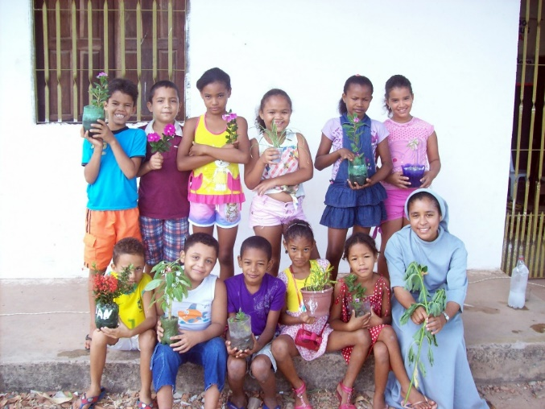
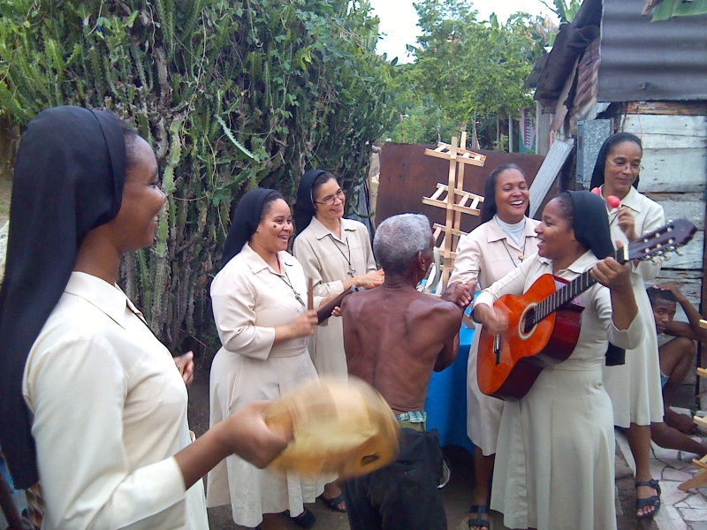
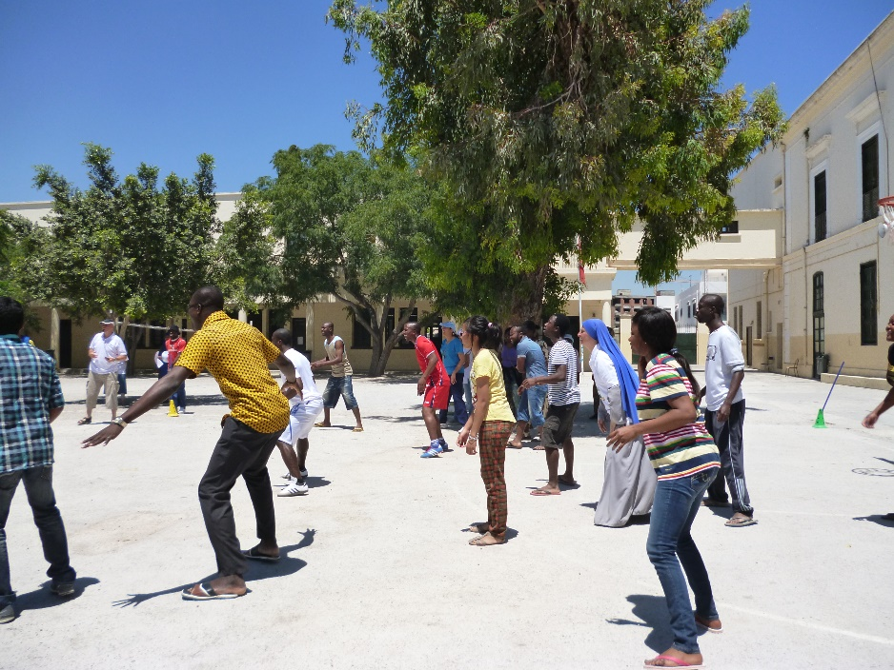
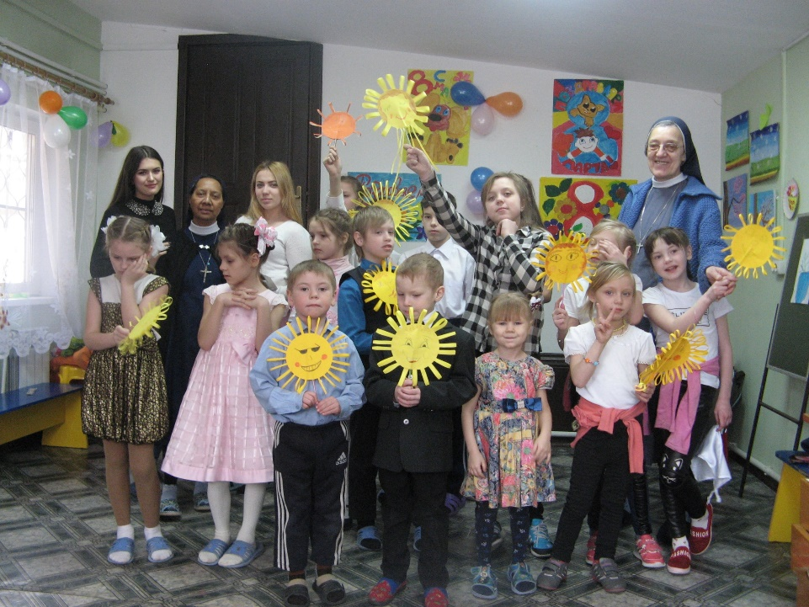
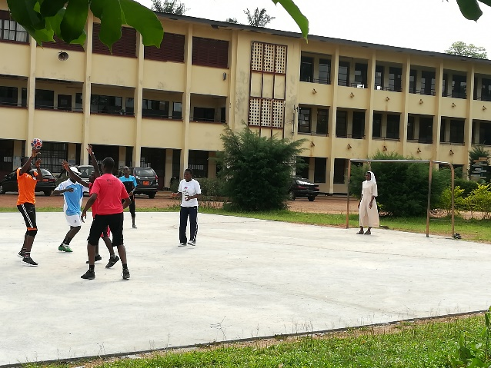
©ACN
©ACN
©ACN
©ACN
©ACN
©ACN
Religious Sisters having FUN
Notes:
Religious Sisters Having Fun: A great many Religious Sisters around the world help children. Some children don’t have anywhere to live or anyone to take care of them. Sisters help them by teaching them, keeping them warm and safe, sowing them God’s love and even by making sure that everyone is having fun. What’s happening in each of these pictures? Which looks like it would be your favourite way to have fun? What kind of game so you think is being played in the final picture?

Slide 6
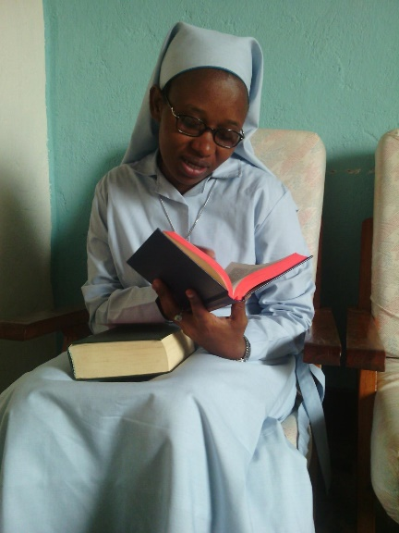
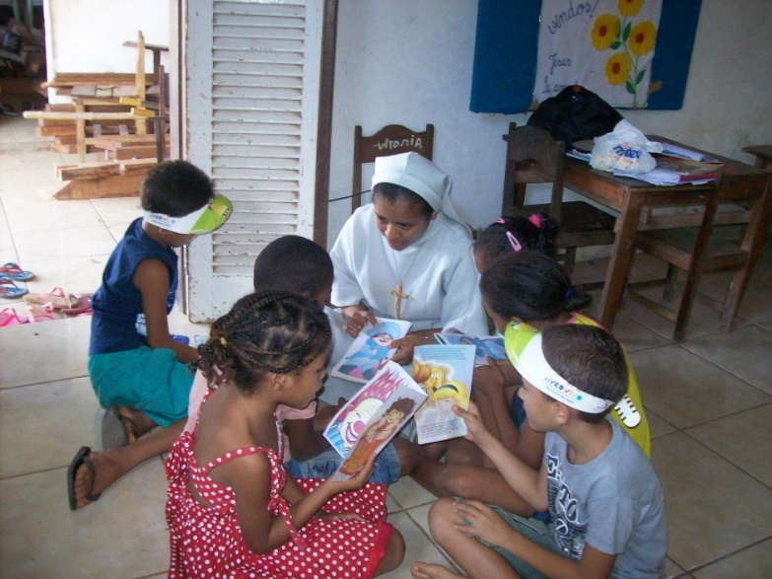
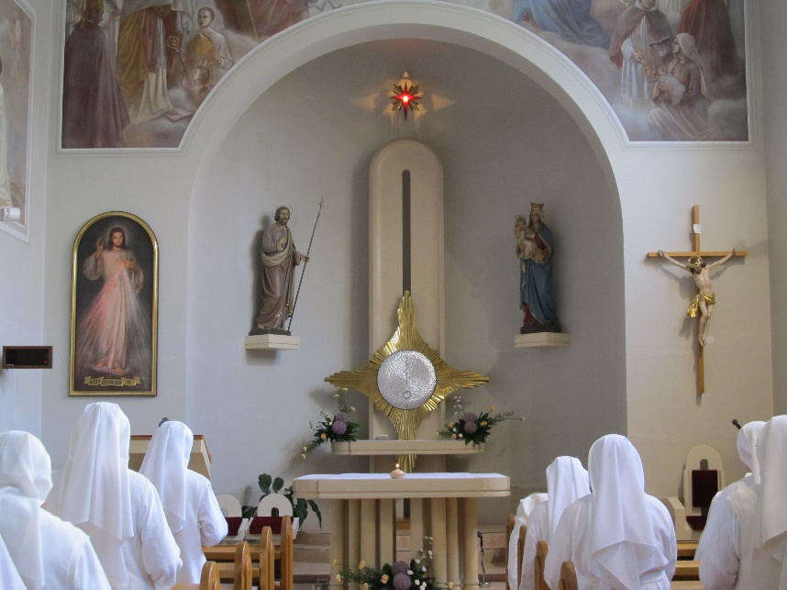
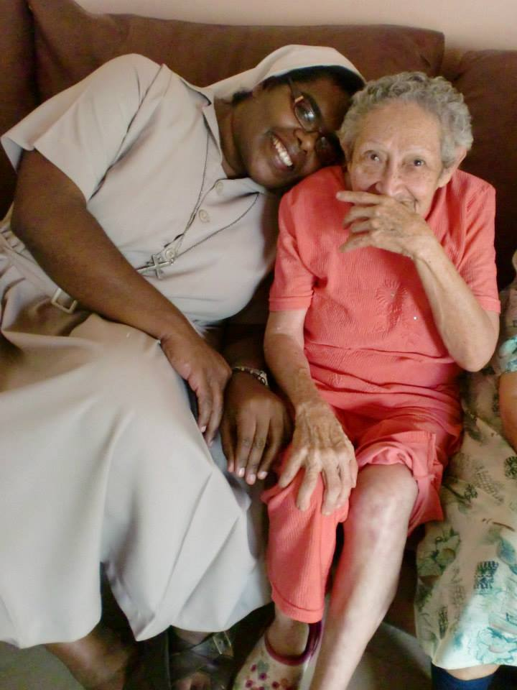
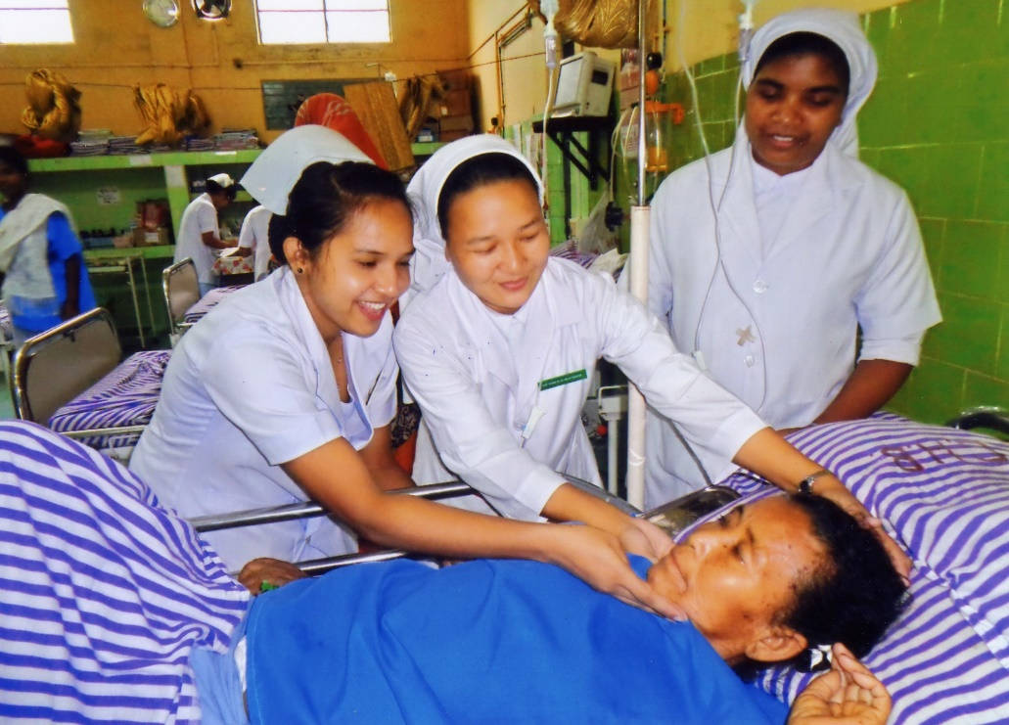
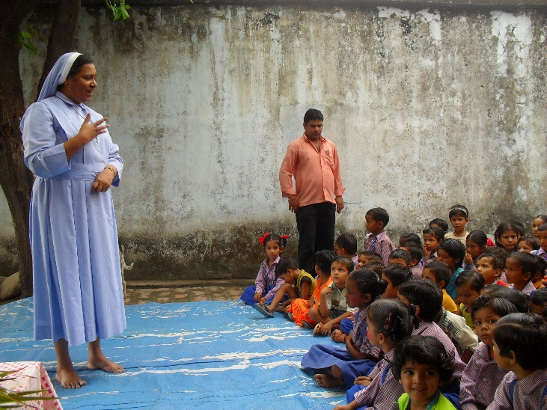
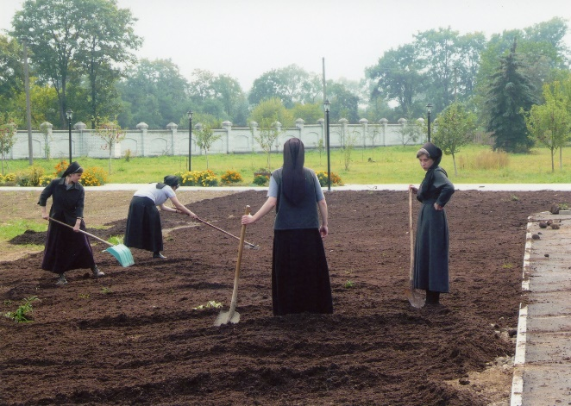
©ACN
©ACN
©ACN
©ACN
©ACN
©ACN
©ACN
Just how do Religious Sisters help?
Notes:
Religious Sisters make a huge difference to lots of lives in so many different ways. Here are just a few—maybe ask the children to think about just how each activity might help someone. 1. teaching in schools; 2. praying; 3. studying; 4. serving as Catechists; 5. nursing the sick; 6. growing crops; 7. offering friendship to those who might be lonely

Slide 7
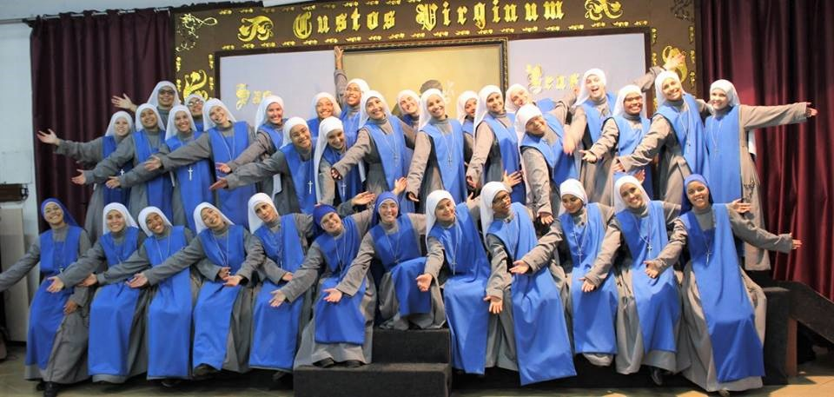
Religious Sisters Around the World:
©ACN
WE THANK YOU!
Notes:
So, now we know quite a bit about what Religious Sisters do every day, everywhere, for everybody around the world. Now it’s time to take a little time out to say thank you to God for all that Religious Sisters do. Here’s a suggestion, but you may want to come up with something yourself or ask the children for ideas. Prayer for Religious Sisters: In the Name of the Father, Son and Holy Spirit. Lord, we pray for Religious Sisters around the world that they may continue to carry out their work to help those most in need. We pray that they will greet each new day with a smile and that they will always feel happy and blessed in the work they do. We pray that you will keep them safe and give them strength to keep going even when times are hard. We thank you for the many gifts that they bring to your people. In Jesus’s name we pray. Amen.

Slide 8
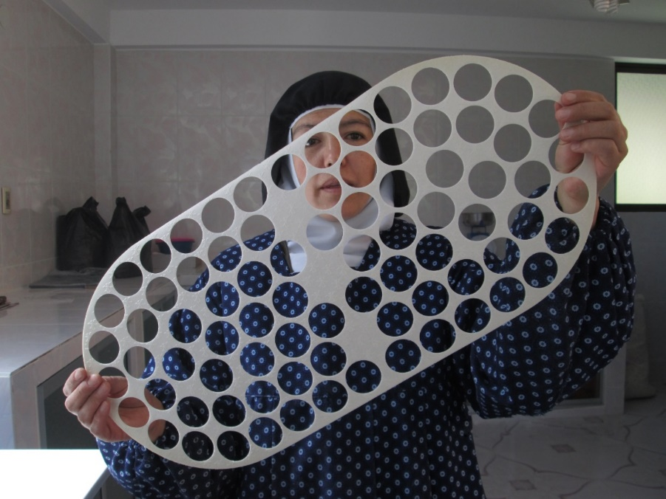
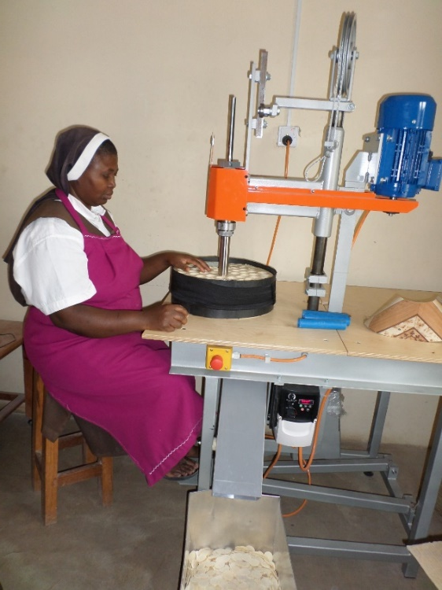
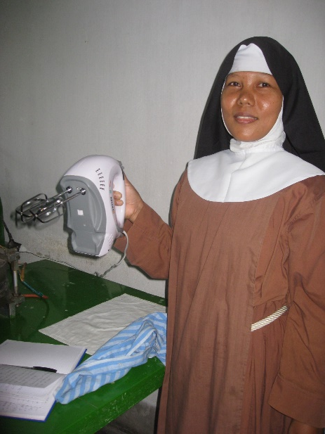
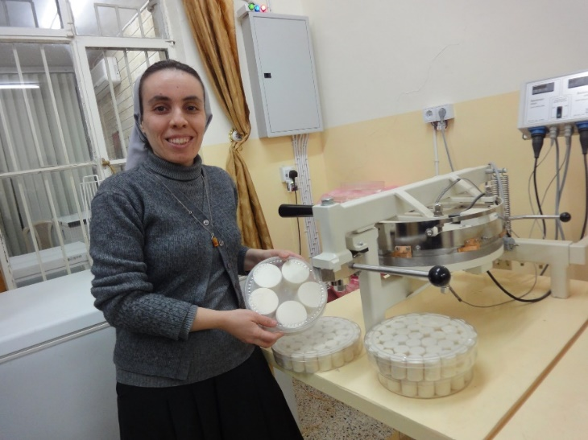
©ACN
©ACN
©ACN
There’s one more
really important thing
that Religious Sisters do…
Can you guess what it is?
©ACN
Notes:
There is another very important thing that Religious Sisters do…it helps all of us every time we go to Mass. Can you guess what it is? Here are some clues—many do you need to see before you figure it out?

