Slide 1
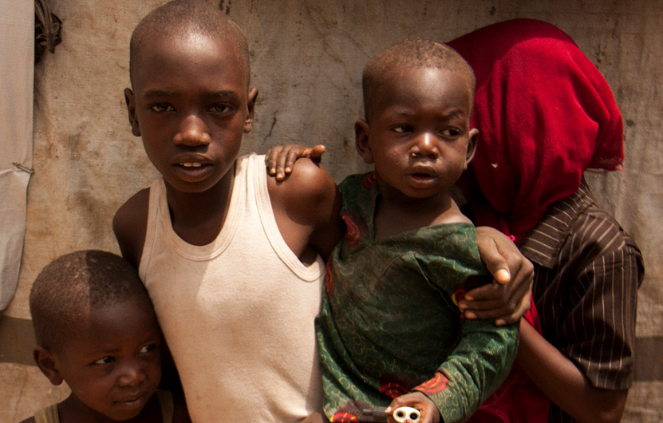
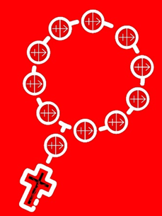
© Aid to the Church in Need
We ask Mary our Mother to watch over the orphans and keep them in her care.
Notes:
You can use these slides as a reflection and prayer focus for your decade of the Rosary per day.
Day 1: In Maiduaguri, Nigeria because of the fighting, there are 15,000 children whose mums and dads were killed. ACN is helping to fund an orphanage where the boys and girls can live, have a safe place to sleep, go to school and have something to eat. In this 3rd decade today, we ask Mary our Mother to watch over the orphans and keep them in her care.

Slide 2
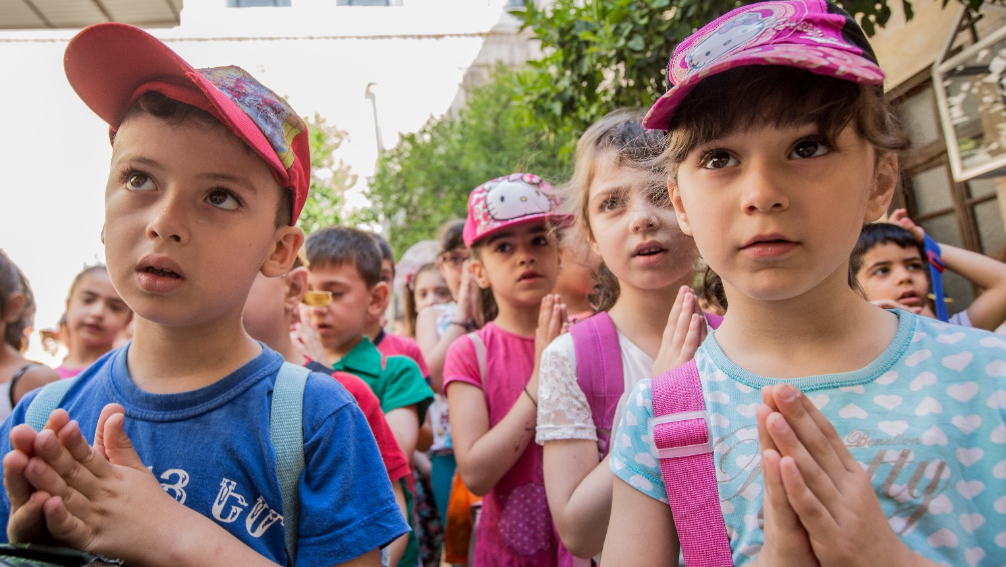
© Aid to the Church in Need
Mary please keep the women strong, healthy and happy so that they can look after their families.
Notes:
DAY 2: As well as the orphans in Maiduguri, there are 5,000 women whose husbands were killed. Most of the women have around nine children to look after without any money. ACN are paying (with your help) to send the women back to school so that they can train for jobs and are then able to feed their children. Mary please keep the women strong, healthy and happy so that they can look after their families.

Slide 3
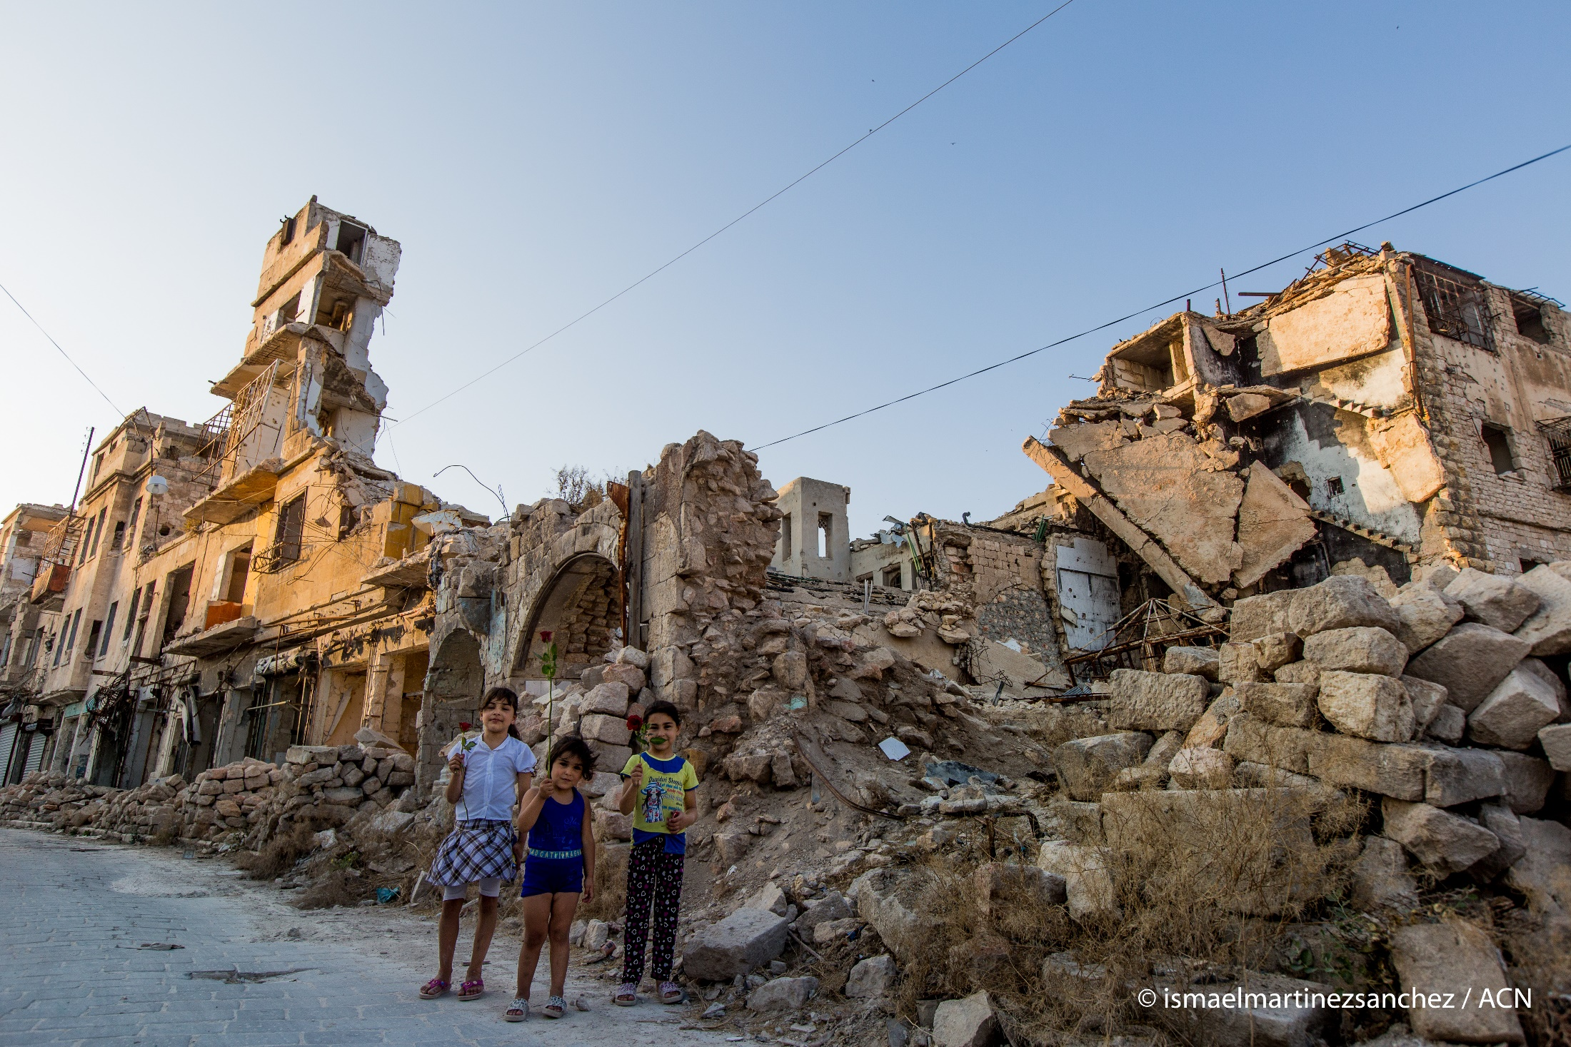
We pray for the families who are homeless and ask Mary our Mother to protect them and keep them safe.
Notes:
DAY 3: In Syria, 12 million people have lost their houses because of the bombs. Aid to the Church in Need is helping to rebuild houses and Churches and find new homes for those whose houses are still in the middle of the fighting. During this decade of the rosary, we pray for the families who are homeless and ask Mary our Mother to protect them and keep them safe.

Slide 4
© ismaelmartinezsanchez / ACN
We pray that all the fighting and wars stop and that our world finds peace .
Notes:
DAY 4: In this last decade of the Maisy Milk Rosary for Peace, ACN ask you to dedicate it to everyone in the world. Please help those who want to fight, understand that it is much better to be friends and love one another. Mary, as our Mother, please look down on and bless all those who suffer because of who they are and where they live. We pray that all the fighting and wars stop and that our world finds peace.

Slide 5
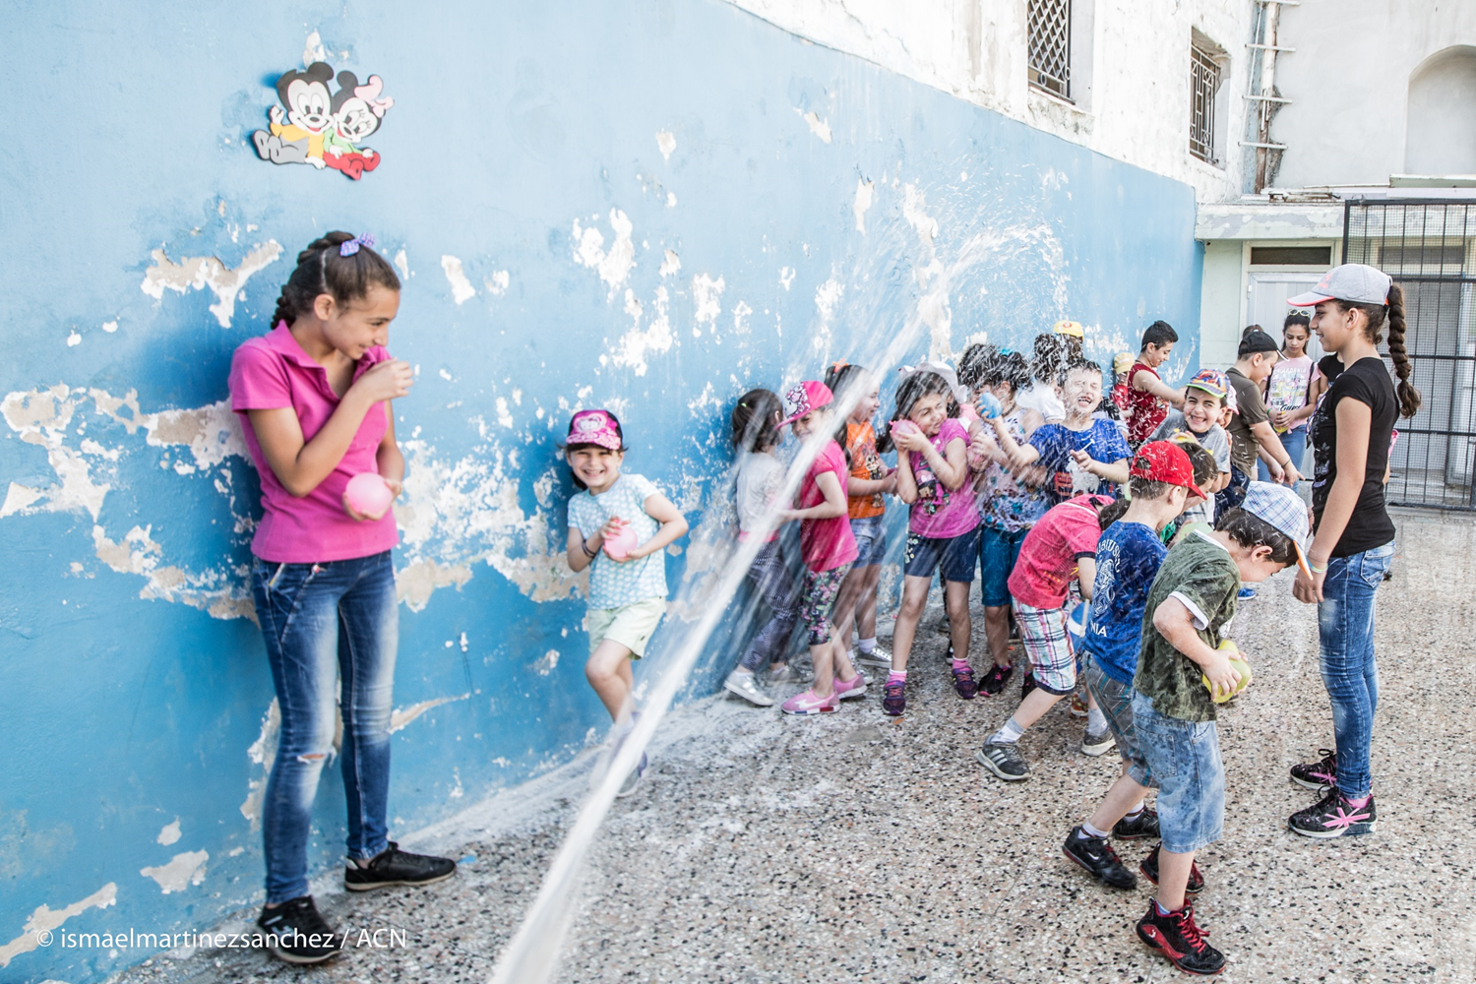
We ask Our Lady to look down on the children, doctors and teachers and help all of them to have a fun time in the summer camp.
.
Notes:
Day 5: In 2018, explosions killed over 1,000 children in Syria. It is not safe for them to play in the street so ACN is paying to send 130 children to a summer camp in Kassab. Whilst in the camp, the children are helped by doctors as many of them are having nightmares because of the terrible things that they have seen during the war. The children will also get to play and catch up with their schoolwork whilst living in a safe place. During this decade, we ask Our Lady to look down on the children, doctors and teachers and help all of them to have a fun time in the summer camp.

