Slide 1
Advent 2021
Notes:
Begin with a prayer. There are lots of examples on the Advent Prayers Sheet.

Slide 3
This year, rather like the previous year, has been a tough year for many of us...
Notes:
There are three main sections (to make it easier for you to summarise afterwards):
The effects of COVID on you and images of people and systems we were reliant on during the lockdowns
The work of ACN helping the poor worldwide during the pandemic
ACN Christmas parcels.

Slide 4
The continuing COVID-19 pandemic and its effect on:
communities and families;

Slide 5
Health, medical and social care services and research facilities;
Students, teachers, lecturers and their families as schools, colleges and universities switched to online learning and teaching;

Slide 6
All places of worship and faith communities;
Parishioners, who for a while, could only participate spiritually in the celebration of the Mass online;
Businesses large and small, rural or urban, manufacturers or retailers.

Slide 7
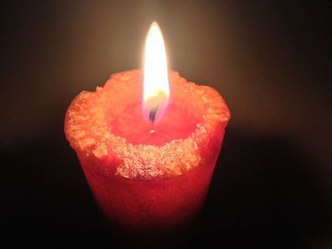
Notes:
Despite the immense difficulties and dreadful problems causing great distress to many families we saw wonderful acts of kindness, selflessness and love demonstrating the light of HOPE was still shining through the darkness.

Slide 8
Despite these very serious consequences the light of hope was visible in, seemingly, surprising places.
Notes:
There are three main sections (to make it easier for you to summarise afterwards):
The effects of COVID on you and images of people and systems we were reliant on during the lockdowns
The work of ACN helping the poor worldwide during the pandemic
ACN Christmas parcels.

Slide 9
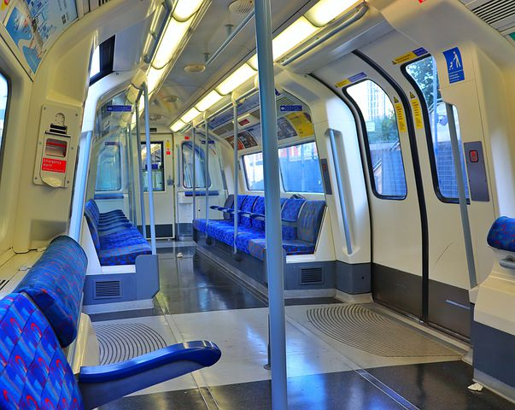
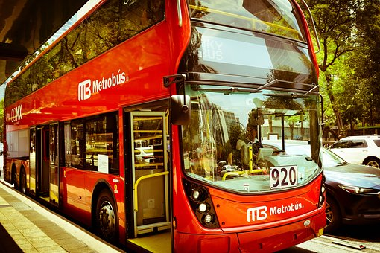
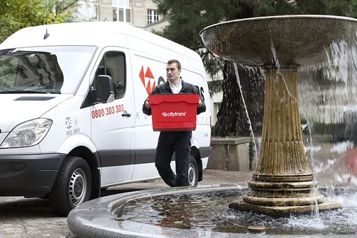
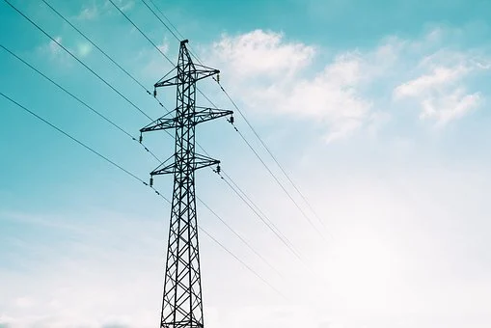
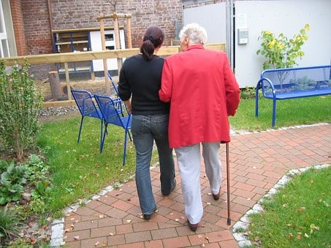
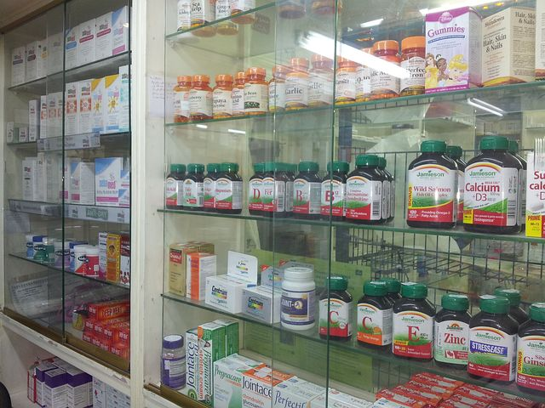
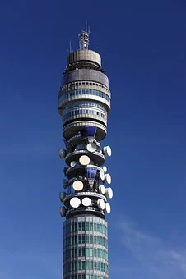
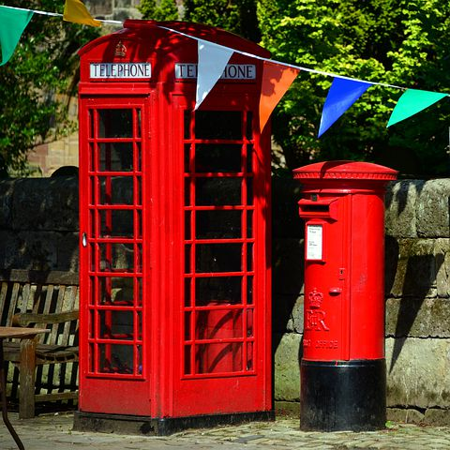
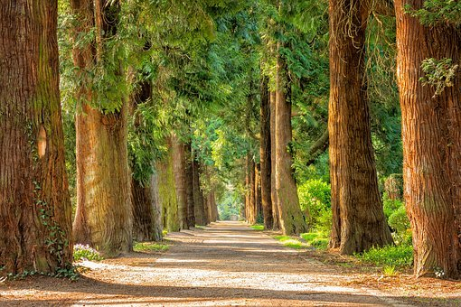
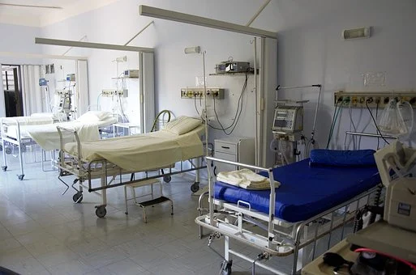
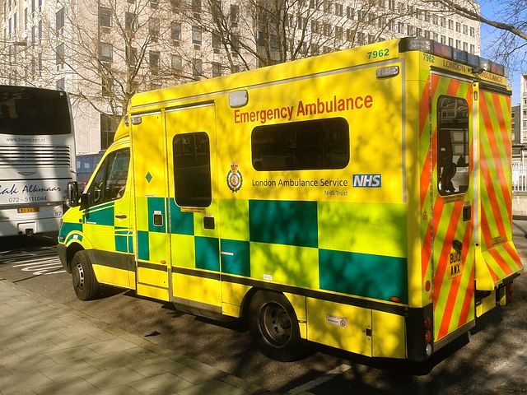
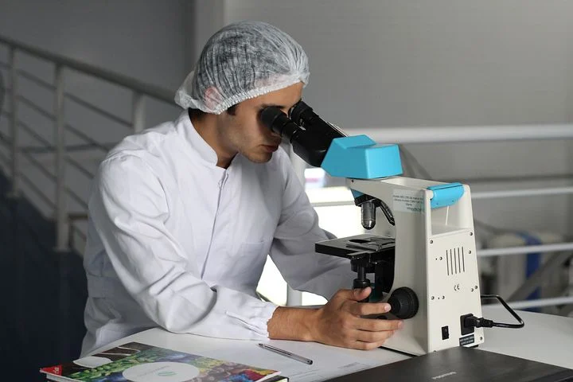
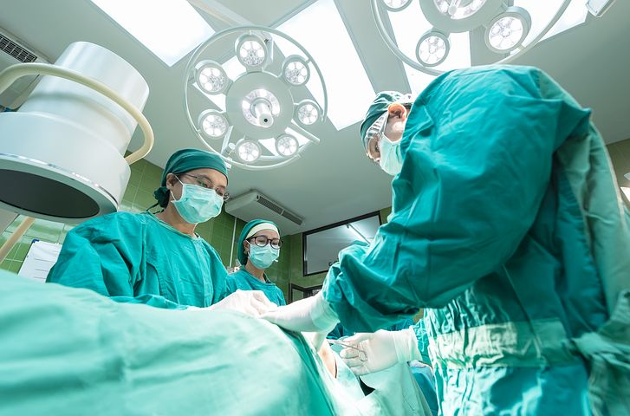
Notes:
Just some of the people who we relied on heavily among many, many other people:
Doctors, nurses, paramedics, healthcare workers, pharmacists, medical researchers, childminders…
Utility suppliers, telecommunication/Internet service provider companies, TikTok, Instagram, You Tube, Twitter, Flickr, Facebook…
Delivery drivers, public transport workers
Public parks, the countryside and open spaces
The work of ACN helping the poor worldwide during the pandemic
ACN Christmas parcels.
The effects of covid on you and examples of heroic responses

Slide 10
Discussion and prayer:
After you have watched the presentation
Notes:
Questions for discussion:
What has been the most difficult part of the COVID crisis for you?
Have there been any unexpected benefits?
What do you think inspires people to help others even when they themselves are suffering?
Summarise the work of ACN during the pandemic.
Why are the Christmas parcels so important to the Syrian children?
Why might some people not be in a position to fundraise this year?
What do you have in terms of time, talents, motivation and ideas to contribute to ACN’s mission?
Why do we believe prayers are important?
Can we/you commit to pray during Advent?

Slide 11
Notes:
Explain that there is a different prayer for each day of the three weeks the school term overlaps with Advent. Each day has a different theme, which is represented by a star or a hand. The five points of the star and/or the five fingers of a hand forms the activity. Each one represents one of the prayers.

Slide 12
Make your Star
Notes:
For short a video tutorial see: How to make a PAPER STAR

Slide 13
Prayers for the world
Prayers for an end to Covid 19
Prayers for ACN projects
Prayers for my family and friends
Prayers for me
Notes:
They will be writing their prayers on their actual star (or hand) to offer to Jesus in the crib.

Slide 14
It might look like this:
Notes:
For short a video tutorial see: How to make a PAPER STAR

Slide 15
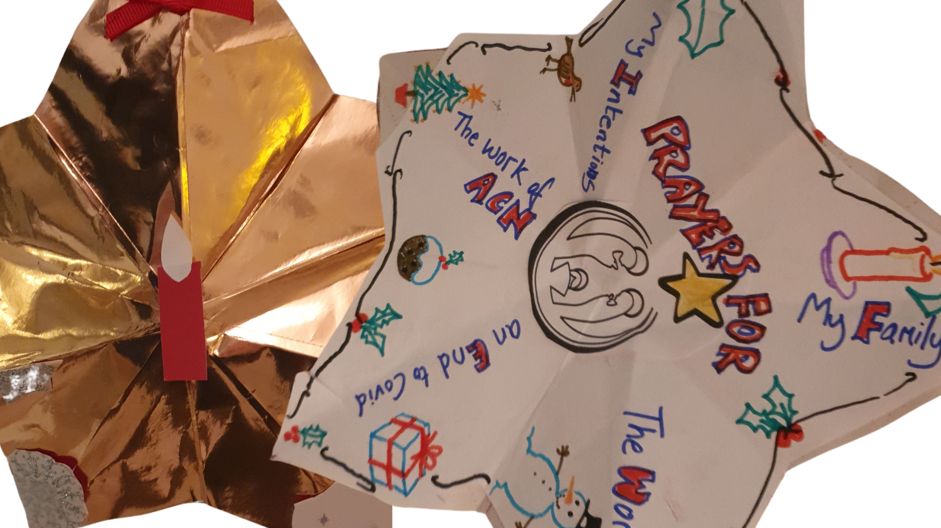
Notes:
Here is a version we made at ACN to show you. The pupils can actually write their prayers on the five points of the star. They may want to bring in wrapping paper and old Christmas cards to decorate it. If they want to hang it on the tree, hole punch the top point and thread with ribbon or string. If you are having an Advent liturgy, pupils could offer these up as prayer intentions.

Slide 16
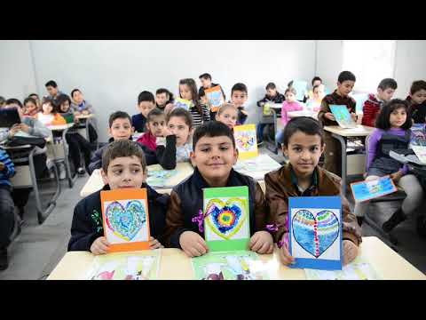
Notes:
Play video.
This will remind them about the Christmas parcels

Slide 17
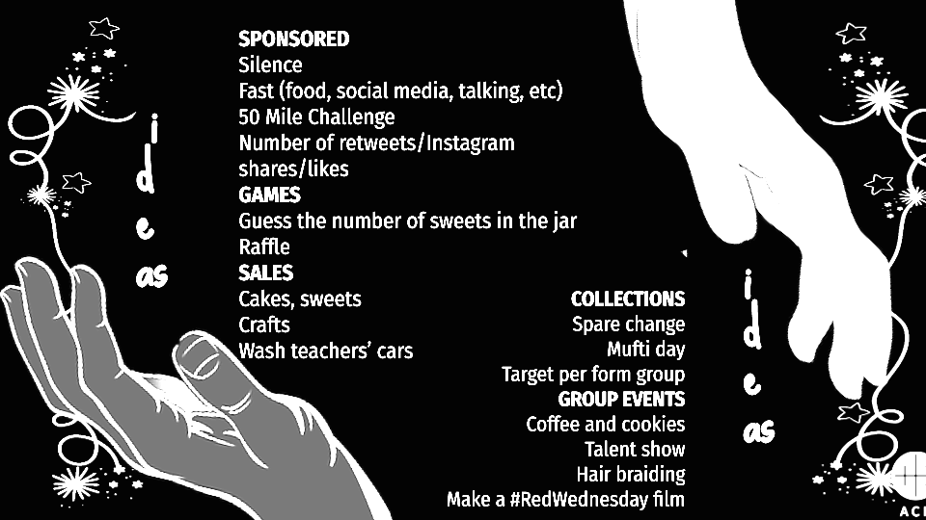
Notes:
Here are some fundraising ideas for you to think about.

Slide 18
Notes:
Discuss why it is so important for ACN to send Christmas parcels to children in Syria.

Slide 19
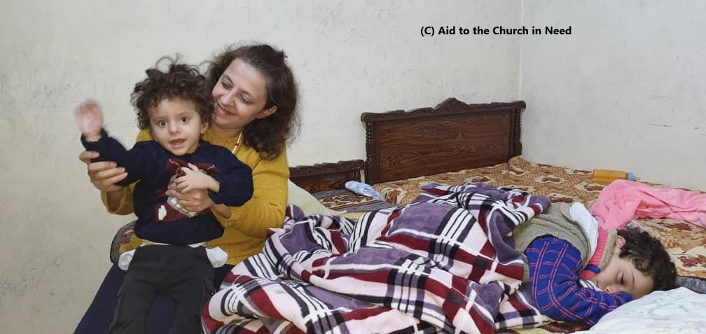

Slide 20
Prayers for Advent 2021
Notes:
See prayer sheets:

Slide 21
From Aid to the Church in Need
On behalf of all the people we are able to help because
of your generosity and your prayers

Slide 22
Thank you and Happy Christmas

