Slide 2
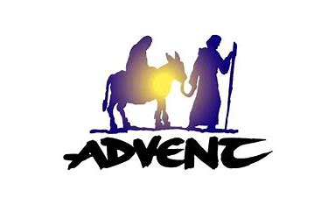

Slide 3
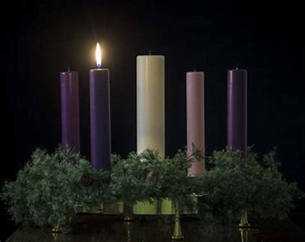
Advent Quiz
Based on the
Year of St Joseph
2020 - 2021
“…and her husband Joseph, being a just man…” (Mt 1:19)

Slide 4
QUESTION 1
Who was St. Joseph’s father?

Slide 5
Answer 1
St. Matthew (1:16) calls St. Joseph the son of Jacob; according to St. Luke (3:23), Heli was his father.

Slide 6
QUESTION 2
Where was St. Joseph born?

Slide 7
Answer 2
Bethlehem

Slide 8
QUESTION 3
From which King of Israel is Joseph descended?

Slide 9
Answer 3
King David

Slide 10
QUESTION 4
What was St. Joseph’s occupation?

Slide 11
Answer 4
Carpenter

Slide 12
QUESTION 5
Why did St. Joseph take the Holy Family to Bethlehem from Nazareth?

Slide 13
Answer 5
To be enrolled in Bethlehem, according to the decree issued by Caesar Augustus

Slide 14
QUESTION 6
What did St. Joseph plan to do after learning that his wife, Our Lady, was with child?

Slide 15
Answer 6
"to put her away privately” (see Mt 1:19)

Slide 16
QUESTION 7
Why did St. Joseph take the Holy Family to Egypt?

Slide 17
Answer 7
"an angel of the Lord appeared in sleep to Joseph, saying: Arise, and take the child and his mother, and fly into Egypt: and be there until I shall tell thee"(see Mt 2:13)
And/or
King Herod wanted to kill the baby Jesus.

Slide 18
QUESTION 8
In the West, in which year was the first church dedicated to St. Joseph?
954
727
1129
1553

Slide 19
Answer 8
c)1129 at Bologna

Slide 20
QUESTION 9
Under which Pope was St. Joseph given his feast day in the Church’s calendar?
Sylvester III
Victor II
Constantine
Sixtus IV

Slide 21
Answer 9
d) Sixtus IV (1471-1484)

Slide 22
QUESTION 10
On which date do we celebrate the feast day of St. Joseph?

Slide 23
Answer 10
March 19 (Roman Calendar)

Slide 24
QUESTION 11
St. Joseph has a second feast day. On which date do we celebrate it?

Slide 25
Answer 11
May 1st

Slide 26
QUESTION 12
What was the title of the apostolic letter in which His Holiness, Pope Francis, declared 2020 the year of St Joseph?

Slide 27
Answer 12
Patris Corde, or “With a Father’s Heart.”

Slide 28
QUESTION 13
Which anniversary does the 2020 year of St Joseph mark?

Slide 29
Answer 13
150th anniversary of the proclamation of St. Joseph as patron saint of the Universal Church.

Slide 30
QUESTION 14
On which date does the Year of St Joseph begin and end?

Slide 31
Answer 14
8th December

Slide 32
QUESTION 15
Which very special feast day, or to give it its proper title, Solemnity, do we celebrate on the date the Year of St Joseph begins and ends?

Slide 33
Answer 15
The Solemnity of the Immaculate Conception

Slide 34
QUESTION 16
St Joseph is most commonly known as the patron saint of the Universal Church, workers and of a happy death. Name another activity, profession, occupation or group of people of which St Joseph is the patron saint?

Slide 35
Answer 16
St. Joseph is also patron saint of:
families, fathers, expectant mothers (pregnant women),
travellers, migrants,
house sellers and buyers, craftsmen, engineers, and working people in general among many others

Slide 36
QUESTION 17
When did Pope Pius XII establish the Feast of "St. Joseph the Worker" that we celebrate on May 1?
1584
1612
1858
1955

Slide 37
Answer 17
d) 1955

Slide 38
QUESTION 18
Which ONE of the countries listed below is St. Joseph the patron saint?
Australia
Canada
Chile
Finland

Slide 39
Answer 18
b) Canada
As well as:
Austria; Belgium
Canada; China; Croatia
Korea
Mexico
Peru; Philippines
Vatican City; Vietnam

Slide 40
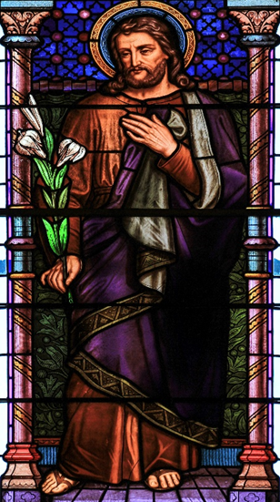
QUESTION 19
Images of St Joseph often depict him holding a rod or walking staff.
What other symbol is often associated with St Joseph?
What does this symbol mean?
Image taken by Lawrence OP, on 3 May 2014

Slide 41
Answer 19
A lily, a symbol of purity

Slide 42
QUESTION 20
Pope Francis practices this St. Joseph devotion: Which one is it?
Slips prayer notes under a statue of St. Joseph so St. Joseph can “sleep on them”
Sings St. Joseph’s name in Latin every day
Touches the foot of a statue of the saint every evening
Wears a white sash emblazoned on the inside with St. Joseph’s name

Slide 43
Answer 20
a) Slips prayer notes under a statue of St. Joseph so St. Joseph can “sleep on them”

Slide 44
QUESTION 21
Which ancient Christmas carol was written about St. Joseph?
“Silent Night”
“Cherry Tree Carol”
“I Saw Three Ships”
“The First Nowell”

Slide 45
Answer 21
b) “Cherry Tree Carol”

Slide 46
QUESTION 22
In which two of our Gospels is St. Joseph mentioned?

Slide 47
Answer 22
In Matthew and Luke

Slide 48
QUESTION 23
Can you guess what the Latin Redemptoris custos means in English?
Redemptoris custos was the title given to an Apostolic exhortation – a sort of letter of encouragement to the Church – about St. Joseph written by Saint Pope John-Paul II in 1989.

Slide 49
Answer 23
Guardian of the Redeemer

Slide 50
QUESTION 24
In which city in the UK would you find the Cathedral Church of St. Joseph?
Bonus point: It is the Mother Church of which diocese?

Slide 51
Answer 24
Swansea
The Cathedral, dedicated to Saint Joseph, is the mother Church to the Diocese of Menevia.

Slide 52
Advent Quiz
Based on the
Year of St Joseph
2020 - 2021
“…and her husband Joseph, being a just man…” (Mt 1:19)

Slide 53
QUESTIONS

Slide 54
Aid to the Church in Need
acn_schools
acn_schools
acnschools
AidtotheChurchinNeed

