Slide 1

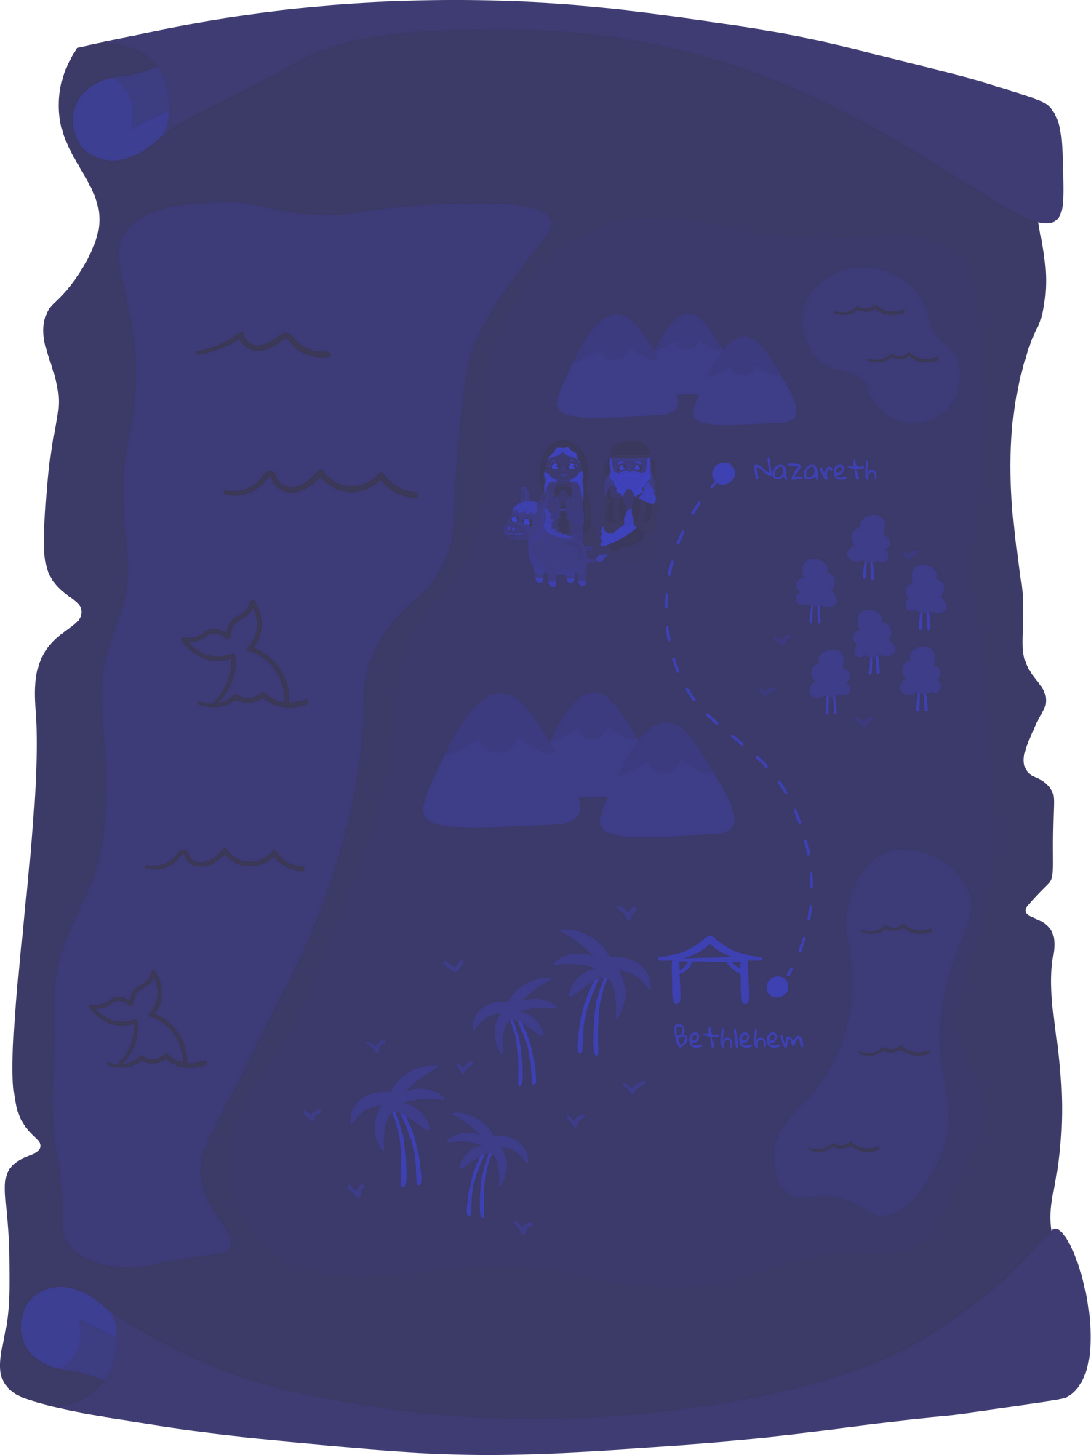
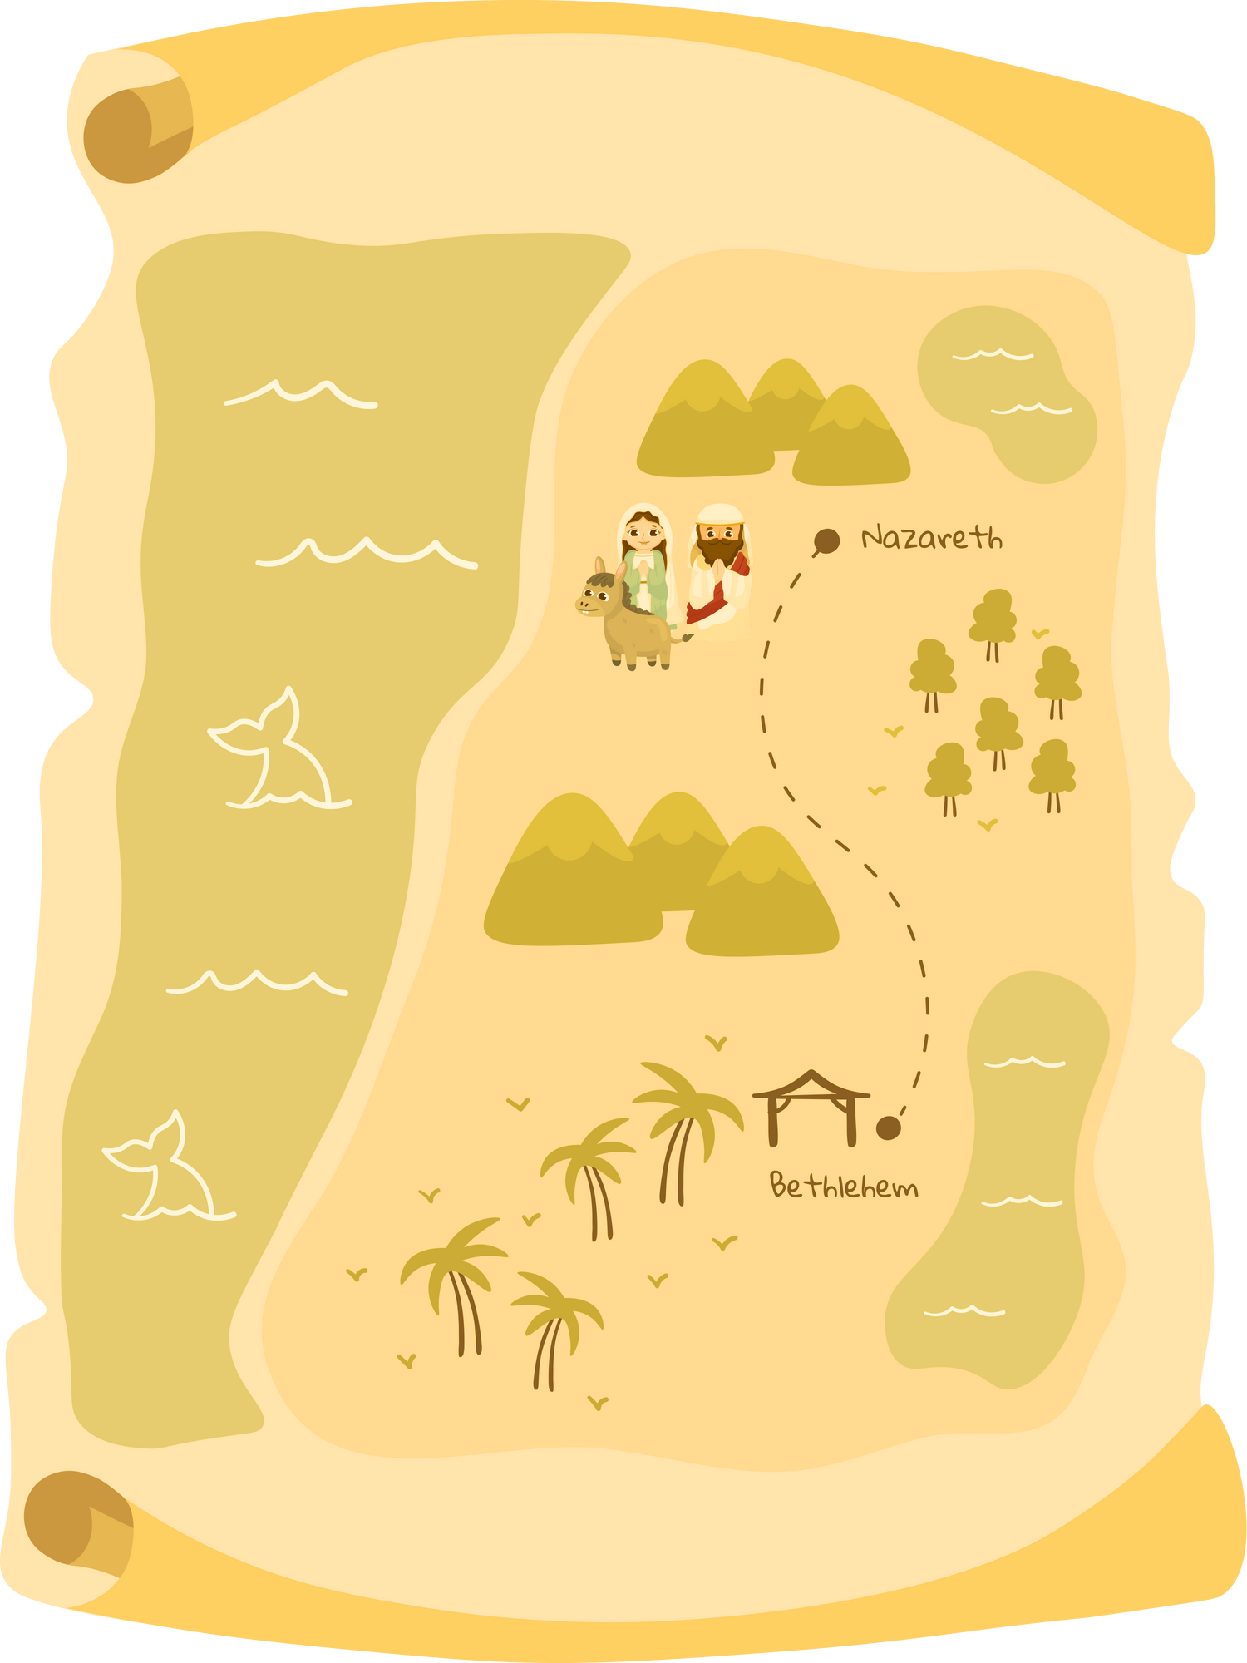



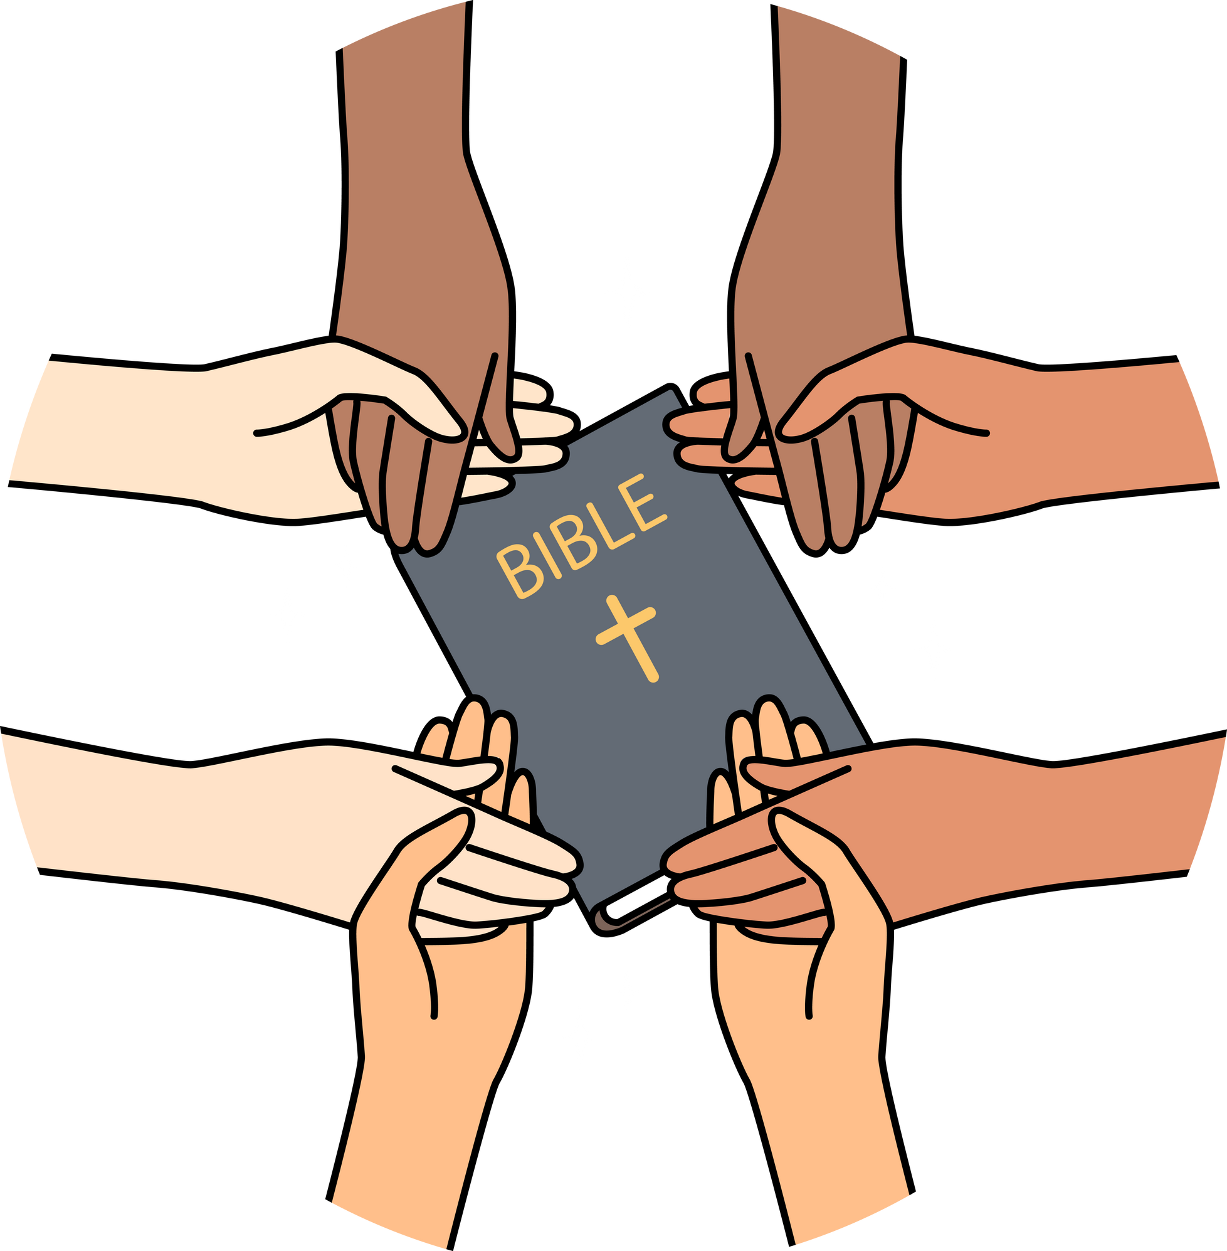







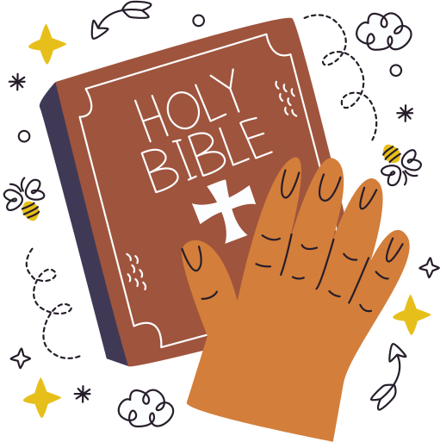
Session 1:
The Word of God
Ministry of the Word training for schools
Notes:
Leader notes for Session 1:
Optional: A Bible/Bibles
(This session is about the word of God)
See also: Overview

Slide 2
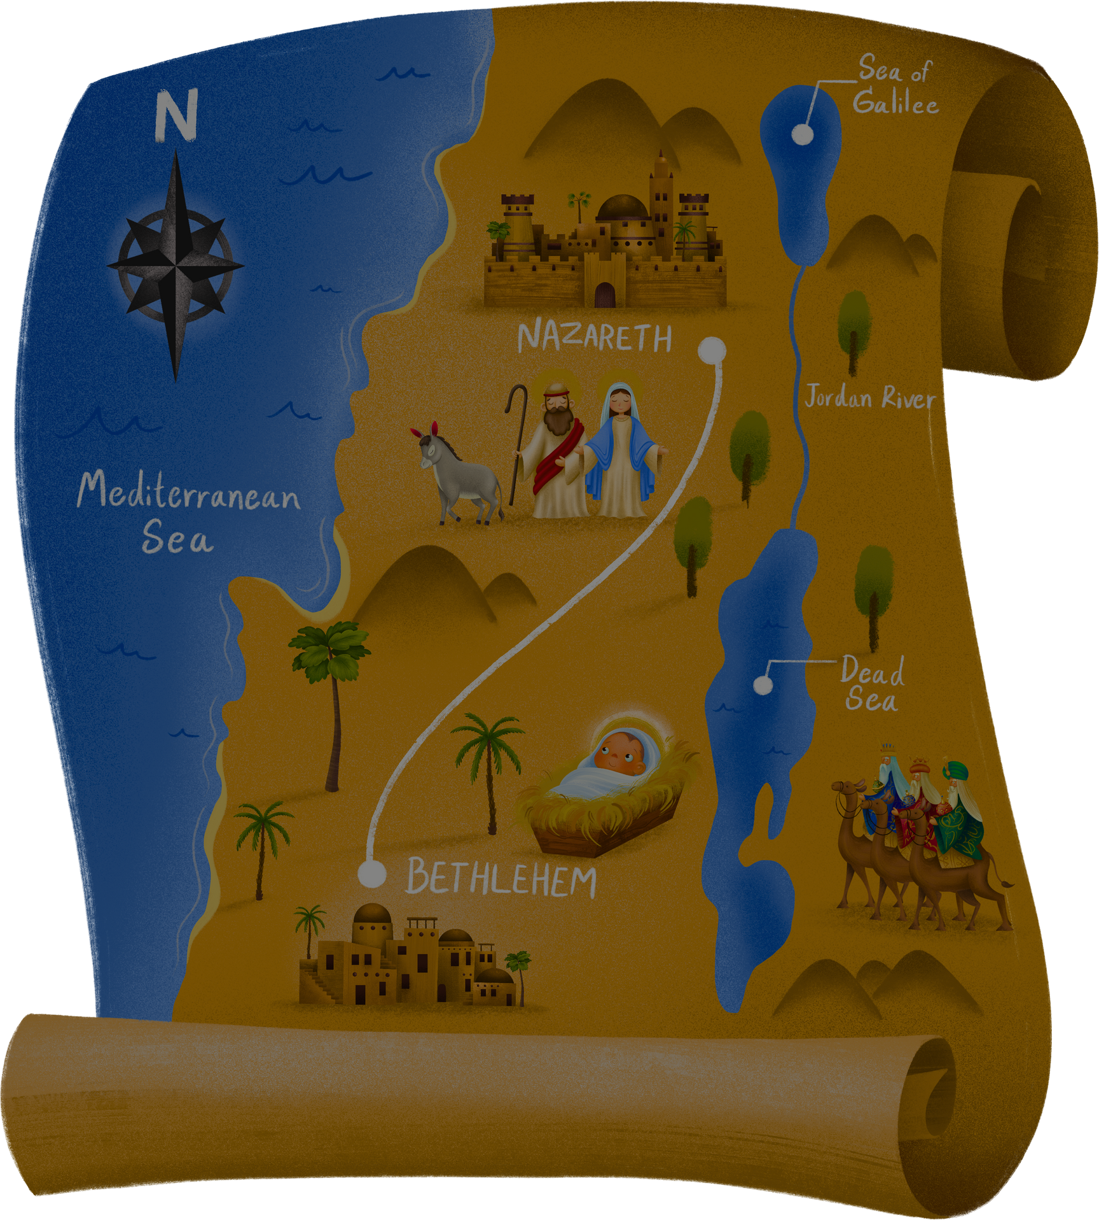
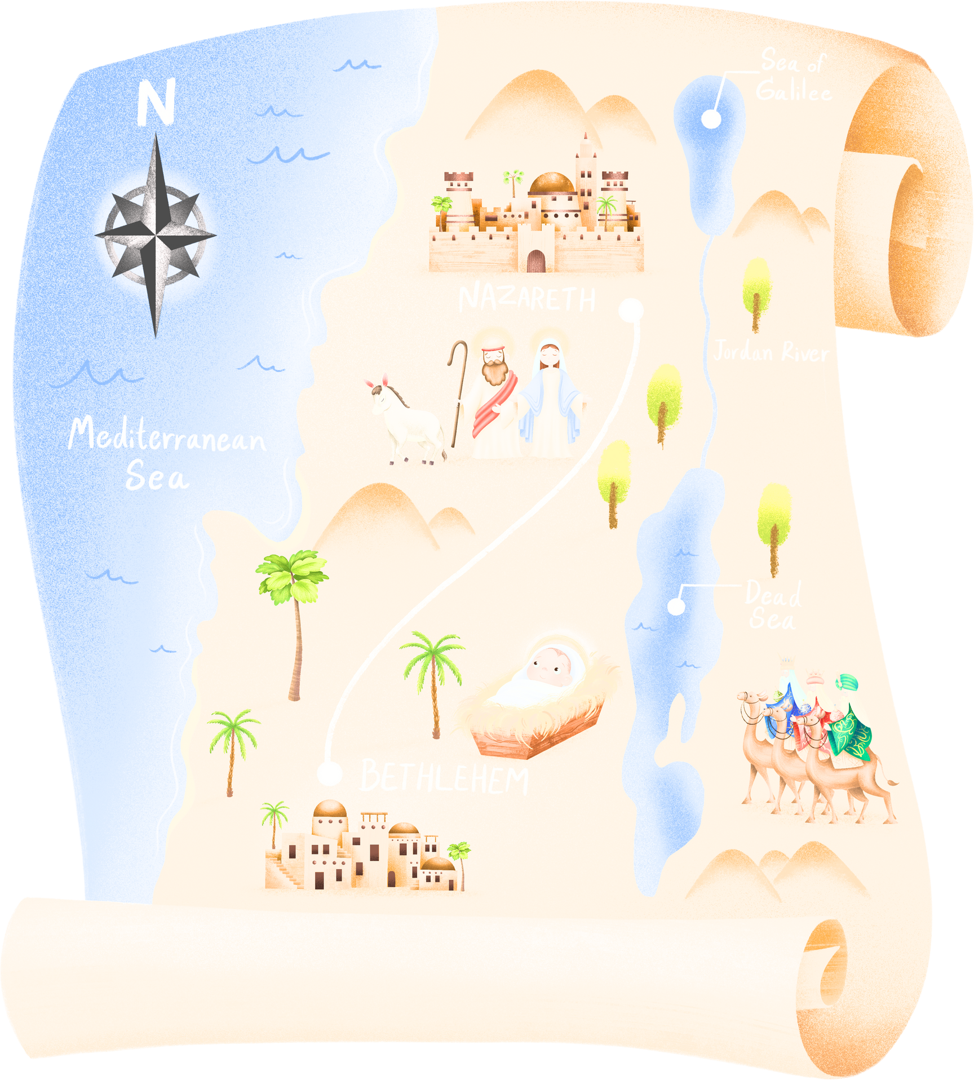
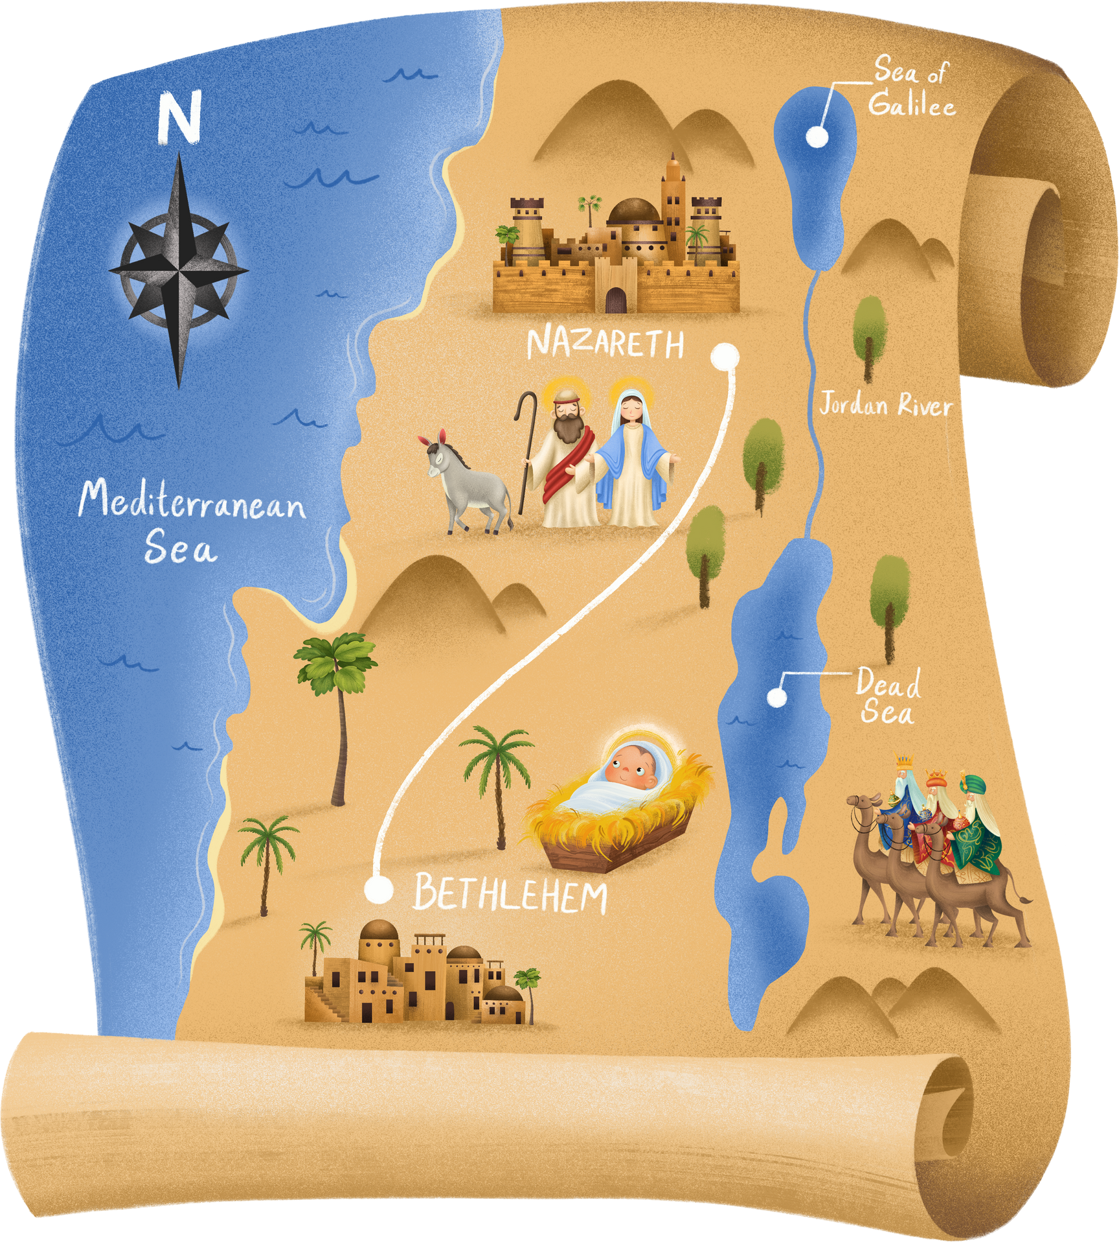
THE WORD
OF GOD
Session 1:

Slide 3
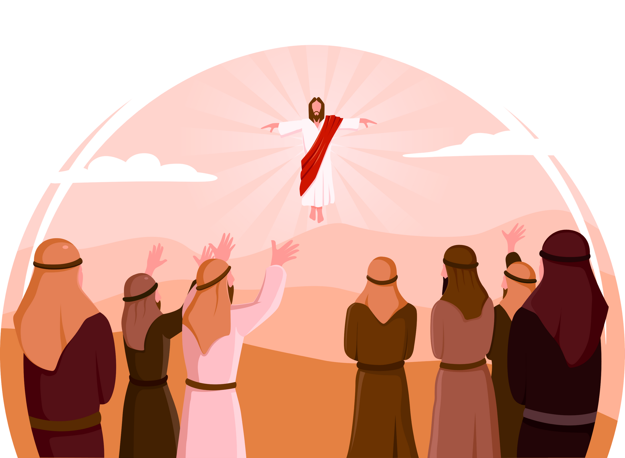



Today's Session (1)
WHAT IS THE WORD OF GOD AND HOW SHOULD
IT BE PROCLAIMED?
  Opening prayer
  Church Teaching and Tradition
  Scripture
  Reflection
  Links to ACN
  Practical examples

Slide 4

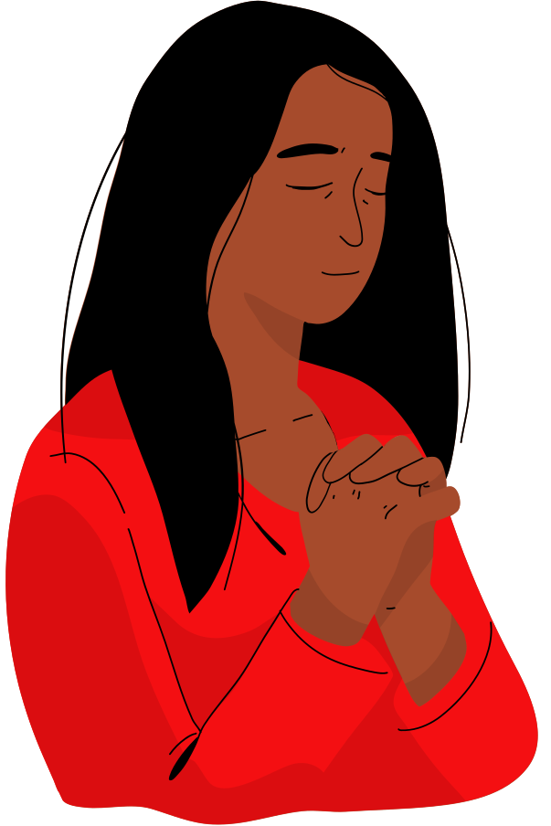
Opening Prayer
Father,
Thank you for your word
which tells of your love and compassion
for each and every one of us.
Help us to listen to your word
with open minds and hearts
so that we can be loving and merciful
to all those we meet.
We ask this in Jesus’ name.
Amen
Notes:
Leader info: This prayer is one to say before reading the Bible, to get your heart ready for God's word. It is an ancient prayer which is attributed to St John Chrysostom. This version has been slightly amended for younger pupils.
There are two parts to this prayer. This is the first part, the second part, as well as the whole prayer, will be shared during future sessions.
See https://aleteia.org/2019/09/13/before-reading-the-bible-pray-this-prayer-of-st-john-chrysostom

Slide 5
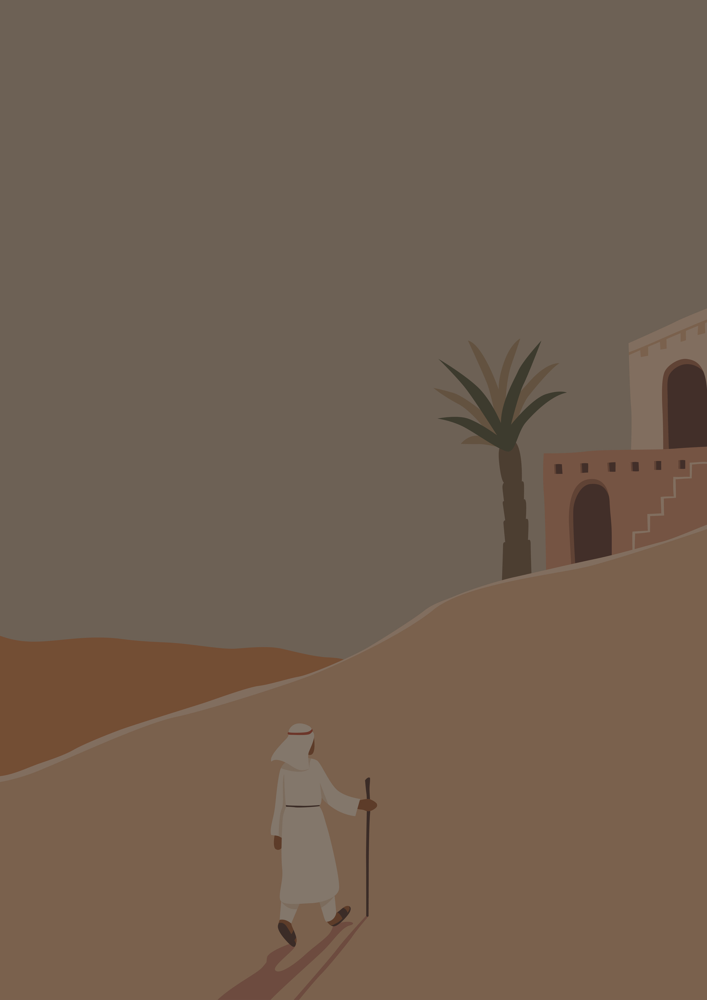



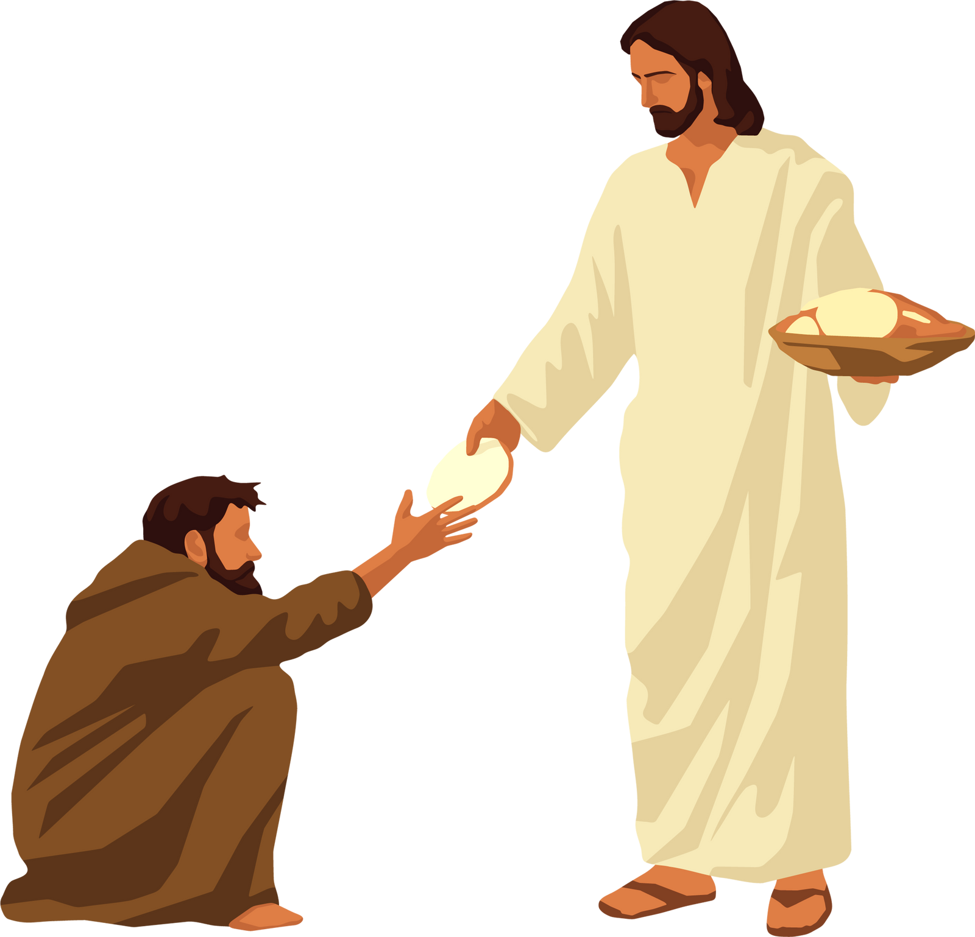
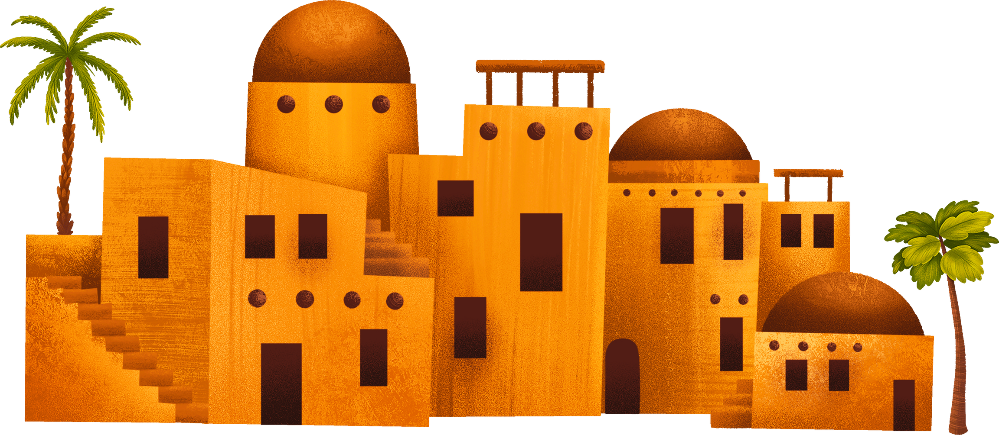
Today's Session (1)
What is the Word of God
and how should it
be proclaimed?
Notes:
For leader: This session is about the word of God. This is what the catechism teaches:
God is the author of Sacred Scripture. "The divinely revealed realities, which are contained and presented in the text of Sacred Scripture, have been written down under the inspiration of the Holy Spirit..” Still, the Christian faith is not a "religion of the book". Christianity is the religion of the "Word" of God, "not a written and mute word, but incarnate and living". If the Scriptures are not to remain a dead letter, Christ, the eternal Word of the living God, must, through the Holy Spirit, "open (our) minds to understand the Scriptures.” Catechism of the Catholic Church 105, 108
See https://northamptondiocese.org/wp-content/uploads/Year-of-the-Word-Readers-Course.pdf

Slide 6
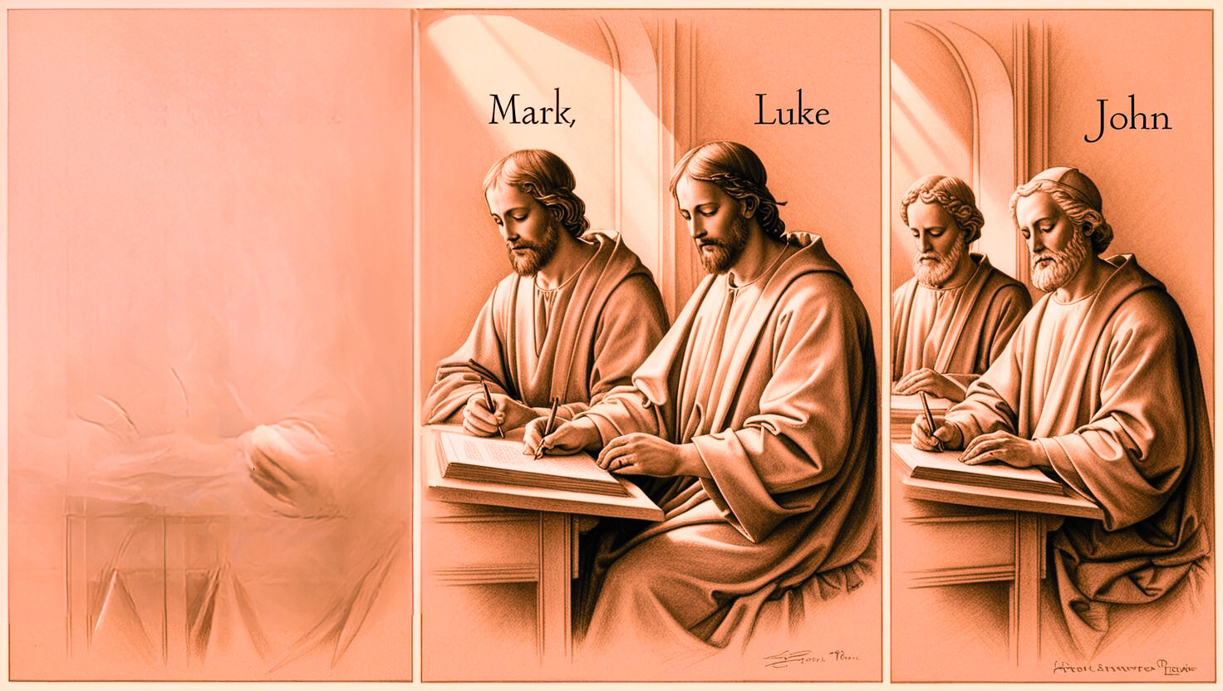


The Bible
‘Known as the word of God or Sacred Scripture
‘Biblos’ - Library or collection of books
Inspired by the Holy Spirit
Can you think
of a text that tells
of God’s love
and/or mercy?
Written by holy men and women over many years
God’s story of love and mercy
From Creation (Old Testament) to Revelation (New Testament)
Notes:
To share: The Bible (from the word ‘biblos’ meaning a library or collection of books) is the word of God. It is also known as sacred scripture. Although the books in the Bible were written by holy men and women, we believe that these writers were all inspired by the Holy Spirit who dictated what God told them. God has communicated to his people this way for thousands of years. The Bible tells us of God’s great love and mercy for all people, from the story of creation in the Old Testament, to the Book of Revelation in the New Testament. It tells the story of salvation through Christ.
Thinking of a text that tells of God's love and mercy...
Texts could include stories such as the Lost Sheep, the Prodigal Son, the Good Shepherd, Jesus' death and resurrection... They could also include psalms, songs, letters... There are so many! Ask pupils to explain their reasoning (if time allows).

Slide 7


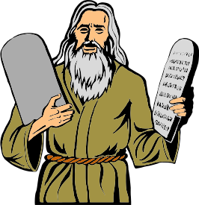

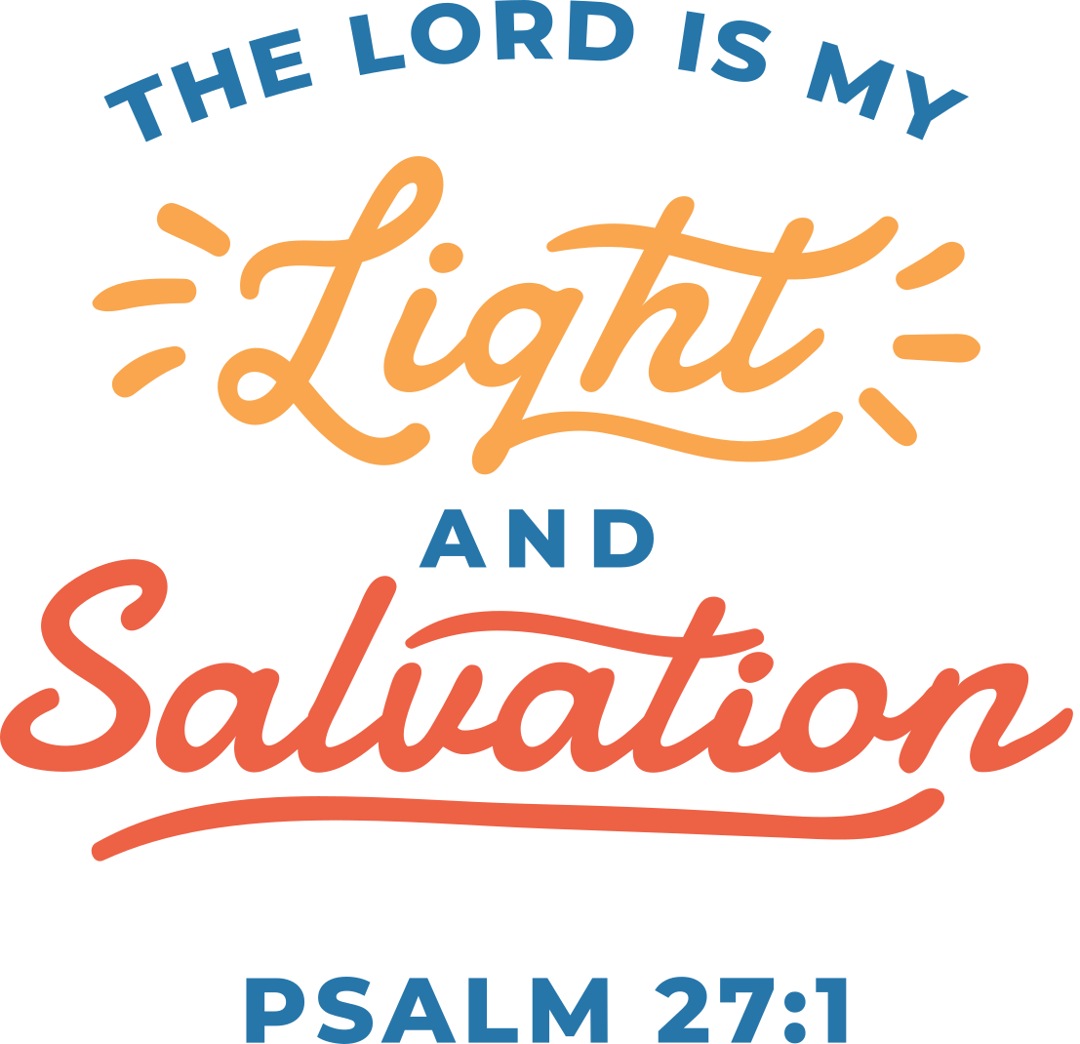


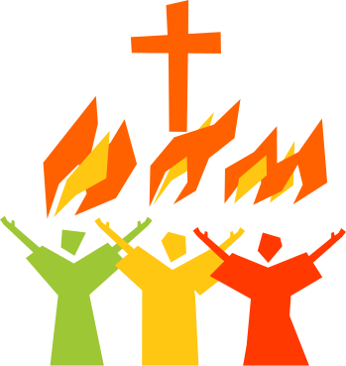
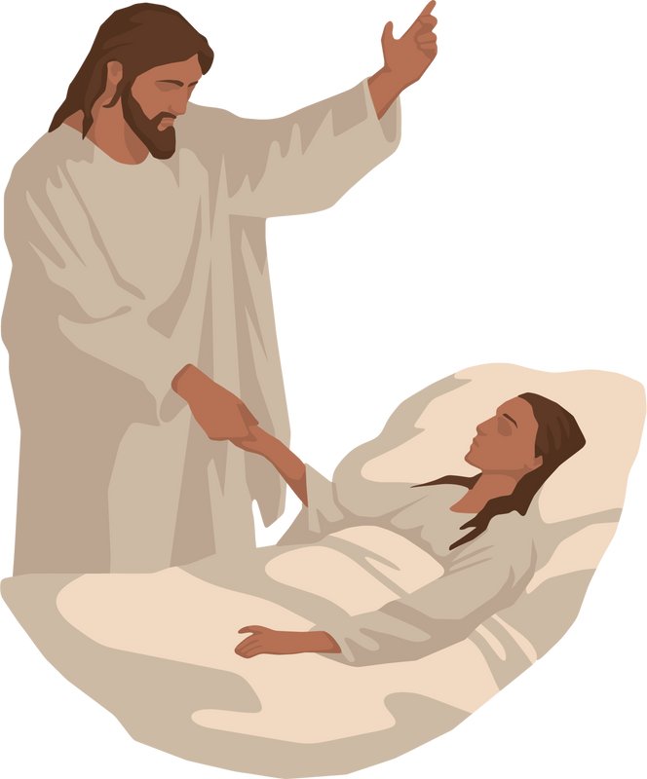
The Readings at Mass
What text from the
Old or New Testament
do you like best?
First Reading
These are from the Old Testament, the time before the life of Jesus.
Psalm
These are from the Book of Psalms, many of which were written by King David. They are poems which were written to be sung.
Second Reading
These are from the New Testament (not Gospels). There is not always a second reading.
Gospel and Acclamation
These are the highlight of the Liturgy of the Word as they include the words of Jesus and details of his life, death and resurrection.
Notes:
To share: The readings at Mass all come from the Bible. The first reading and psalm are from the Old Testament while the second reading, Gospel and Acclamation are from the New Testament. Although there is always a first reading, psalm, Gospel and acclamation, the second reading is usually only read on Sundays, holy days of obligation and special occasions. For the latter, it is at the discretion of the priest so it is best to agree this beforehand.
When discussing favourite texts, those that could be discussed include: the Christmas and Easter stories, the miracles and parables of Jesus, stories about the prophets (Abraham, Joseph, Moses...) or disciples (Peter, Andrew, James, John, Paul....). Leaders may wish to give some examples to inspire pupils, and even ask them if they can remember exact details and words.
Note: This will be expanded upon in future sessions

Slide 8
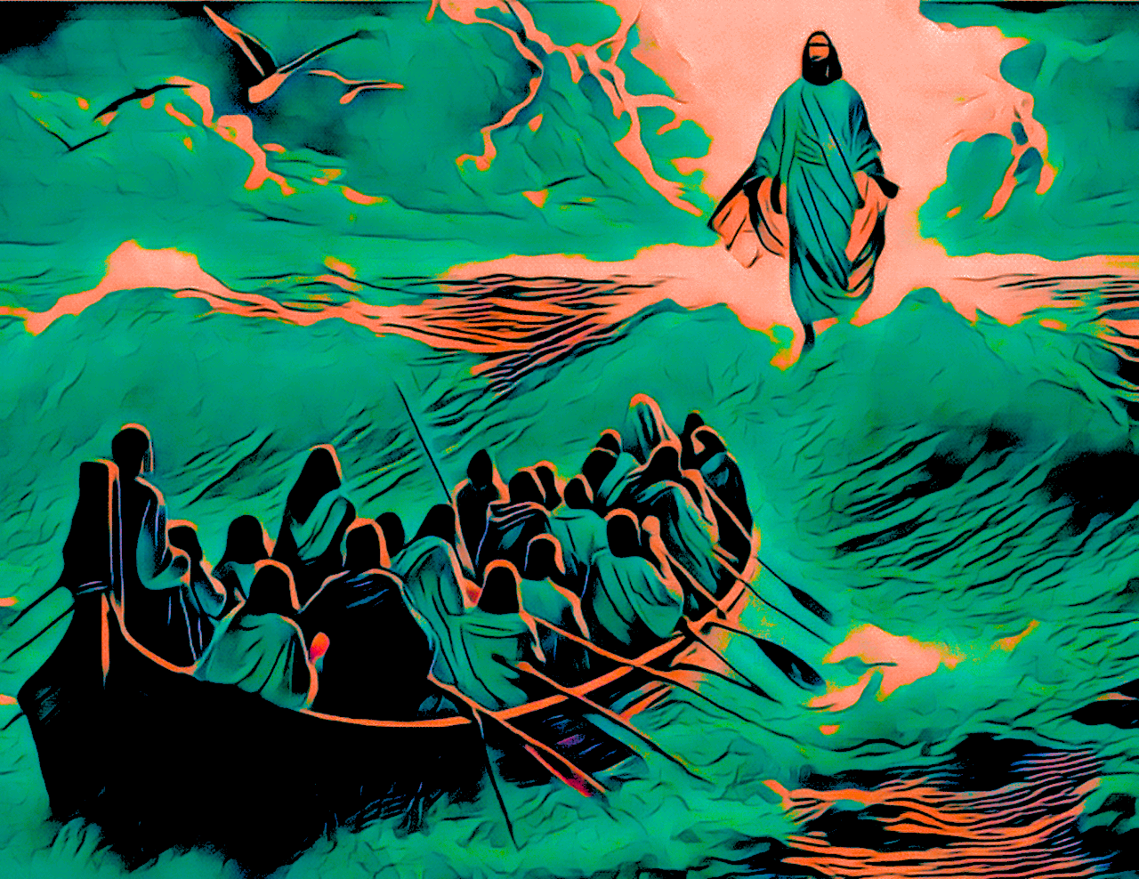

How might you
show respect for God’s word?
God’s word:
Proclaimed
Believed
Respected
Communicated
Prayer and practice
Image adapted from Ken Williams: Pixabay
Notes:
Because the readings are God’s word, they are not just read, they are proclaimed. The reader must therefore believe what they are saying, have the utmost respect for God’s word, and do their very best at communicating God’s important message to others. This requires prayer and practice.
Some of the ways we can show respect for God's word could be:
- Reading it carefully beforehand to understand it
- Praying to the Holy Spirit for help in understanding, proclaiming and living it
- Reading it slowly and respectfully
- Touching the lectionary with clean and respectful hands
- Bowing to the altar/tabernacle before and after reading
- Always being reverent when speaking about the Bible and God's word
Note: This will be revised and expanded upon in future sessions

Slide 9

“Ignorance of the Scriptures is ignorance of Christ.” - Saint Jerome
“Ever since you were a child, you have known the holy scriptures - from these you can learn the wisdom that leads to salvation through faith in Christ Jesus. All scripture is inspired by God and useful for refuting error, for guiding people's lives and teaching them to be upright. This is how someone who is dedicated to God becomes fully equipped and ready for any good work.”
[II Timothy 3:15-17]

Slide 10

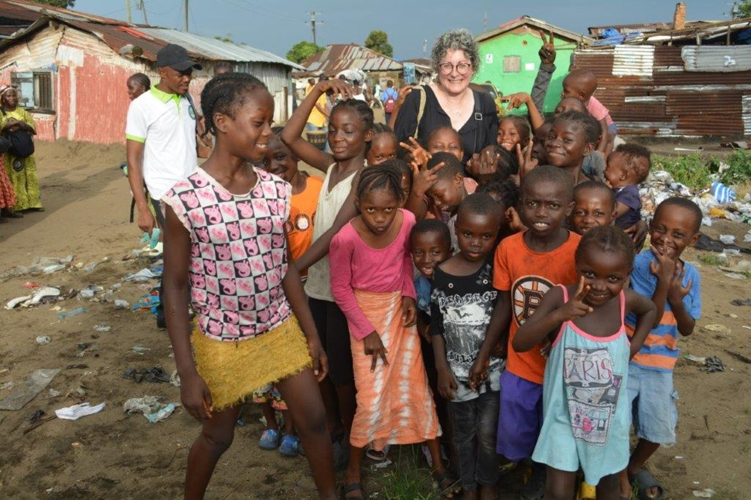

ACN: Liberia
New church for slum area in New Cru Town, Monrovia
Notes:
This image is of a small community in Liberia which is:
- 4th poorest country in the world
- 2nd poorest in Africa
- one of the least developed countries in the world.
Because this community is so poor, it did not have a church and so the community could not hear the word of God. With the help of ACN (Aid to the Church in Need), the community was able to build a new church so that members of all ages could hear God's word.
Reflect: Why do you think having a church and listening to God's word is important to this community?

Slide 11
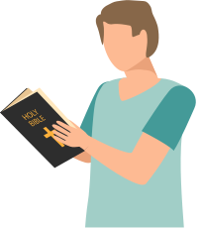
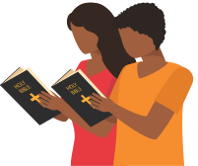
Over to you...
Now practise reading scripture to others. You can use the examples given or choose your own.
Notes:
See Session 1: Examples for Practice.
Have printed for pupils to practise reading. Explain that, although the readings come from the Bible (shown in the video on this slide), they are put into a special book used at Mass called the Lectionary. However, sometimes at school Masses the readings are printed and backed onto card as they have special readings which may not easily be found in the Lectionary.

Slide 12



Begin: “A reading from...”
(Do not say “First/second reading”)
At the end of the first/second reading, pause and say,
“The Word of the Lord”
(Not “This is...”)
At the beginning of the Psalm,
just read the response.
(Not “The response is...”)
For the Gospel Acclamation, wait until everyone stands up and then read the “Alleluia” and verse (check beforehand if it is being sung. If so, join in).
Notes:
See Session 1: Examples for Practice. Have printed for pupils to practise reading. Explain that, although the readings come from the Bible (shown in the video on this slide), they are put into a special book used at Mass called the Lectionary. However, sometimes at school Masses the readings are printed and backed onto card as they have special readings which may not easily be found in the Lectionary.

Slide 13









