Slide 1
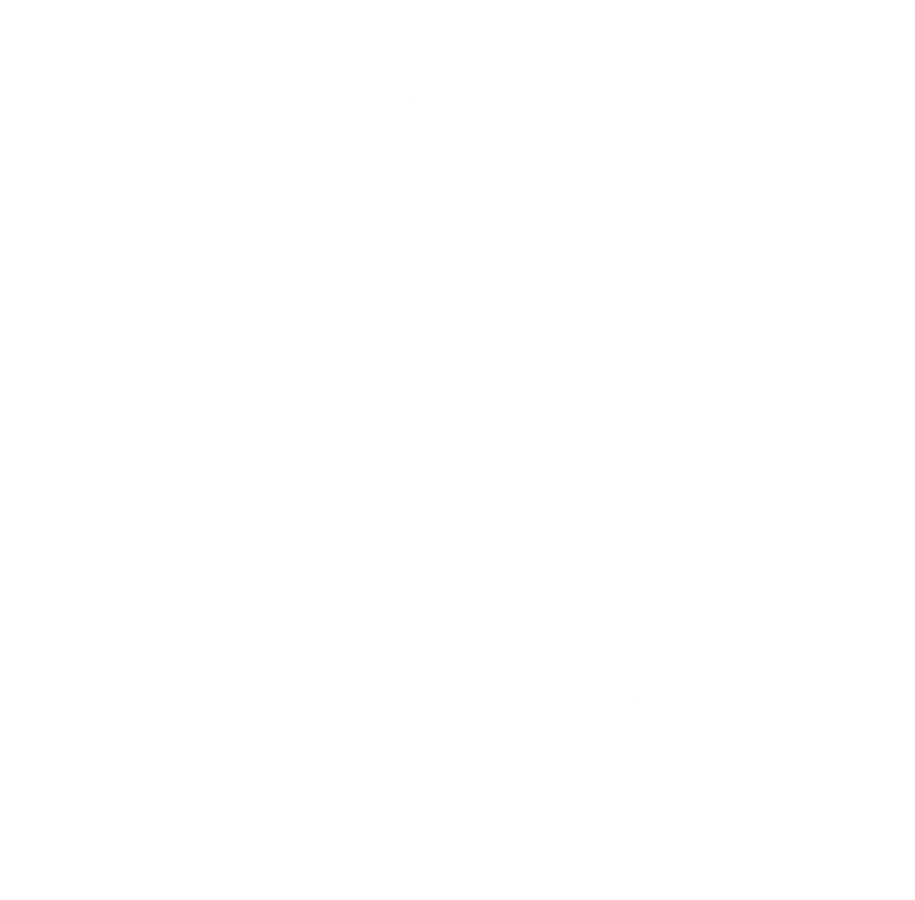
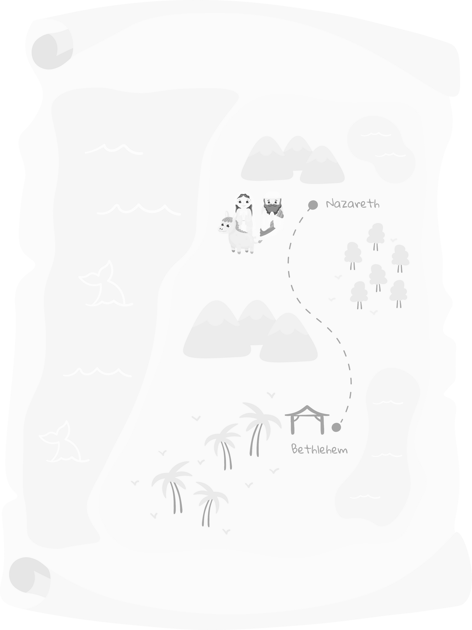
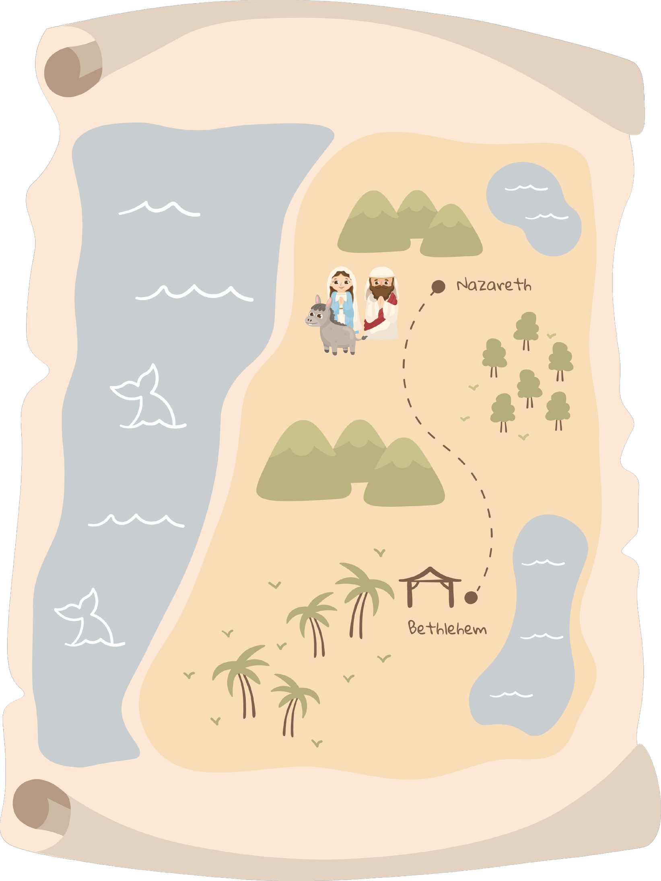
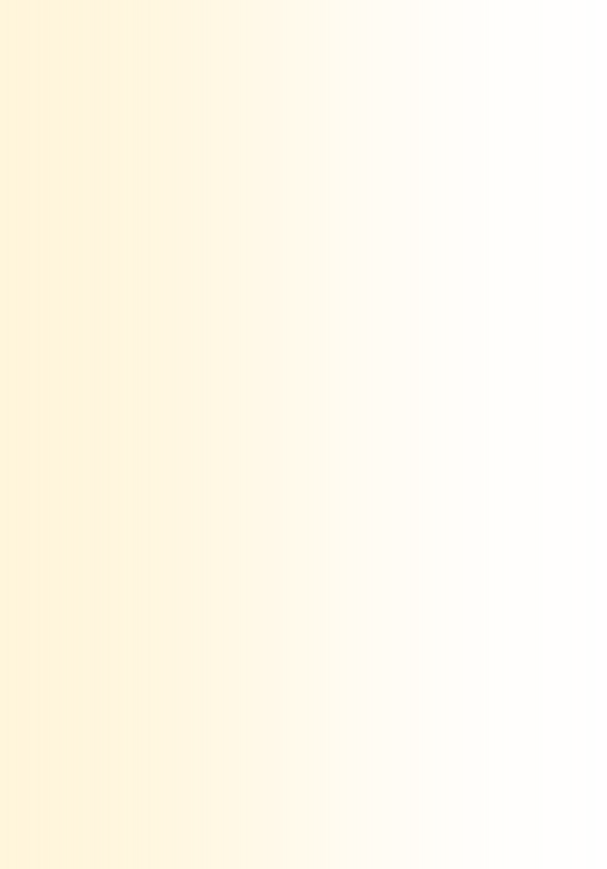
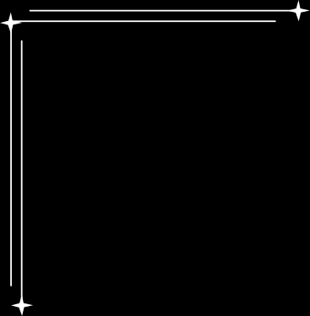

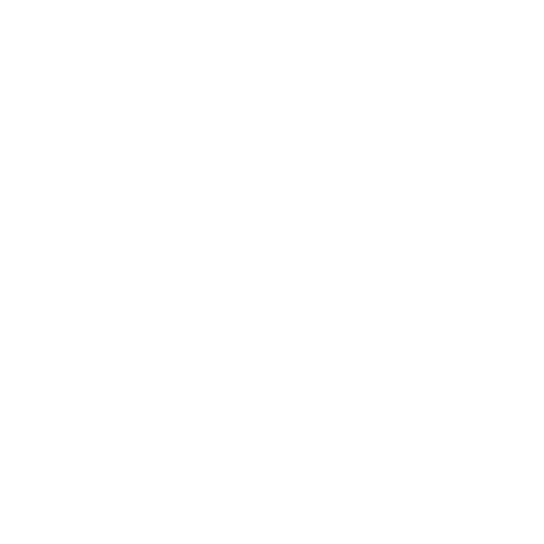
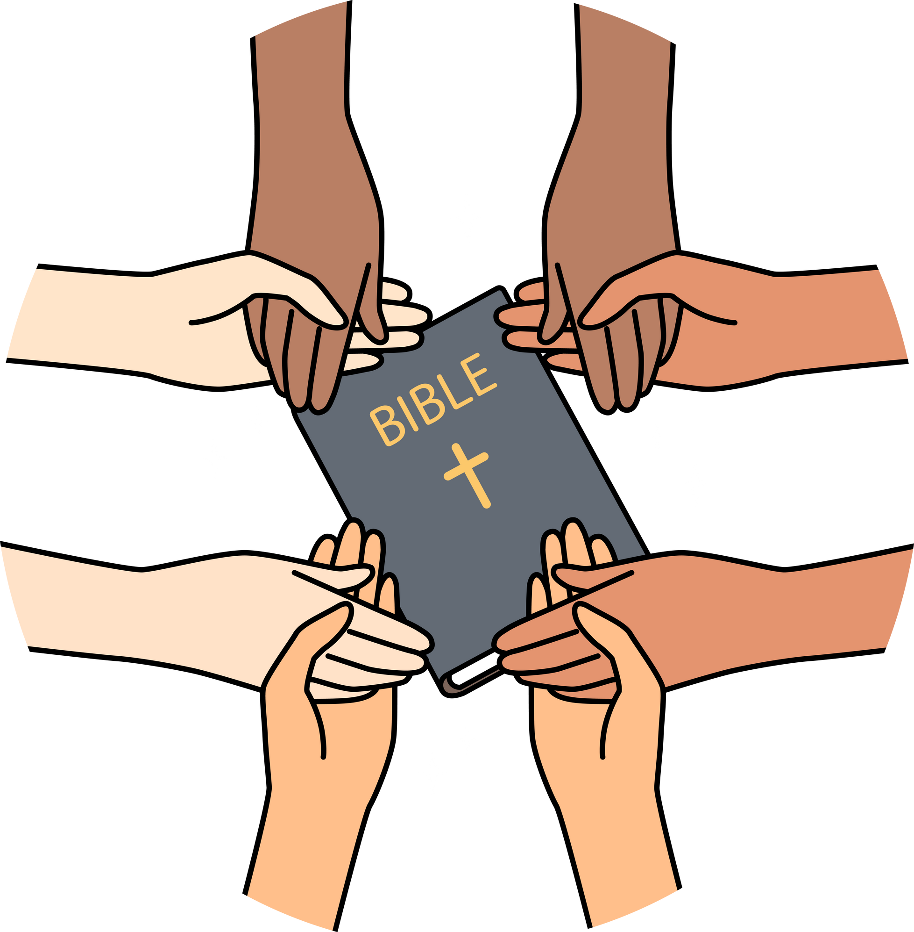
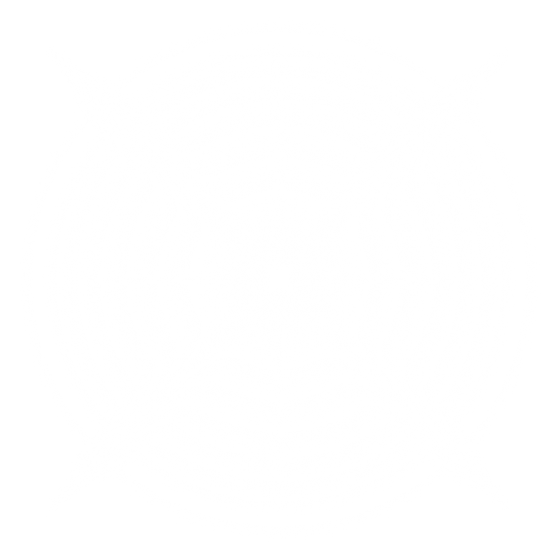

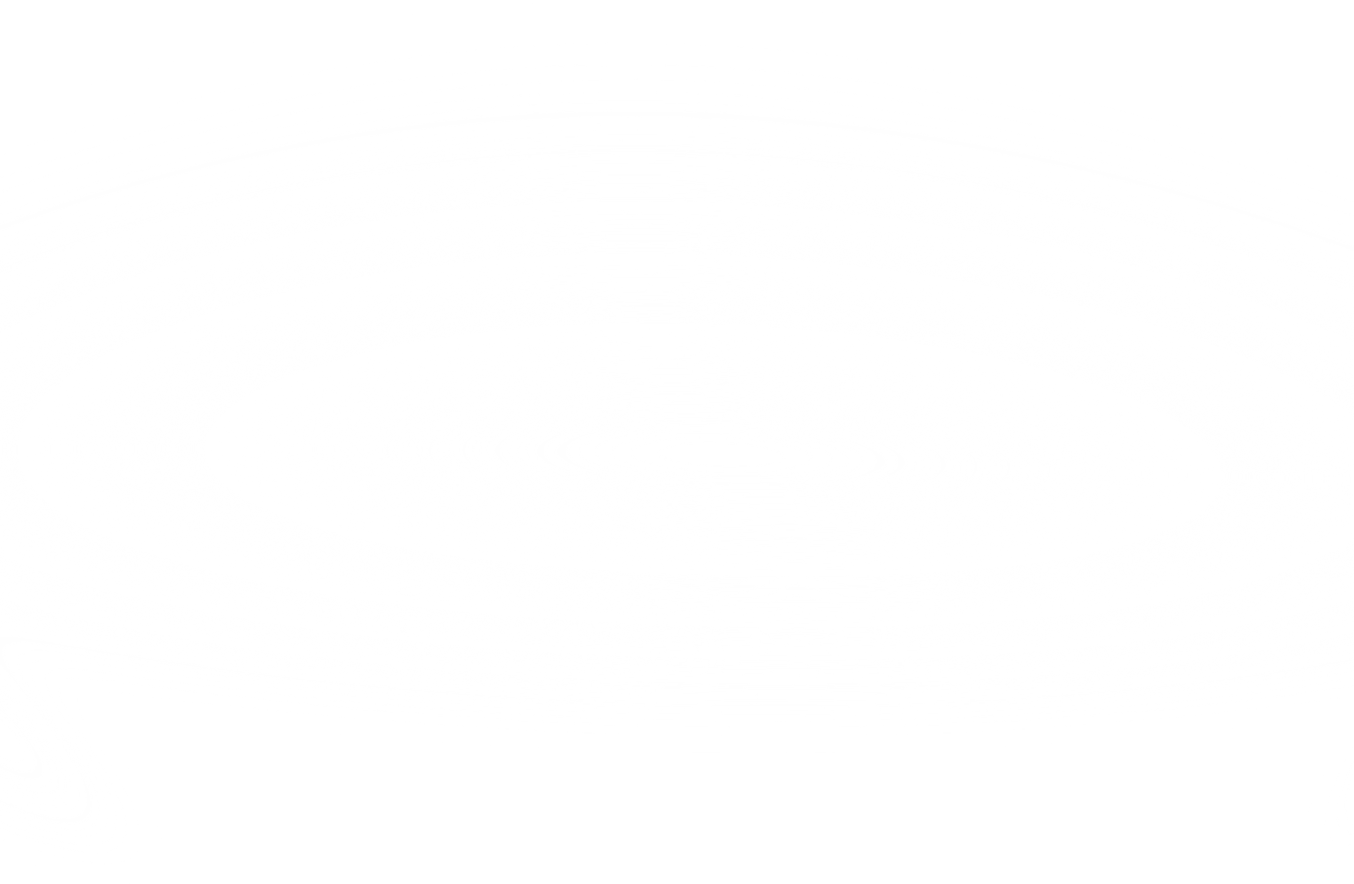
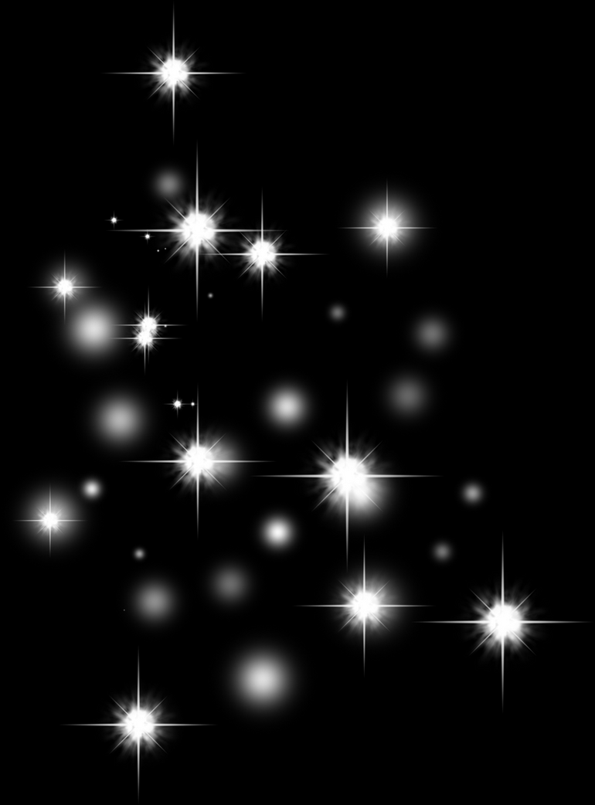
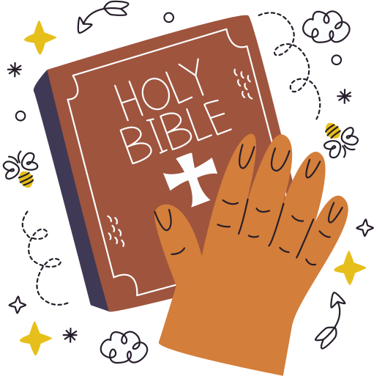
Session 2:
The Liturgy of
the Word
Ministry of the Word training for schools
Notes:
Leader notes for Session 1:
Optional: A Bible/Bibles
(This session is about the word of God)
See also: Overview

Slide 2

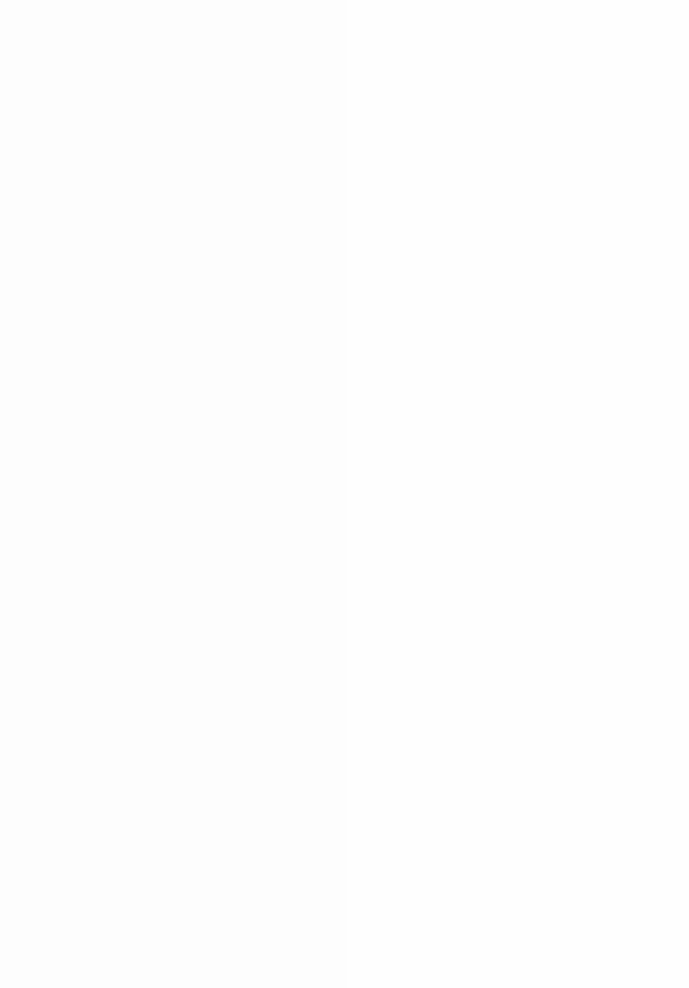
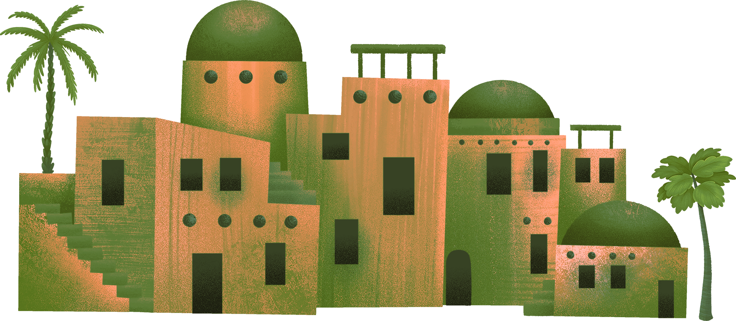
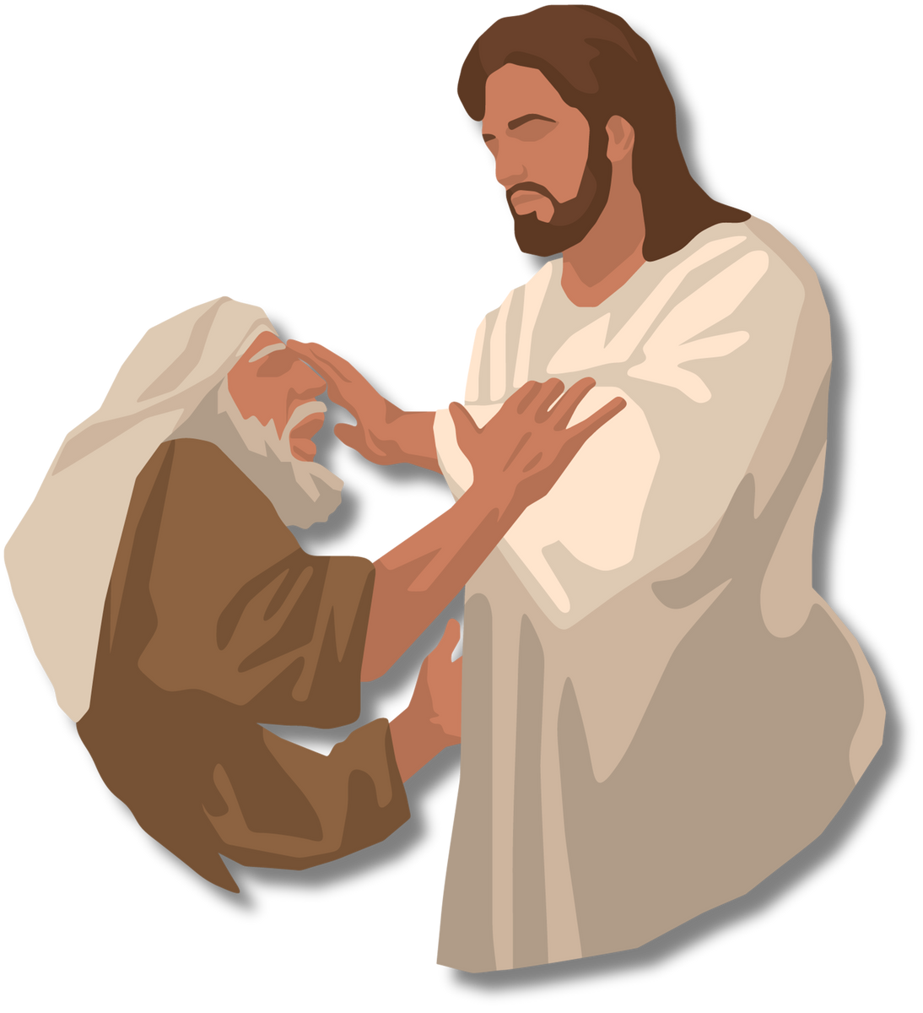

Today's Session (2)
What is the Liturgy of the Word and how does it link to the Mass?
  Opening prayer
  Church teaching and Tradition
  Scripture
  Reflection
  Links to ACN
  Practical examples
Notes:
For leader: This session is about the word of God. This is what the catechism teaches:
God is the author of Sacred Scripture. "The divinely revealed realities, which are contained and presented in the text of Sacred Scripture, have been written down under the inspiration of the Holy Spirit..” Still, the Christian faith is not a "religion of the book". Christianity is the religion of the "Word" of God, "not a written and mute word, but incarnate and living". If the Scriptures are not to remain a dead letter, Christ, the eternal Word of the living God, must, through the Holy Spirit, "open (our) minds to understand the Scriptures.” Catechism of the Catholic Church 105, 108
See https://northamptondiocese.org/wp-content/uploads/Year-of-the-Word-Readers-Course.pdf

Slide 3
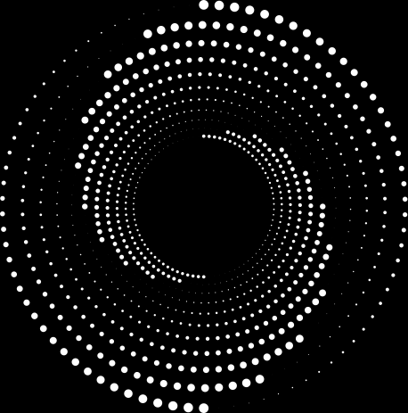

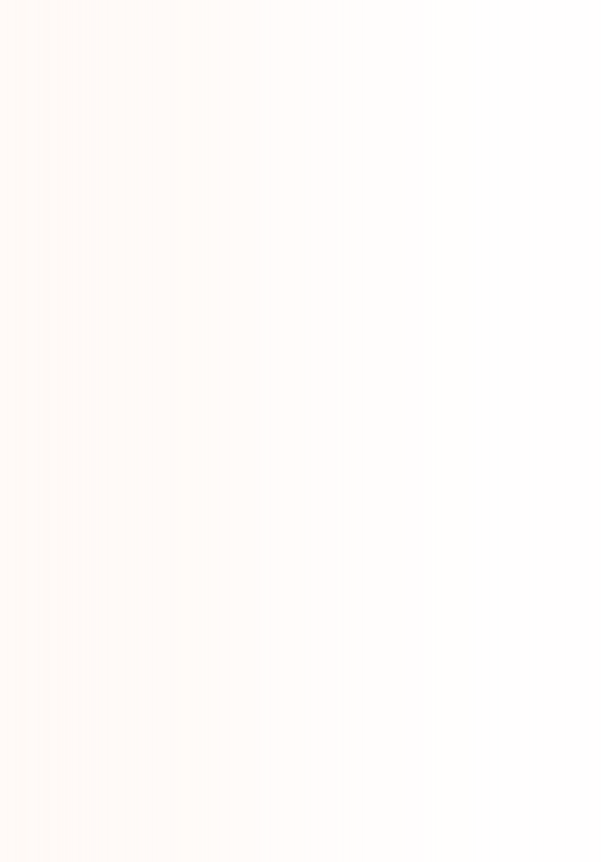




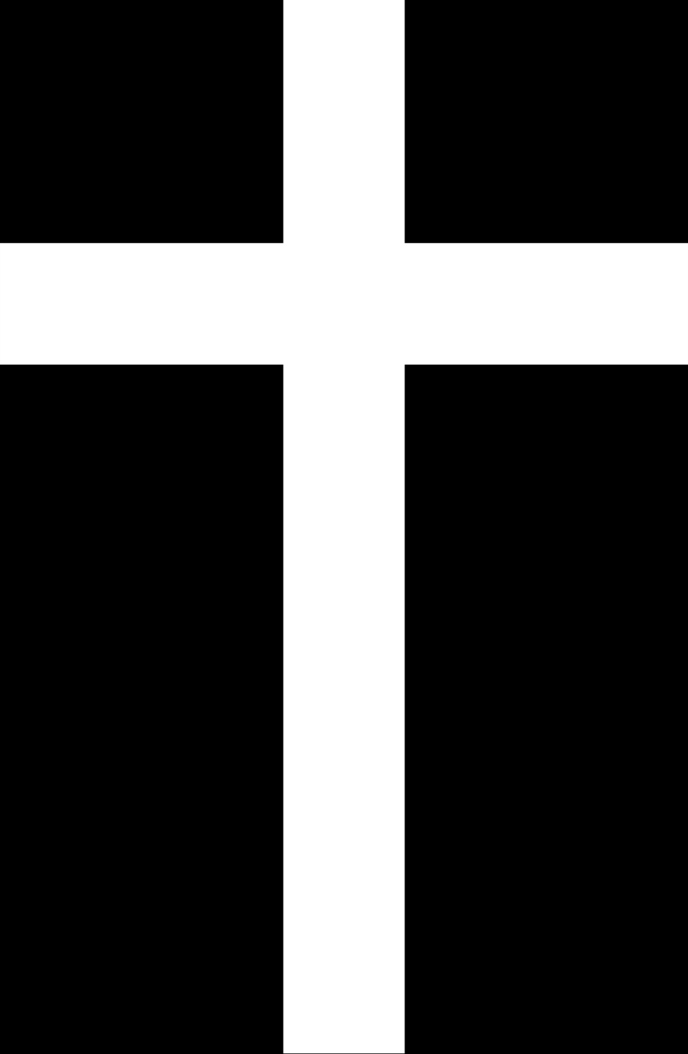

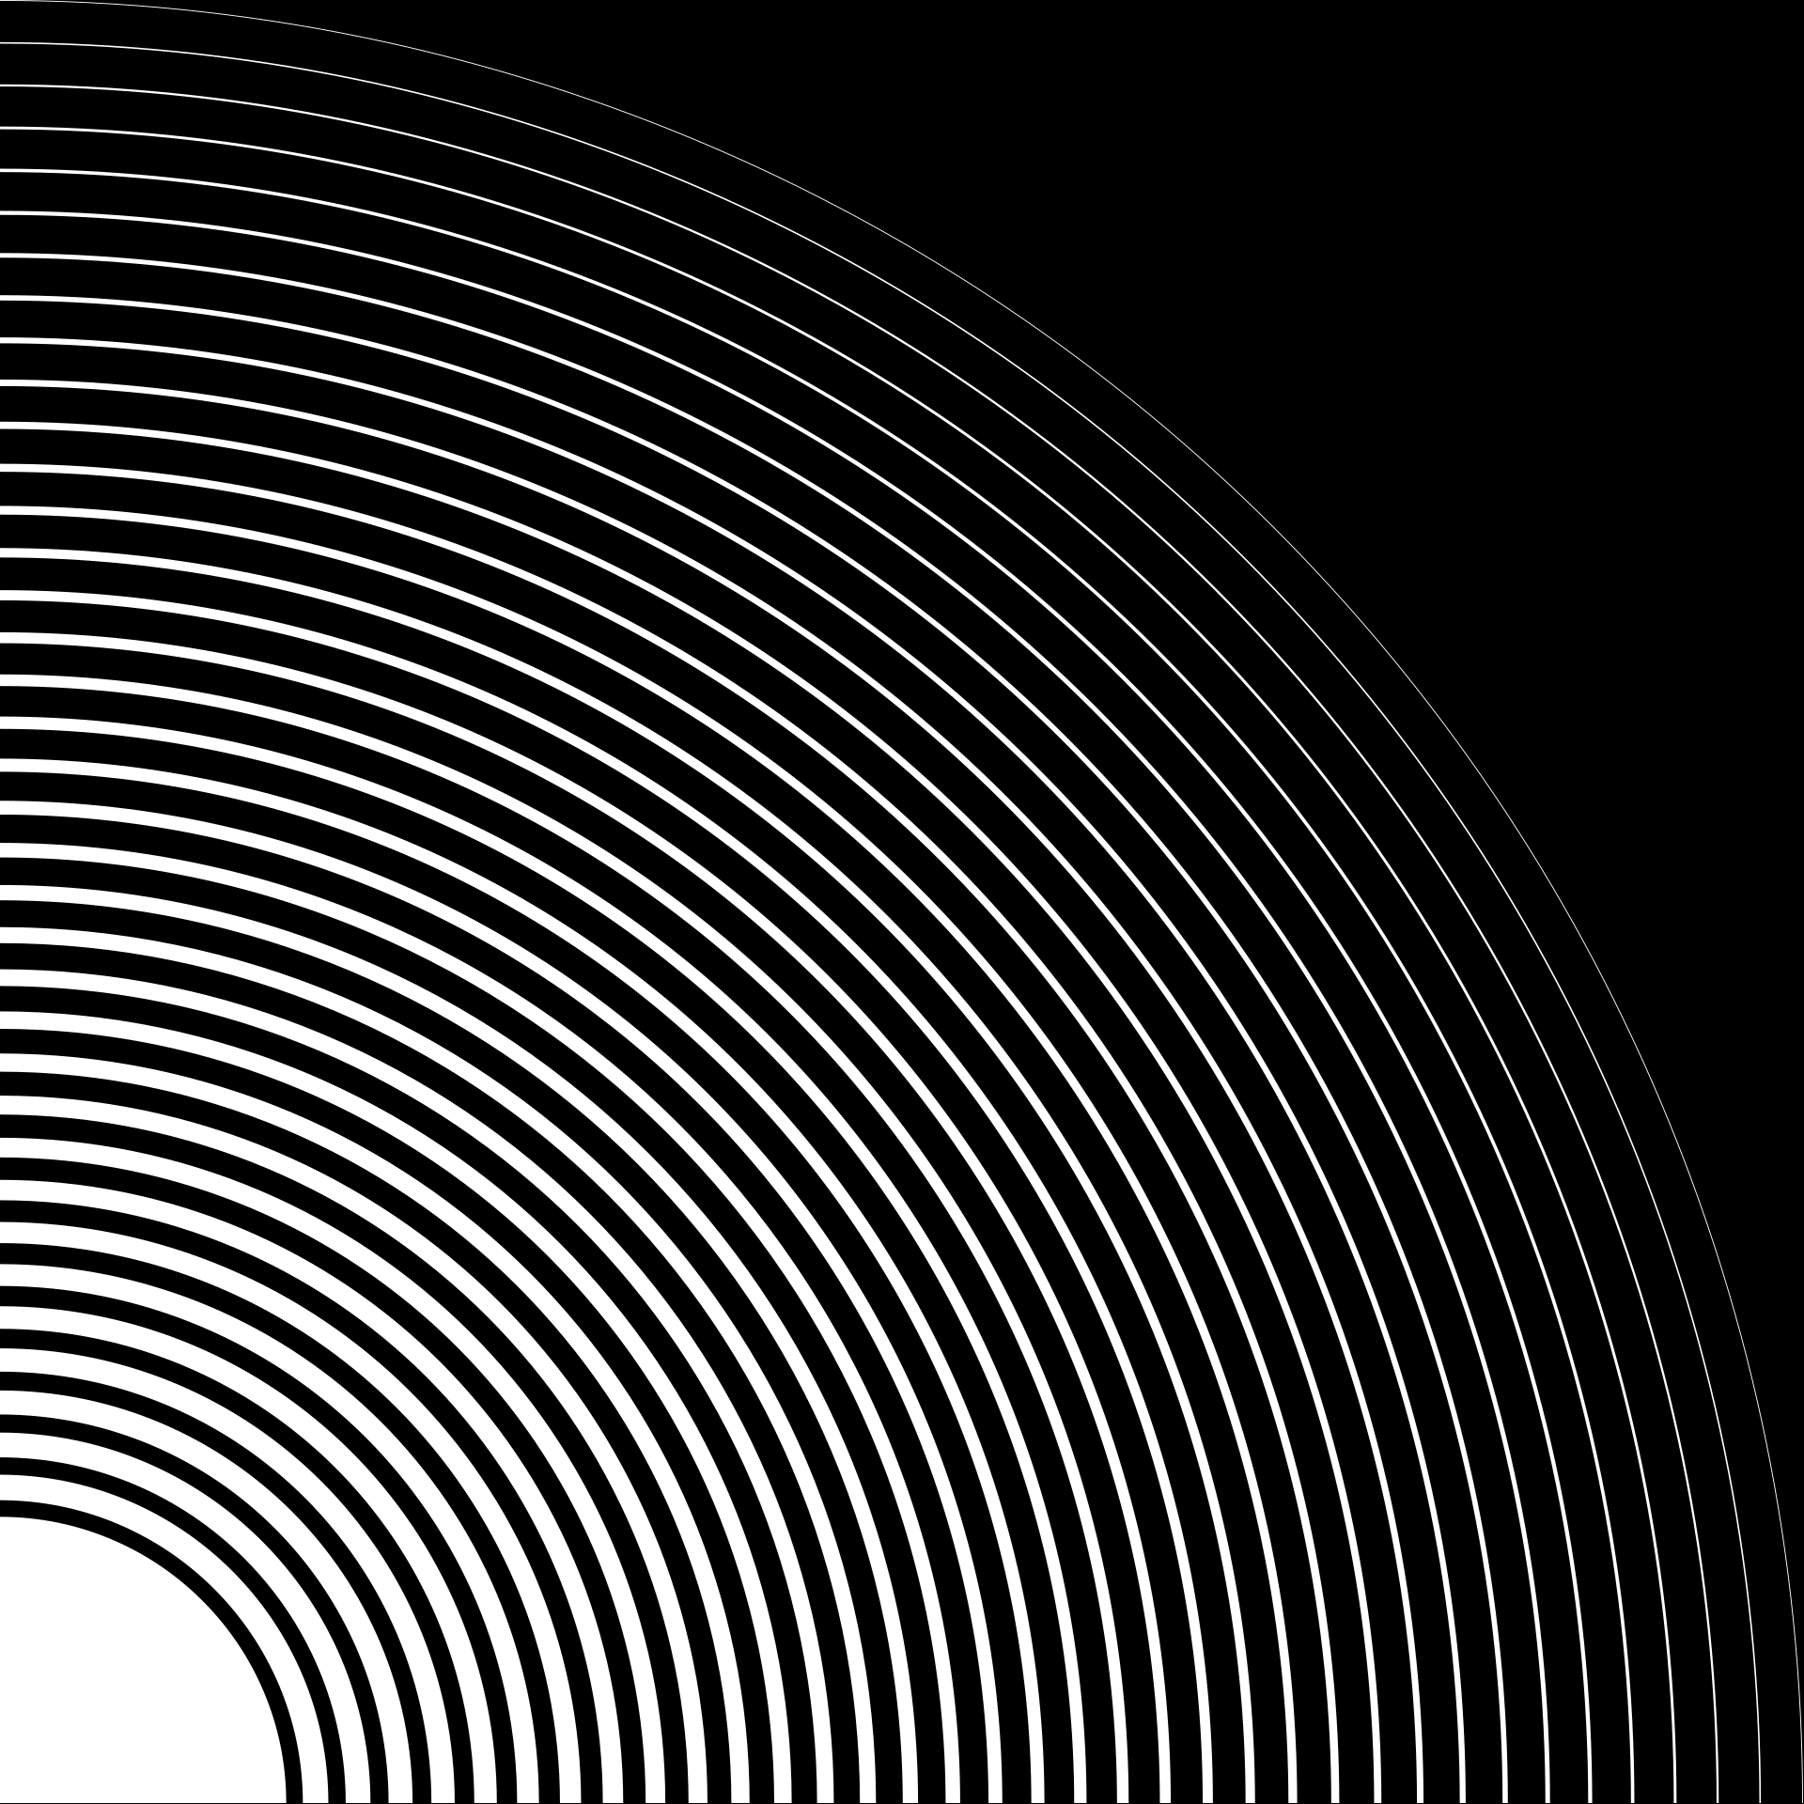


Opening Prayer
Loving Father,
The Sacred Scriptures tell us of the power of your Word:
It is a word that is creative, healing, hope-filled and transformative.
As we listen to your Word, let us experience not only the power of your Word, but also the power of our own words — power for good or for ill.
Fill us with your Holy Spirit, so that your Word will bring us healing and hope
which we can share with others for the good of all, in Jesus’ name. Amen.
Notes:
Leader info: This prayer is one to say before reading the Bible, to get your heart ready for God's word. It is an ancient prayer which is attributed to St John Chrysostom. This version has been slightly amended for younger pupils.
There are two parts to this prayer. This is the first part, the second part, as well as the whole prayer, will be shared during future sessions.
See https://aleteia.org/2019/09/13/before-reading-the-bible-pray-this-prayer-of-st-john-chrysostom

Slide 4
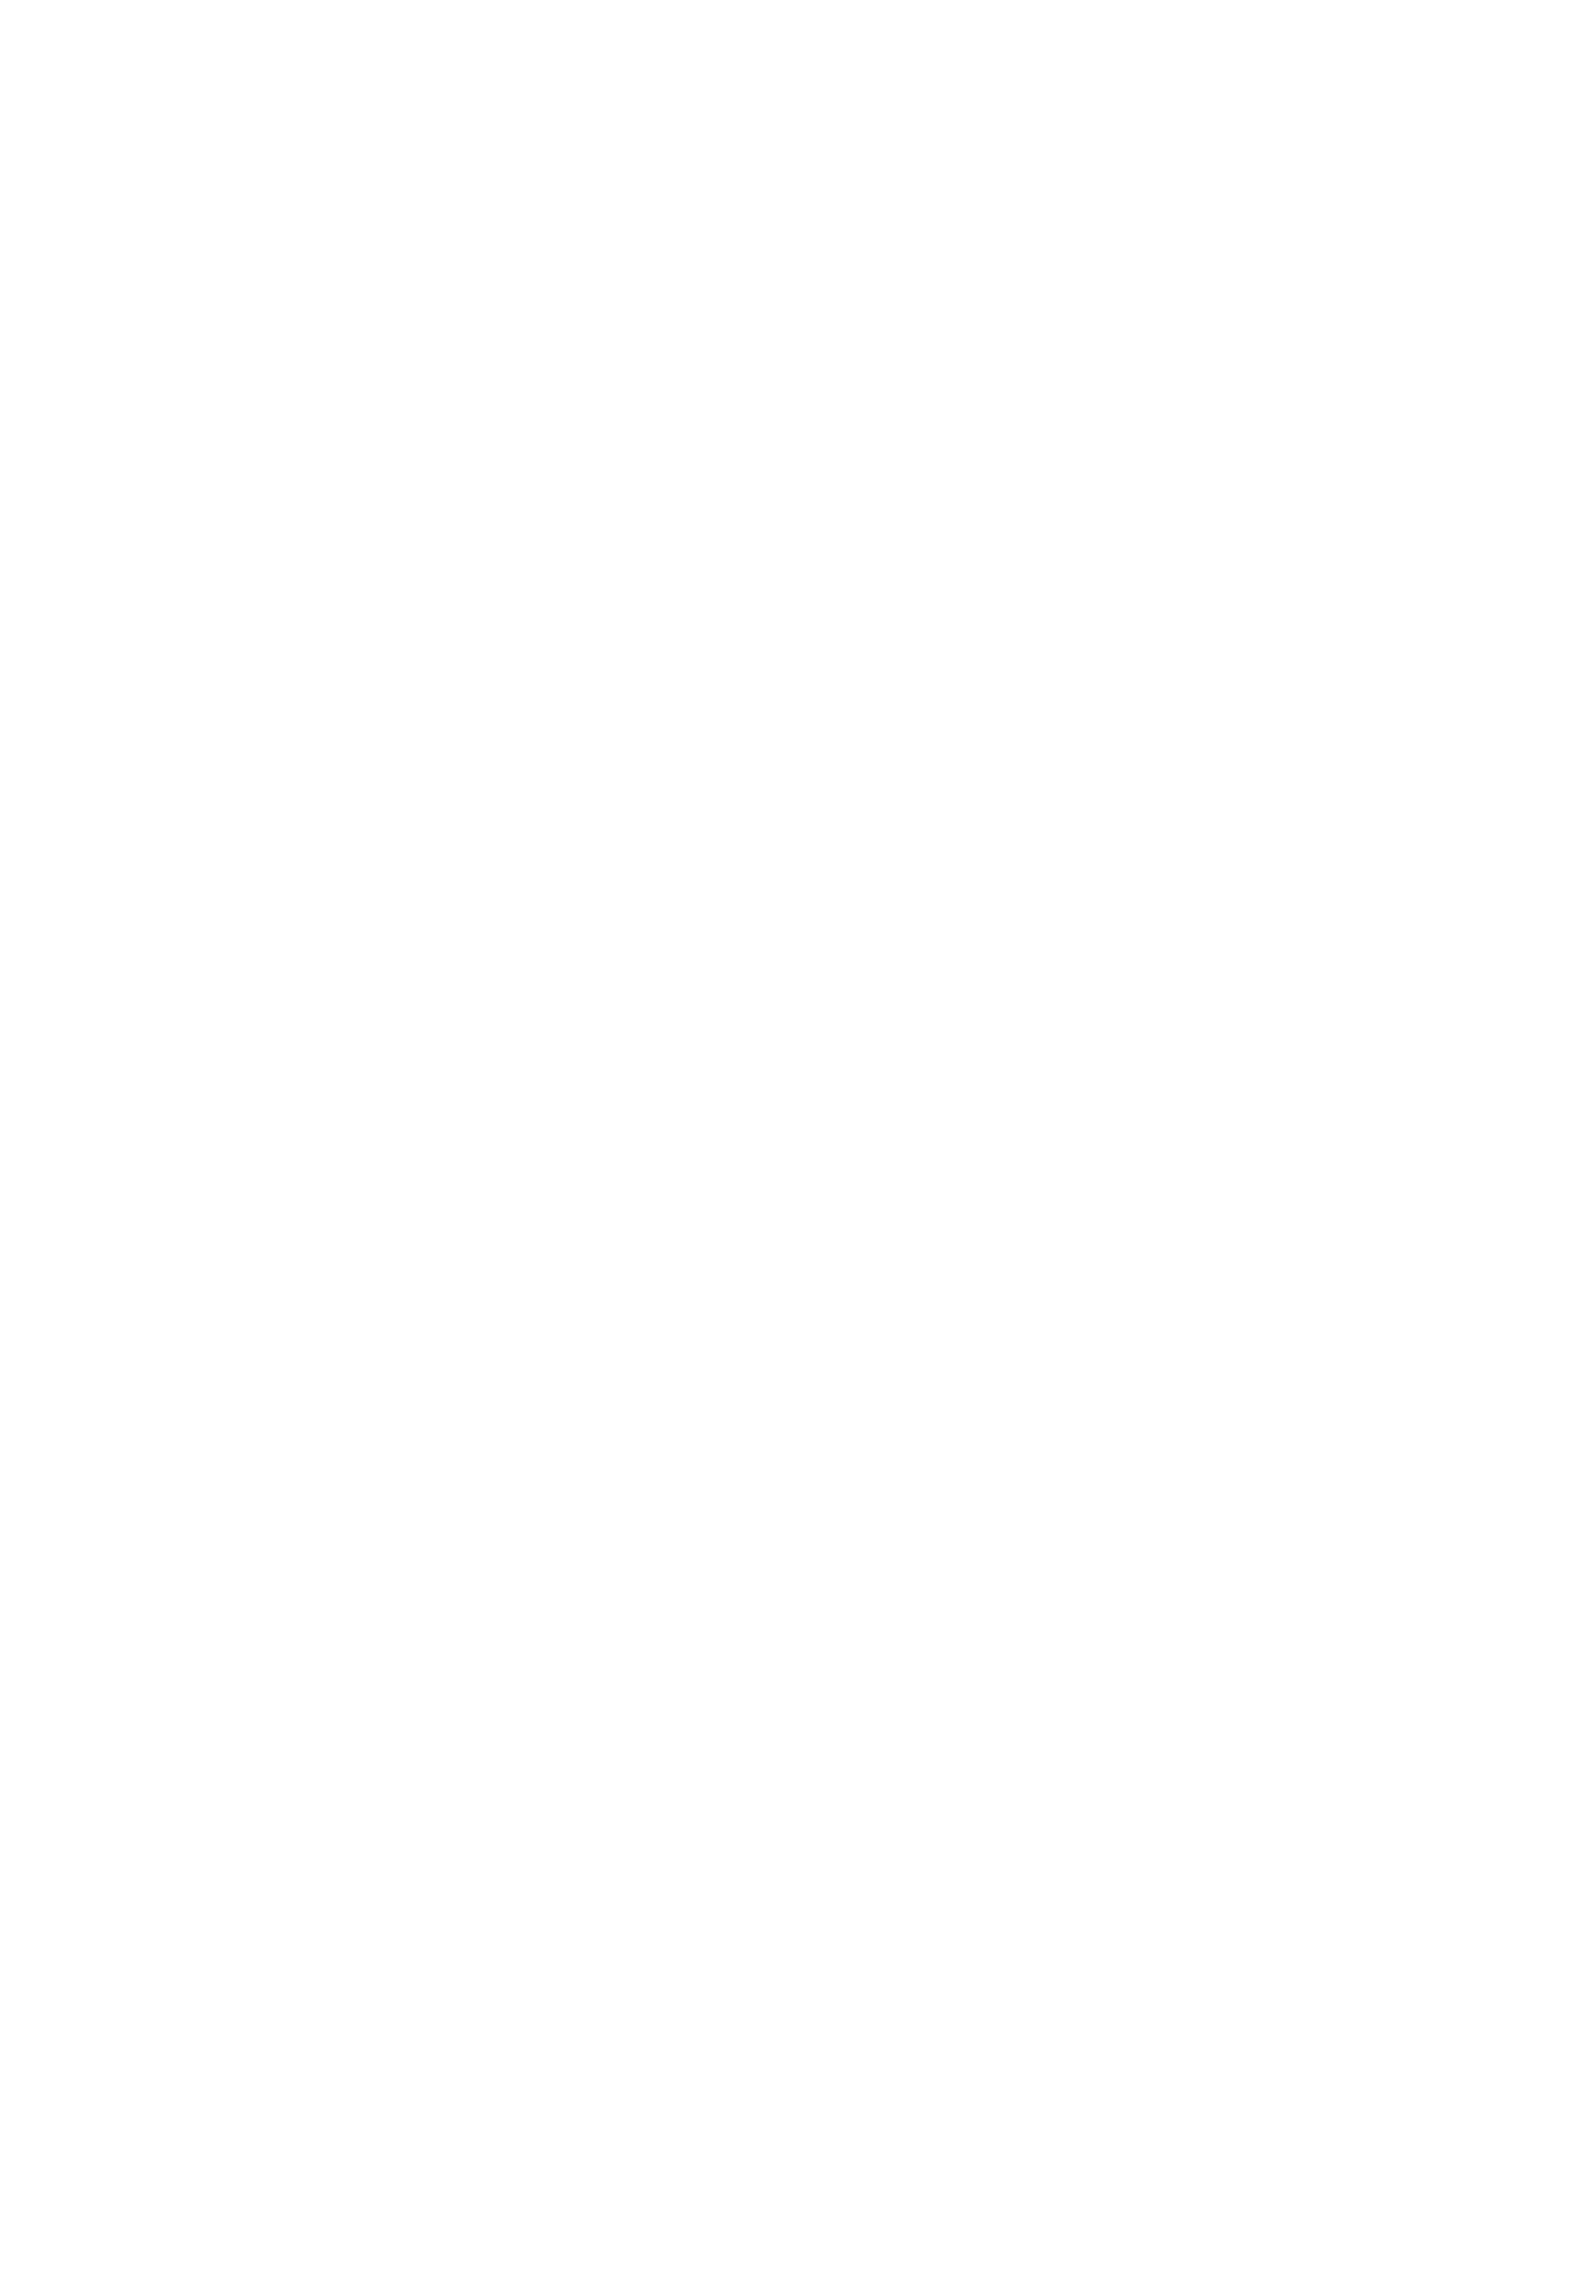

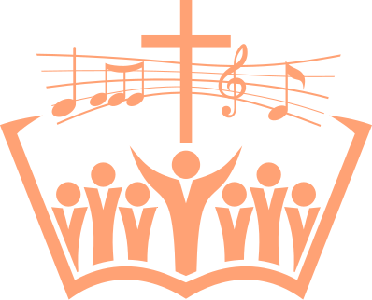


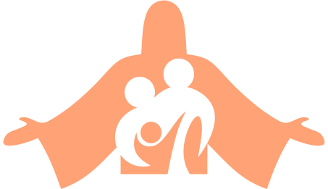
The Liturgy
Can you think
of how the Word of God could lead to service of God and others?
‘Liturgy’ meaning ‘public work’ or ‘service’ for the people
Participation of people of God in the ‘work of God’
Through liturgy, Christ continues his redeeming work
He does this with and through his Church (the people)
Liturgy is divine worship AND proclamation of Gospel
It leads to active charity - service of God and neighbour
Notes:
To share: The readings at Mass all come from the Bible. The first reading and psalm are from the Old Testament while the second reading, Gospel and Acclamation are from the New Testament. Although there is always a first reading, psalm, Gospel and acclamation, the second reading is usually only read on Sundays, holy days of obligation and special occasions. For the latter, it is at the discretion of the priest so it is best to agree this beforehand.
When discussing favourite texts, those that could be discussed include: the Christmas and Easter stories, the miracles and parables of Jesus, stories about the prophets (Abraham, Joseph, Moses...) or disciples (Peter, Andrew, James, John, Paul....). Leaders may wish to give some examples to inspire pupils, and even ask them if they can remember exact details and words.
Note: This will be expanded upon in future sessions

Slide 5
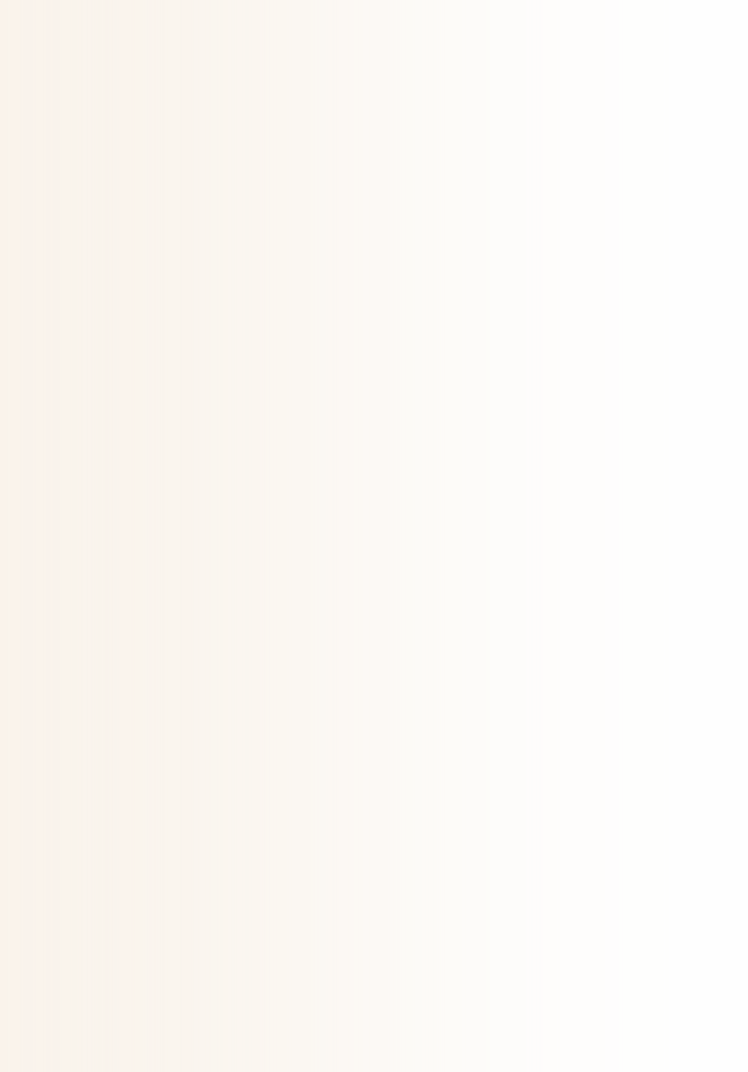


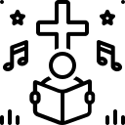

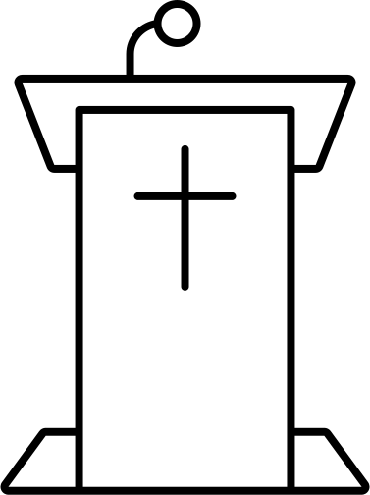
The Liturgy of the Word (1)
First Reading
Second Reading
These are from the Old Testament, the time before the life of Jesus. They take different forms (eg stories, prophecies, wisdom writings, historical accounts) and tell of the Law and the Old Covenant. They prepare us for Christ’s first coming at Christmas.
These are from the New Testament. They are often accounts or letters, for example from St Paul or St Peter to Christians. They include details of Christian life fter the Ascension of Christ. They tell of the New Covenant and foretell Jesus’ second coming.
Psalm
Gospel and Acclamation
These are from the Book of Psalms, many of which were composed by King David. They are poems which were intended to be sung, but may alternatively be read. They include many themes such as praise, faith and hope. They also express many emotions such as joy, sadness and fear.
These are the highlight of the Liturgy of the Word as they include the words of Jesus and details of his life, death and resurrection. Gospel means ‘Good News’ which Jesus brought. He is the Word of God. The Acclamation can be sung or read.
Notes:
To share: This is based on the slide from the first session when some information was given about each of these. The slide shows a little bit more... Ask pupils what they remember.
Each of these elements link together through a common theme, such as God feeding his people, or having faith.
The first reading is always read at Mass while people sit and listen, reflecting on its meaning. It tells of God's relationship with his people and their history (Creation and the Fall, the Flood, escape from Egypt, journey in the desert, the Jerusalem temple (building and rebuilding), worship of pagan gods, exile, the Roman empire... This history is written by many different people in different styles. Yet is is always God's word in human words.
The psalms are ideally meant to be sung. If so, the minister of the word does not read at this point. The congregation is invited to join in with the response (said or sung).
The Old Testament readings are about God's covenant with his people and how he frees them, even when they sin. They look forward to the day when salvation will come. This comes in Jesus, the Incarnate Word of God, the Son of God. We hear about him in the second reading and the Gospels. The second reading (which is not always read), continues the theme of the first reading. It includes Pentecost and other acts of the apostles, including their letters to each other, encouraging them in their faith.
The Gospels (from Matthew, Mark, Luke and John) are the highlight of the Liturgy of the Word as they tell us about Jesus' life using his own words and examples. He is the fulfilment of all that God has promised. Because the Gospels are so special, people show respect by standing (as they would do for a king or leader). The priest or deacon read the Gospel. The minister of word waits for everyone to stand and then reads the Gospel Acclamation (unless it is sung instead).
At the end of the first and second readings, the minister of the word proclaims "The word of the Lord", which people respond "Thanks be to God". This is important as it states that we truly believe it is God's word and we give God thanks and praise for it.
At the end of the Gospel, the priest or deacon states "The Gospel of the Lord" to which we respond "Praise to you, Lord Jesus Christ".

Slide 6
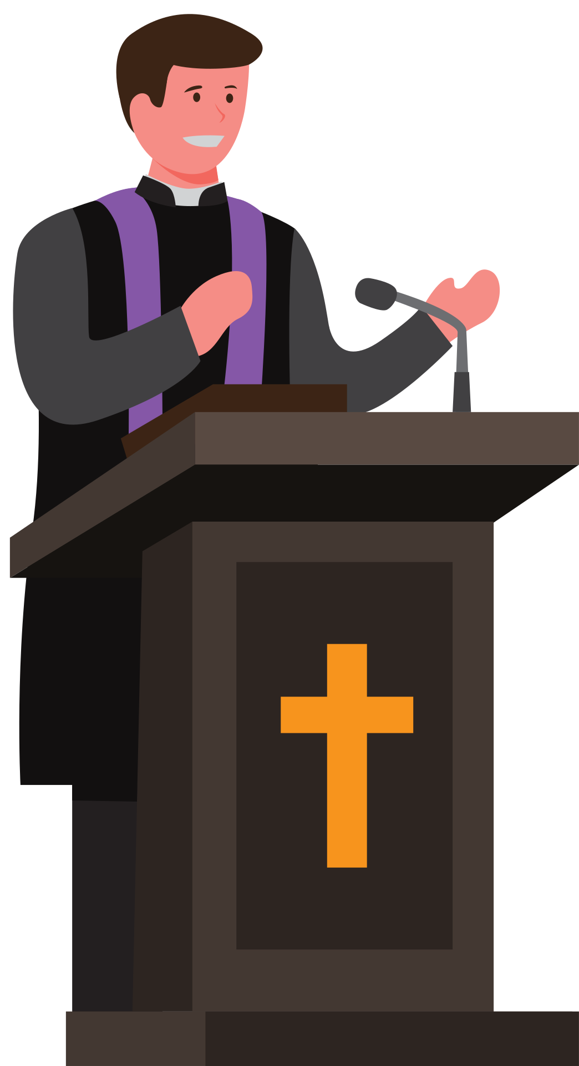


The Liturgy of the Word (1)
What is your
favourite part of the
Liturgy of the
Word? Why?
Homily
This is a special talk given by the priest or deacon after the Gospel reading. It's like a story or lesson that helps everyone understand the Bible better and learn how to live like Jesus. Sometimes the priest may encourage some participation, for example he might ask questions at a school Mass for pupils to respond to.
Creed
This is said by all members of the congregation at Sunday Mass or on other special days. A creed is a statement of belief. and is a reminder of the promises made at Baptism: “I believe in God... I believe in Jesus Christ... I believe in the Holy Spirit...”
Bidding Prayers
They are read by the minister(s) of the Word after an introduction by the priest. The prayers usually follow a certain structure or style and, at the end, a prayer is said by all (Hail Mary).
Notes:
To share: This is based on the slide from the first session when some information was given about each of these. The slide shows a little bit more... Ask pupils what they remember.
Each of these elements link together through a common theme, such as God feeding his people, or having faith.
The first reading is always read at Mass while people sit and listen, reflecting on its meaning. It tells of God's relationship with his people and their history (Creation and the Fall, the Flood, escape from Egypt, journey in the desert, the Jerusalem temple (building and rebuilding), worship of pagan gods, exile, the Roman empire... This history is written by many different people in different styles. Yet is is always God's word in human words.
The psalms are ideally meant to be sung. If so, the minister of the word does not read at this point. The congregation is invited to join in with the response (said or sung).
The Old Testament readings are about God's covenant with his people and how he frees them, even when they sin. They look forward to the day when salvation will come. This comes in Jesus, the Incarnate Word of God, the Son of God. We hear about him in the second reading and the Gospels. The second reading (which is not always read), continues the theme of the first reading. It includes Pentecost and other acts of the apostles, including their letters to each other, encouraging them in their faith.
The Gospels (from Matthew, Mark, Luke and John) are the highlight of the Liturgy of the Word as they tell us about Jesus' life using his own words and examples. He is the fulfilment of all that God has promised. Because the Gospels are so special, people show respect by standing (as they would do for a king or leader). The priest or deacon read the Gospel. The minister of word waits for everyone to stand and then reads the Gospel Acclamation (unless it is sung instead).
At the end of the first and second readings, the minister of the word proclaims "The word of the Lord", which people respond "Thanks be to God". This is important as it states that we truly believe it is God's word and we give God thanks and praise for it.
At the end of the Gospel, the priest or deacon states "The Gospel of the Lord" to which we respond "Praise to you, Lord Jesus Christ".

Slide 7


The Mass
Jesus is truly present in the
word that is shared
(Liturgy of the Word)
Jesus is truly present in the bread and wine that is shared (Liturgy of the Eucharist)
Notes:
Because the readings are God’s word, they are not just read, they are proclaimed. The reader must therefore believe what they are saying, have the utmost respect for God’s word, and do their very best at communicating God’s important message to others. This requires prayer and practice.
Some of the ways we can show respect for God's word could be:
- Reading it carefully beforehand to understand it
- Praying to the Holy Spirit for help in understanding, proclaiming and living it
- Reading it slowly and respectfully
- Touching the lectionary with clean and respectful hands
- Bowing to the altar/tabernacle before and after reading
- Always being reverent when speaking about the Bible and God's word
Note: This will be revised and expanded upon in future sessions

Slide 8




Jesus, with the power of the Spirit in him, returned to Galilee; and his reputation spread throughout the countryside. He taught in their synagogues and everyone glorified him. He came to Nazara, where he had been brought up, and went into the synagogue on the Sabbath day as he usually did. He stood up to read, and they handed him the scroll of the prophet Isaiah. Unrolling the scroll he found the place where it is written: The spirit of the Lord is on me, for he has anointed me to bring the good news to the afflicted. He has sent me to proclaim liberty to captives, sight to the blind, to let the oppressed go free, to proclaim a year of favour from the Lord. He then rolled up the scroll, gave it back to the assistant and sat down. And all eyes in the synagogue were fixed on him. Then he began to speak to them, 'This text is being fulfilled today even while you are listening.'
Luke 4:14-21

Slide 9

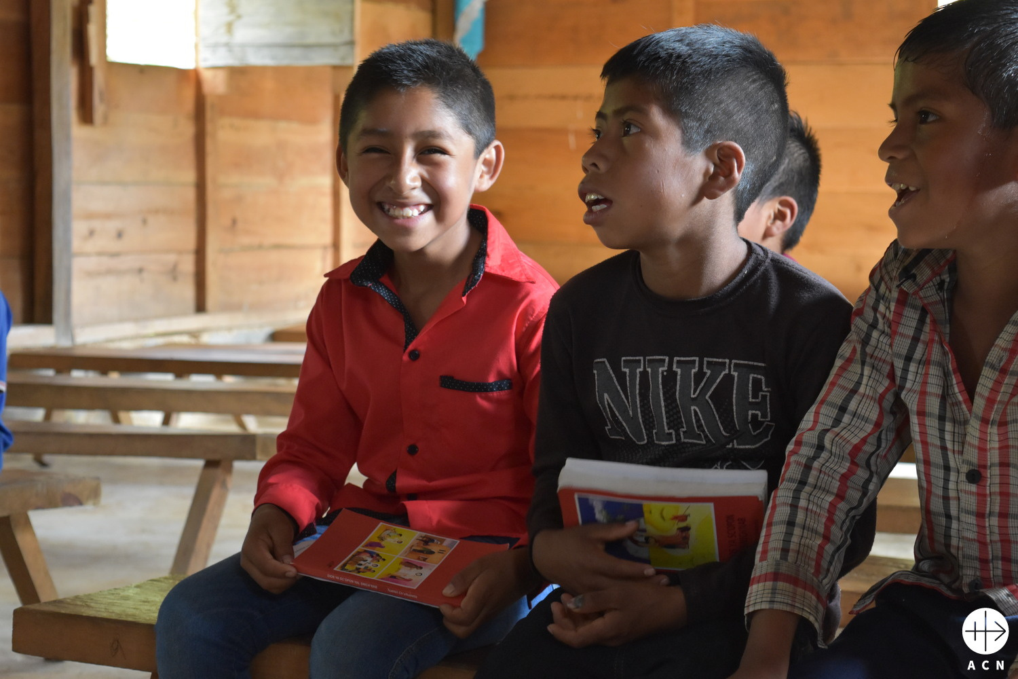
ACN: Mexico
Jesuit Fathers working in the diocese of San Cristobal de las Casas in southern Mexico have translated ACN’s ‘Child’s Bible’ into the indigenous Tseltal language, which is spoken by around half a million people in this region.
Notes:
For the past 30 years almost, this little red book has conquered the world. The ACN Child‘s Bible, "God speaks to his children" has now been published in almost 51 million copies and around 190 different world languages.
Father Werenfried, the founder of ACN, understood that children need something like a Child‘s Bible, so that the image of Christ can become a living one in their hearts. And they will also be gripped by the Old Testament stories of Noah, Abraham, Joseph, Moses and David. Yet for so many children in the Third World the Bible is something they can only dream of, for they are so poor that they cannot afford a book. And so he decided to make a gift of a Child‘s Bible to children throughout the world.

Slide 10
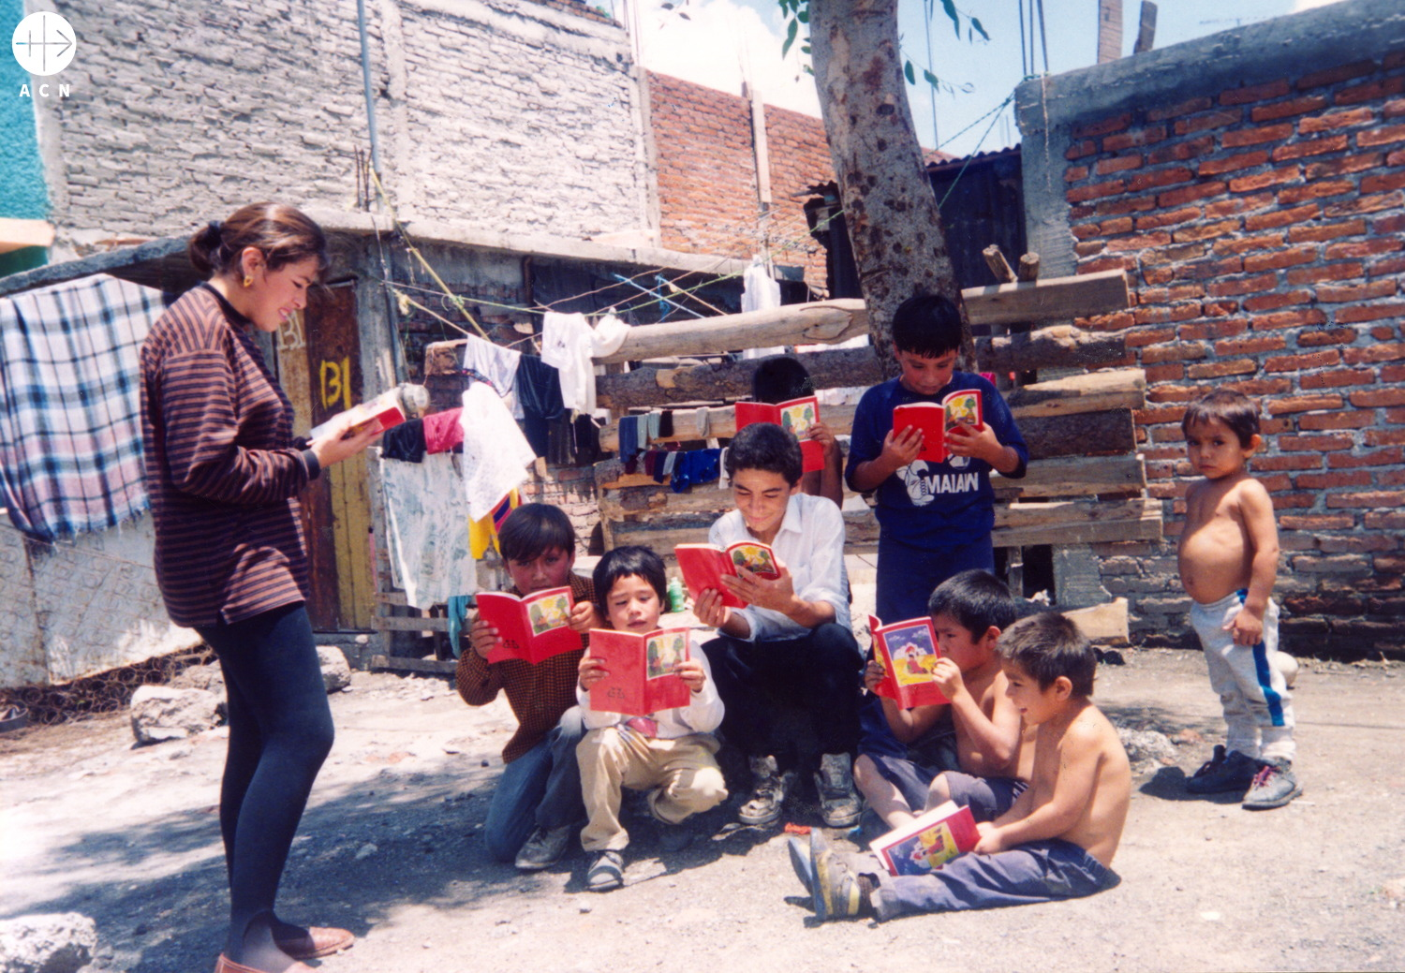
Thanks to our generous benefactors, we have been able to give 18,000 Euros to enable 30,000 Child‘s Bibles to be printed in the Tseltal language. So thanks to your help, the children in this region can now get to know the Word of God in their own mother tongue.
ACN: Mexico
Notes:
Even today, for some of the less widely spoken languages, the ACN Child‘s Bible is still the only printed book available.
Thanks to our generous benefactors, we have been able to give 18,000 Euros to enable 30,000 Child‘s Bibles to be printed in the Tseltal language. So thanks to your help, the children in this region can now get to know the Word of God in their own mother tongue. This is an incalculable treasure for them. Many, many thanks to all who have helped!
Reflect: Why do you think having a church and being able to read God's word is important to these children?

Slide 11
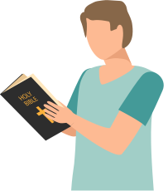
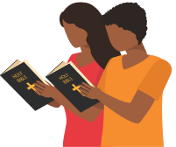
Over to you...
Now practise reading scripture to others. Remember the tips from last time. Try to show respect through your body language, voice and gestures.
Notes:
See Session 1: Examples for Practice.
Have printed for pupils to practise reading. Explain that, although the readings come from the Bible (shown in the video on this slide), they are put into a special book used at Mass called the Lectionary. However, sometimes at school Masses the readings are printed and backed onto card as they have special readings which may not easily be found in the Lectionary.

Slide 12

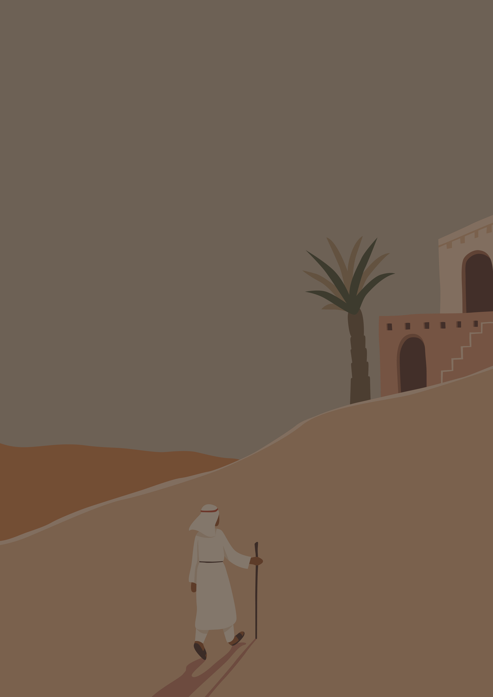



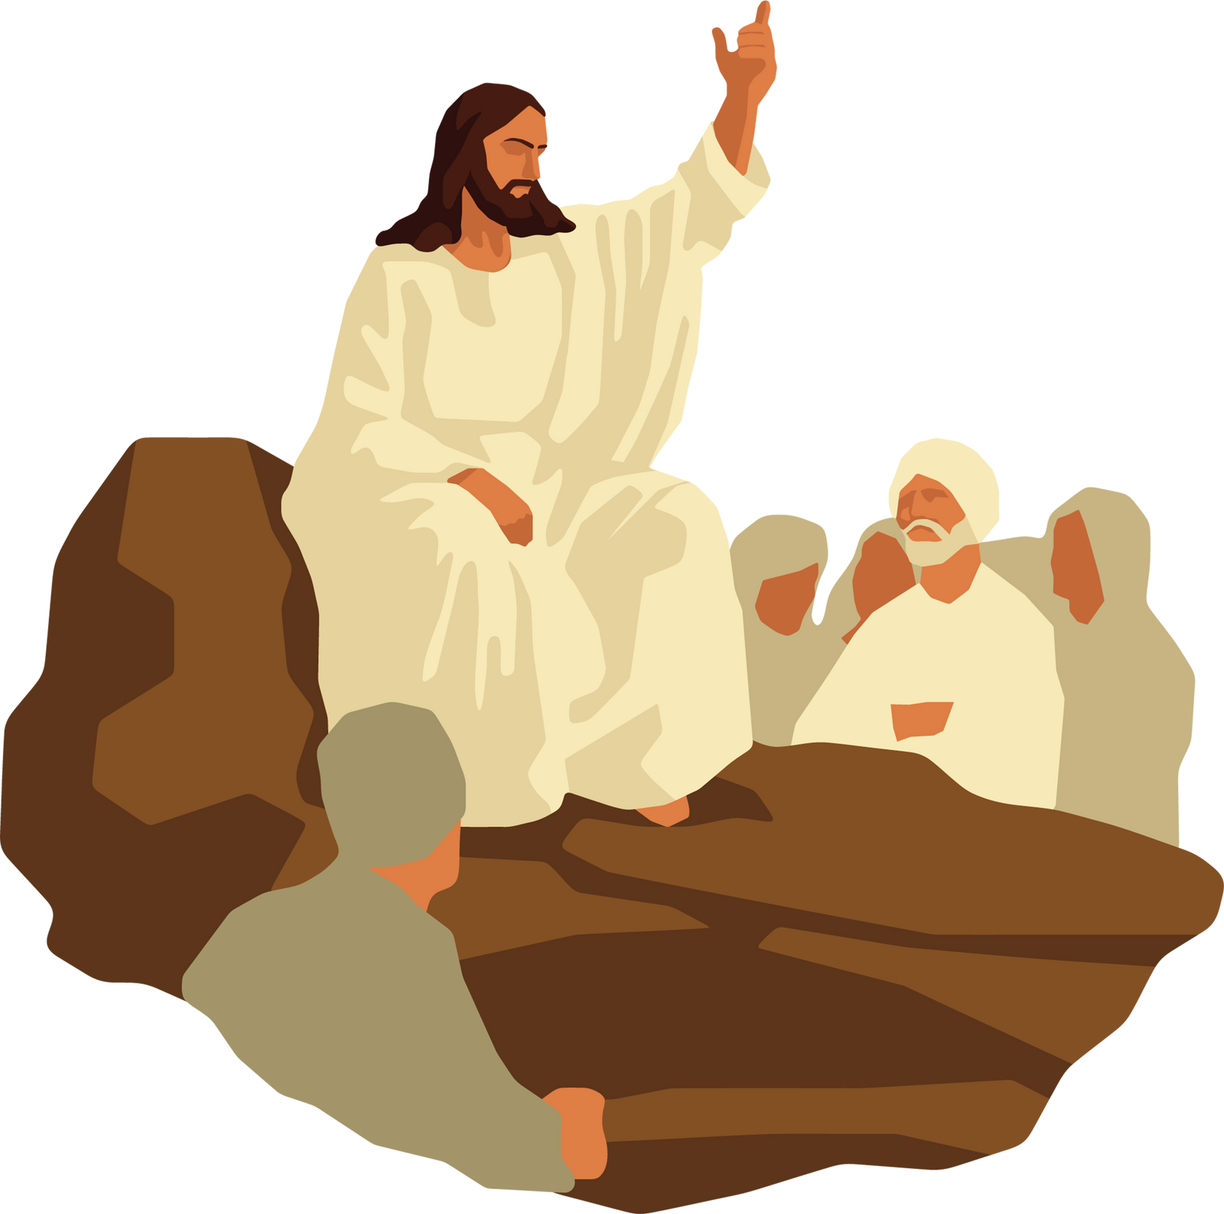
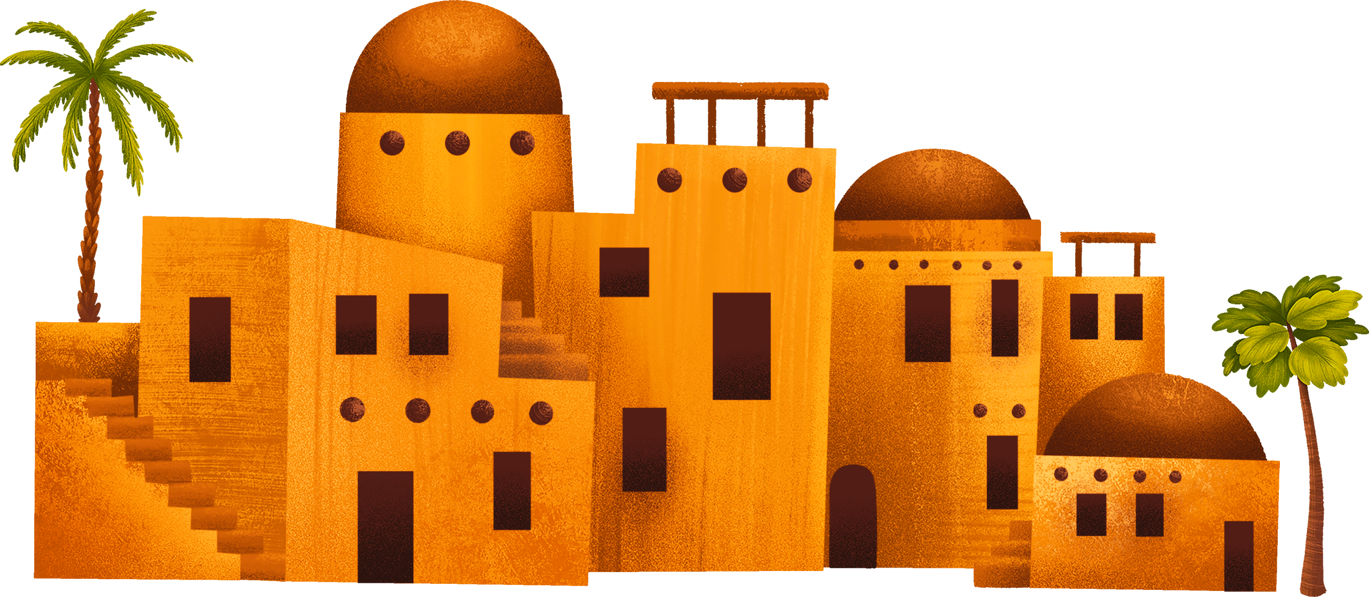
Bow reverently and in
time with others.
Hold the reading/paper carefully in front of you, with arms still.
Keep feet/legs together, standing still. Try not to fidget!
Speak slowly and clearly. Think about the meaning of the words you are saying and the fact that you are proclaining the Word of God.

Slide 13


