Slide 1
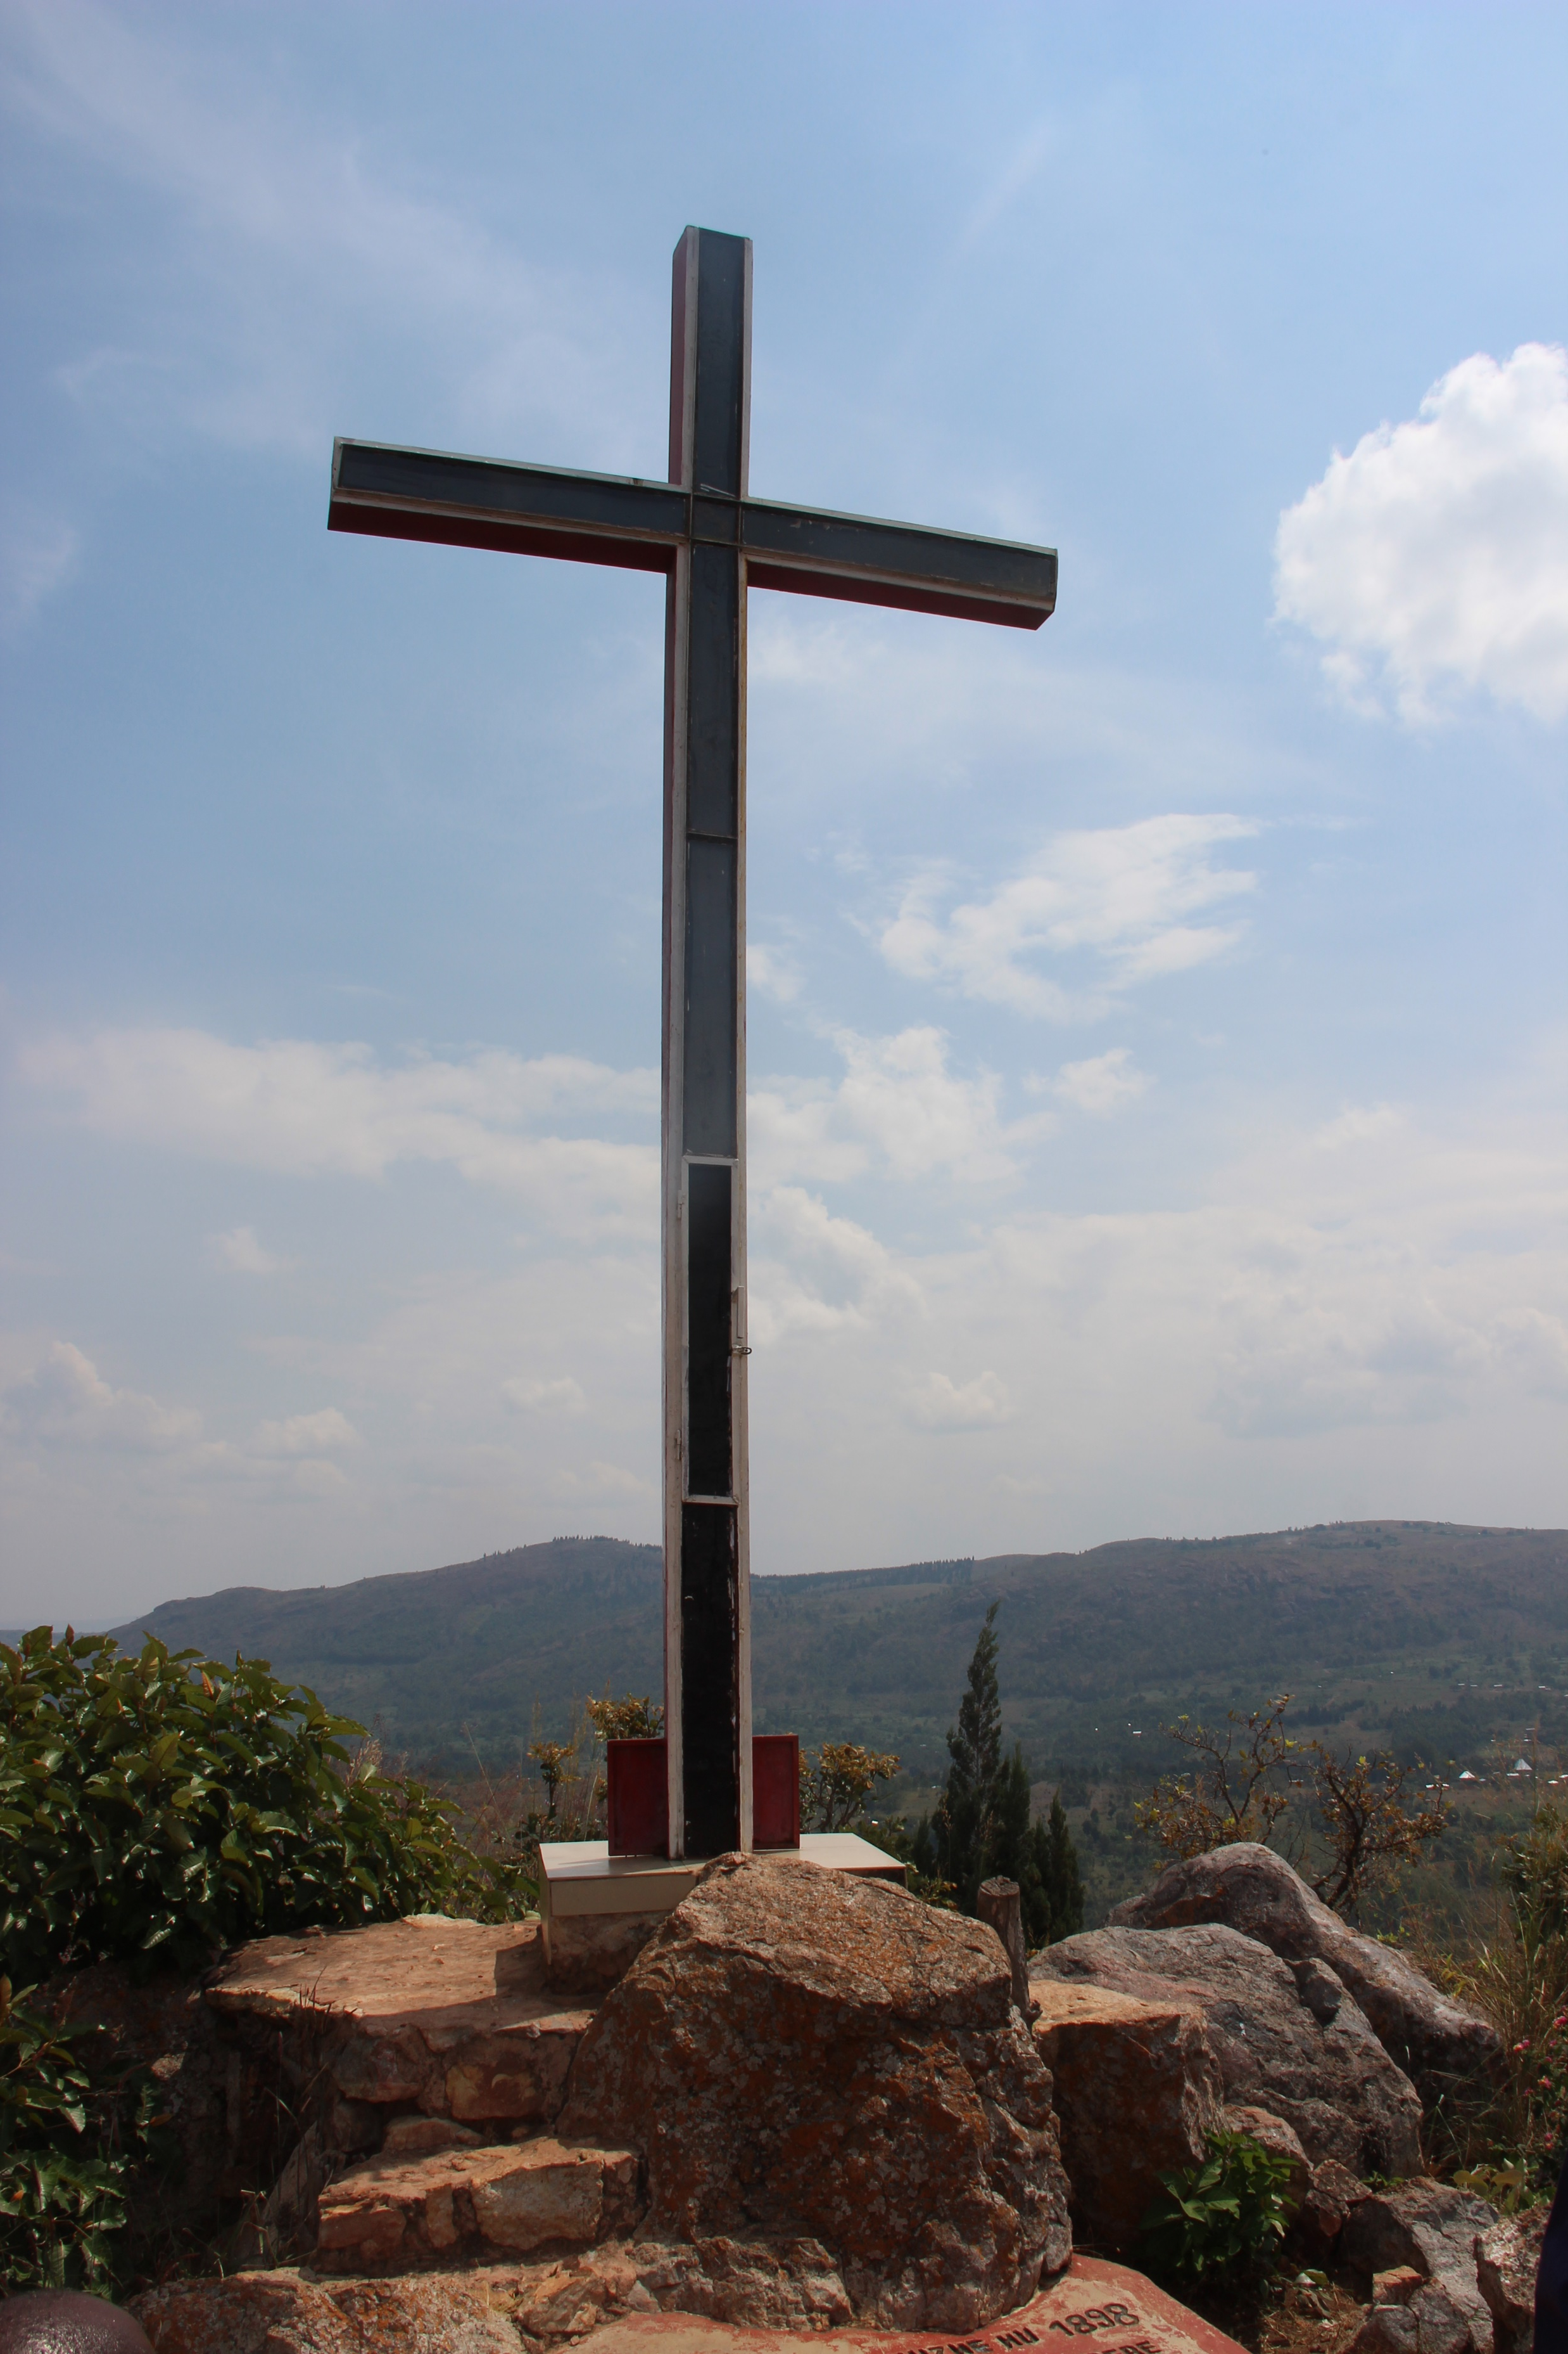
The Way of the Cross
© Aid to the Church in Need
The cross of the Society of Missionaries of Africa (commonly known as the White Fathers because of their white habits) in Muyaga, Burundi. This is one of the oldest crosses in the country.
Stations of the Cross for the Suffering Church

Slide 2
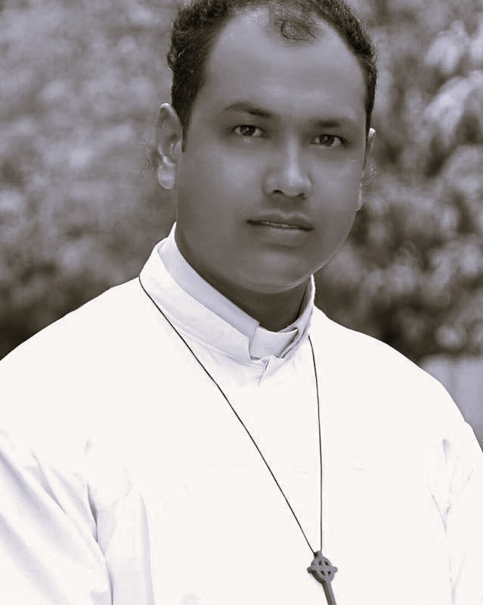
1st Station:
JESUS IS CONDEMNED TO DEATH
© Catholic Archdiocese of Mandalay
Father Donald Martin Ye Naing Win, a 44-year-old priest of the Catholic Archdiocese of Mandalay, whose body was found on the morning of Friday 14th February 2025 in the grounds of Our Lady of Lourdes Parish Church, Kangyi Taw, Burma (Myanmar).
Notes:
NIGERIA

Slide 3
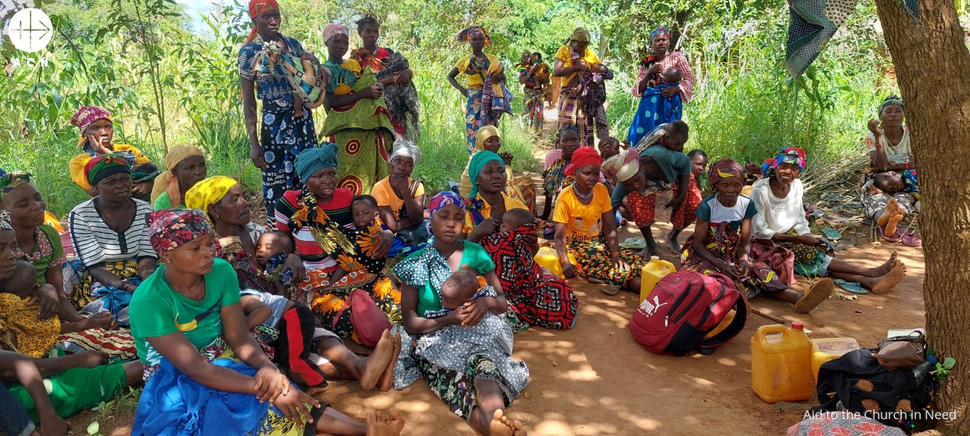
2nd Station:
JESUS TAKES UP THE CROSS
© Radio Veritas Mandalay
In Mozambique, since October 2017 about 5,000 people have been killed and one million displaced, as a result of the violent clashes between insurgents seeking to establish an Islamic state and the Mozambique Defence Armed Forces. The fighting has been concentrated around Muslim-majority Cabo Delgado Province in northern Mozambique.
Notes:
BURMA (MYANMAR)

Slide 4
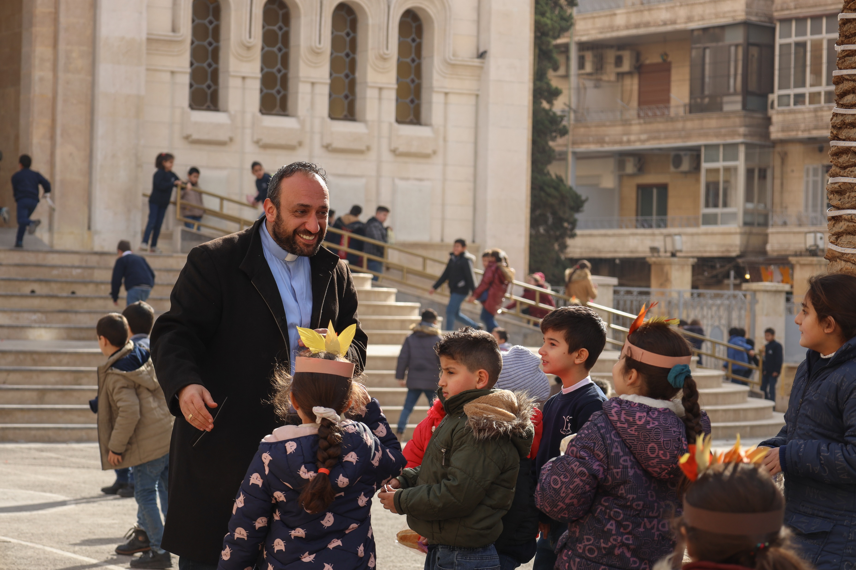
3rd Station:
JESUS FALLS FOR THE FIRST TIME
© JacobACN
Despite Syria’s Christian schools reopening concerns remain about the future of Christianity in the country. The authorities have assured the public that Christian schools would be able to operate as normal. After 13 years of conflict, in which Syria suffered a crippling financial crisis, trust in the authorities has been deeply shaken.
Notes:
PAKISTAN

Slide 5
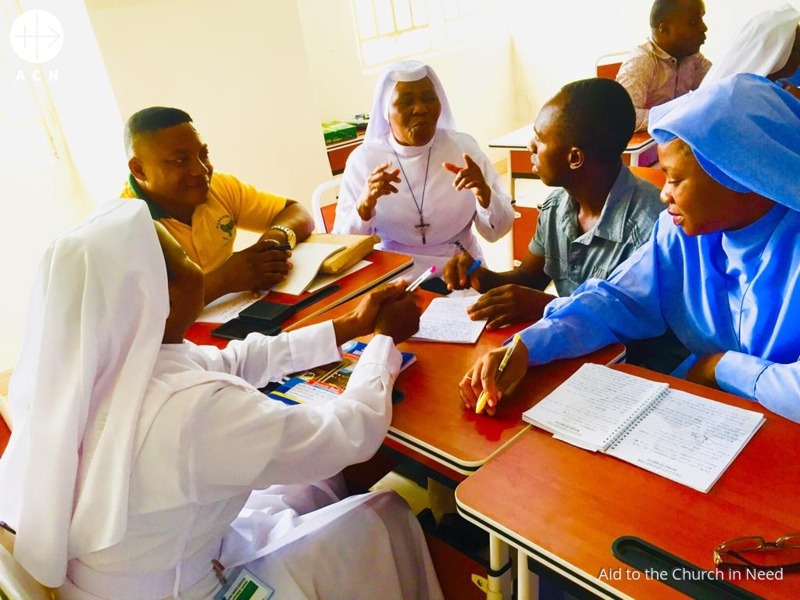
4th Station:
JESUS MEETS HIS MOTHER
Sister Vincentia María Nwankwo and Sister Grace Mariette Okoli, were abducted on 7th January 2025 in Anambra State, south-east Nigeria. Both religious Sisters belong to Sisters of the Immaculate Heart of Mary, Mother of Christ. In 2024, according to research by ACN, 11 priests were abducted in the country and another priest was killed.
Notes:
GHANA

Slide 6
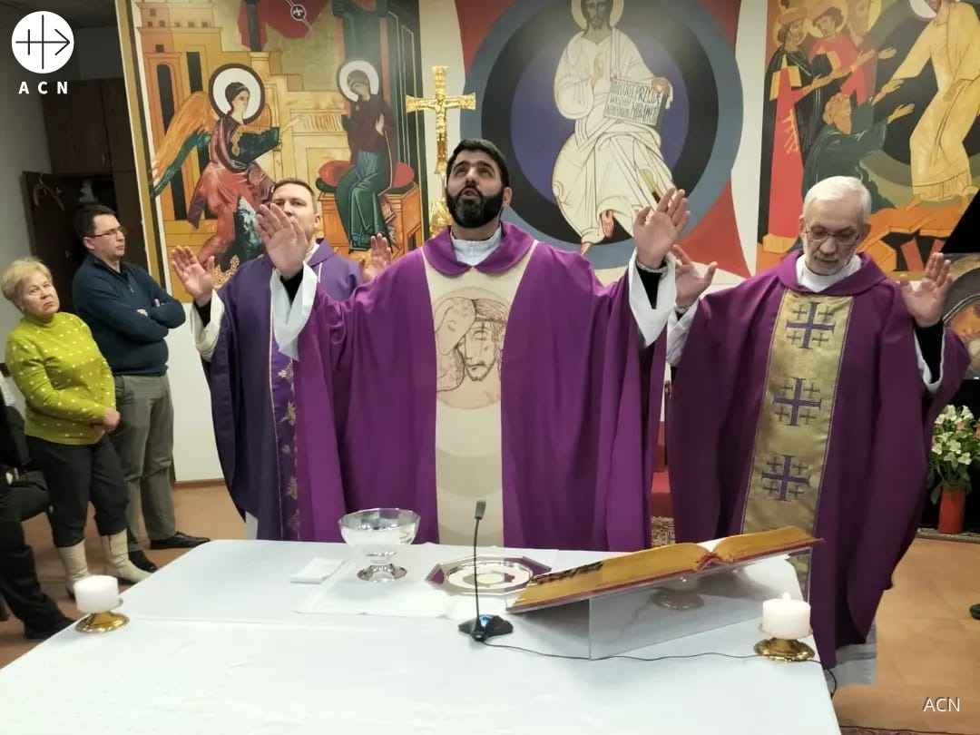
5th Station:
SIMON OF CYRENE HELPS JESUS TO CARRY THE CROSS
After more than a thousand days of fighting in Ukraine, Father Lucas Perozzi (pictured, centre), a Brazilian missionary priest ministering in Kyiv, told ACN that “psychologically, people are tired, very scared and without hope”. it seems that “nothing consoles them anymore. They have given up searching. They have become apathetic, disillusioned.”
Notes:
UKRAINE

Slide 7
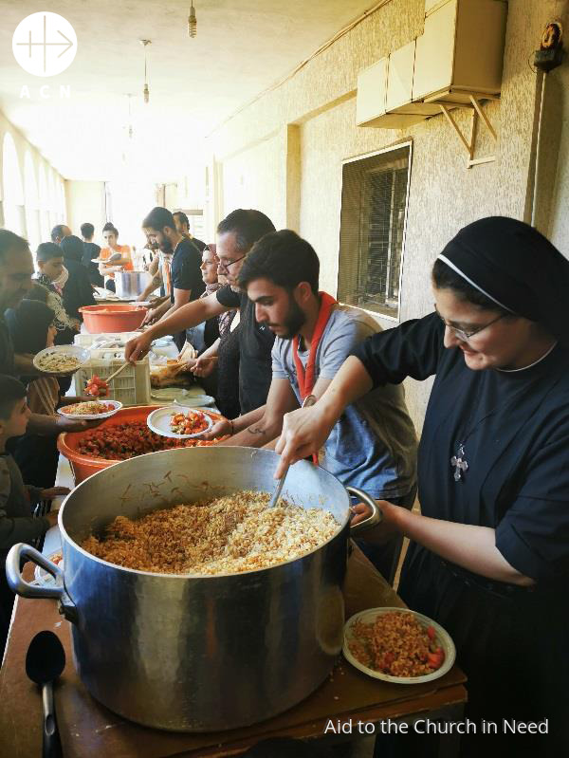
6th Station
VERONICA WIPES
THE FACE OF JESUS
Emergency support for 800 people (IDPs) displaced by the war in Lebanon, provided by the Congregation of the Sisters of Good Service (Baalbek, 2024). There are 1.5 million displaced people - one in four people in Lebanon - mostly concentrated in the Mount Lebanon region, who were forced to leave their homes in southern Lebanon because of Israel’s bombing of Hezbollah targets.
Notes:
SYRIA/LEBANON

Slide 8
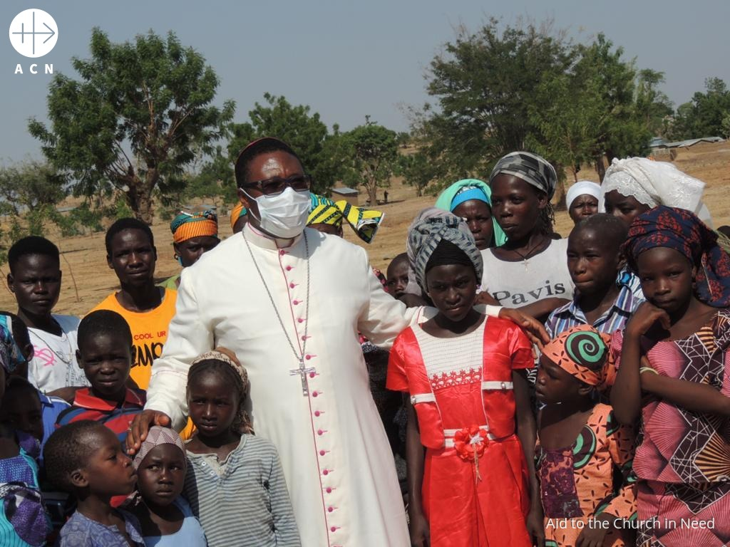
7th Station:
JESUS FALLS THE SECOND TIME
Bishop Bruno Ateba of Maroua-Mokolo, Cameroon visiting Nigerian refugees in his Diocese at the Minawao refugee settlement from 25-27 May 2021. The Diocese of Maroua-Mokolo is in the far north of Cameroon. Since 2013, Nigerians have fled Nigeria to Cameroon to escape the abuses of Boko Haram fighters.
Notes:
INDIA (northeast India)

Slide 9
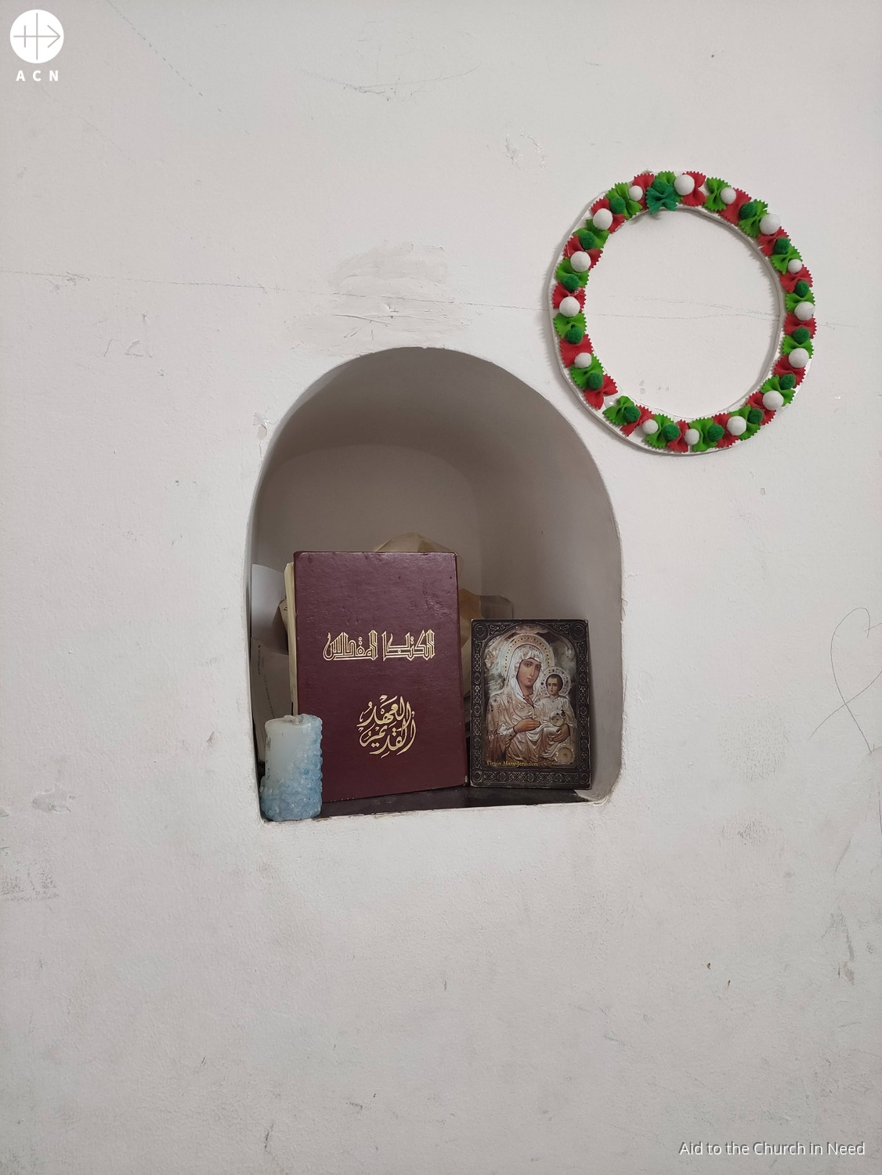
8th Station:
JESUS CONSOLES THE
WOMEN OF JERUSALEM
In April Cardinal Pizzaballa, Latin Patriarch of Jerusalem told ACN that, after the war, it will be possible to “rebuild the infrastructure – but how can we rebuild relationships?” The patriarch said “What concerns me is the level of hatred. The hate speech, the language of contempt, the denial of the other is very problematic.” Cardinal Pizzaballa continued it is essential for Christians to remain in the region to “keep the memory of Jesus alive in the land of Jesus”.
Notes:
SUDAN

Slide 10
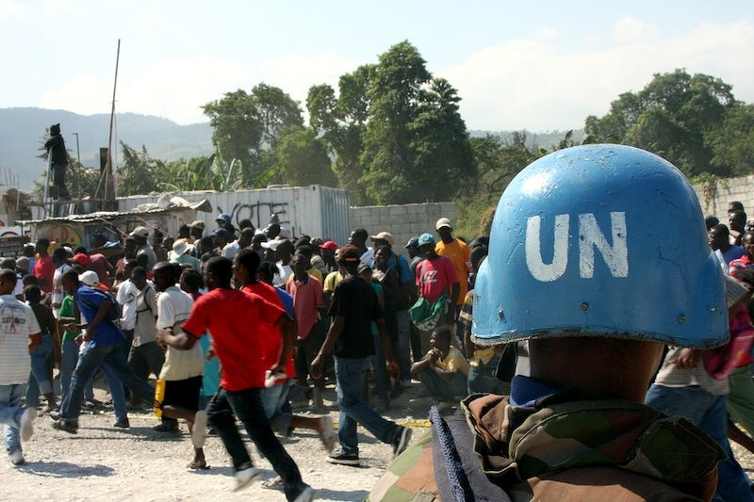
9th Station:
JESUS FALLS FOR THE THIRD TIME
© U.S. Government/U.S. Marine Corps
Haiti – which is the poorest country in the western hemisphere – has been going through a deep political, social and economic crisis for years, with armed gangs having taken control of the capital. Since March 2024, Haiti has been paralysed by violence. Criminals have cut off the main transport routes between Port-au-Prince and the rest of the country destroying livelihoods and depriving the population of basic services. Within a period of four days in November, more than 20,000 people in the Port-au-Prince region fled their homes according to reports from the United Nations.
Notes:
PHILIPPINES

Slide 11
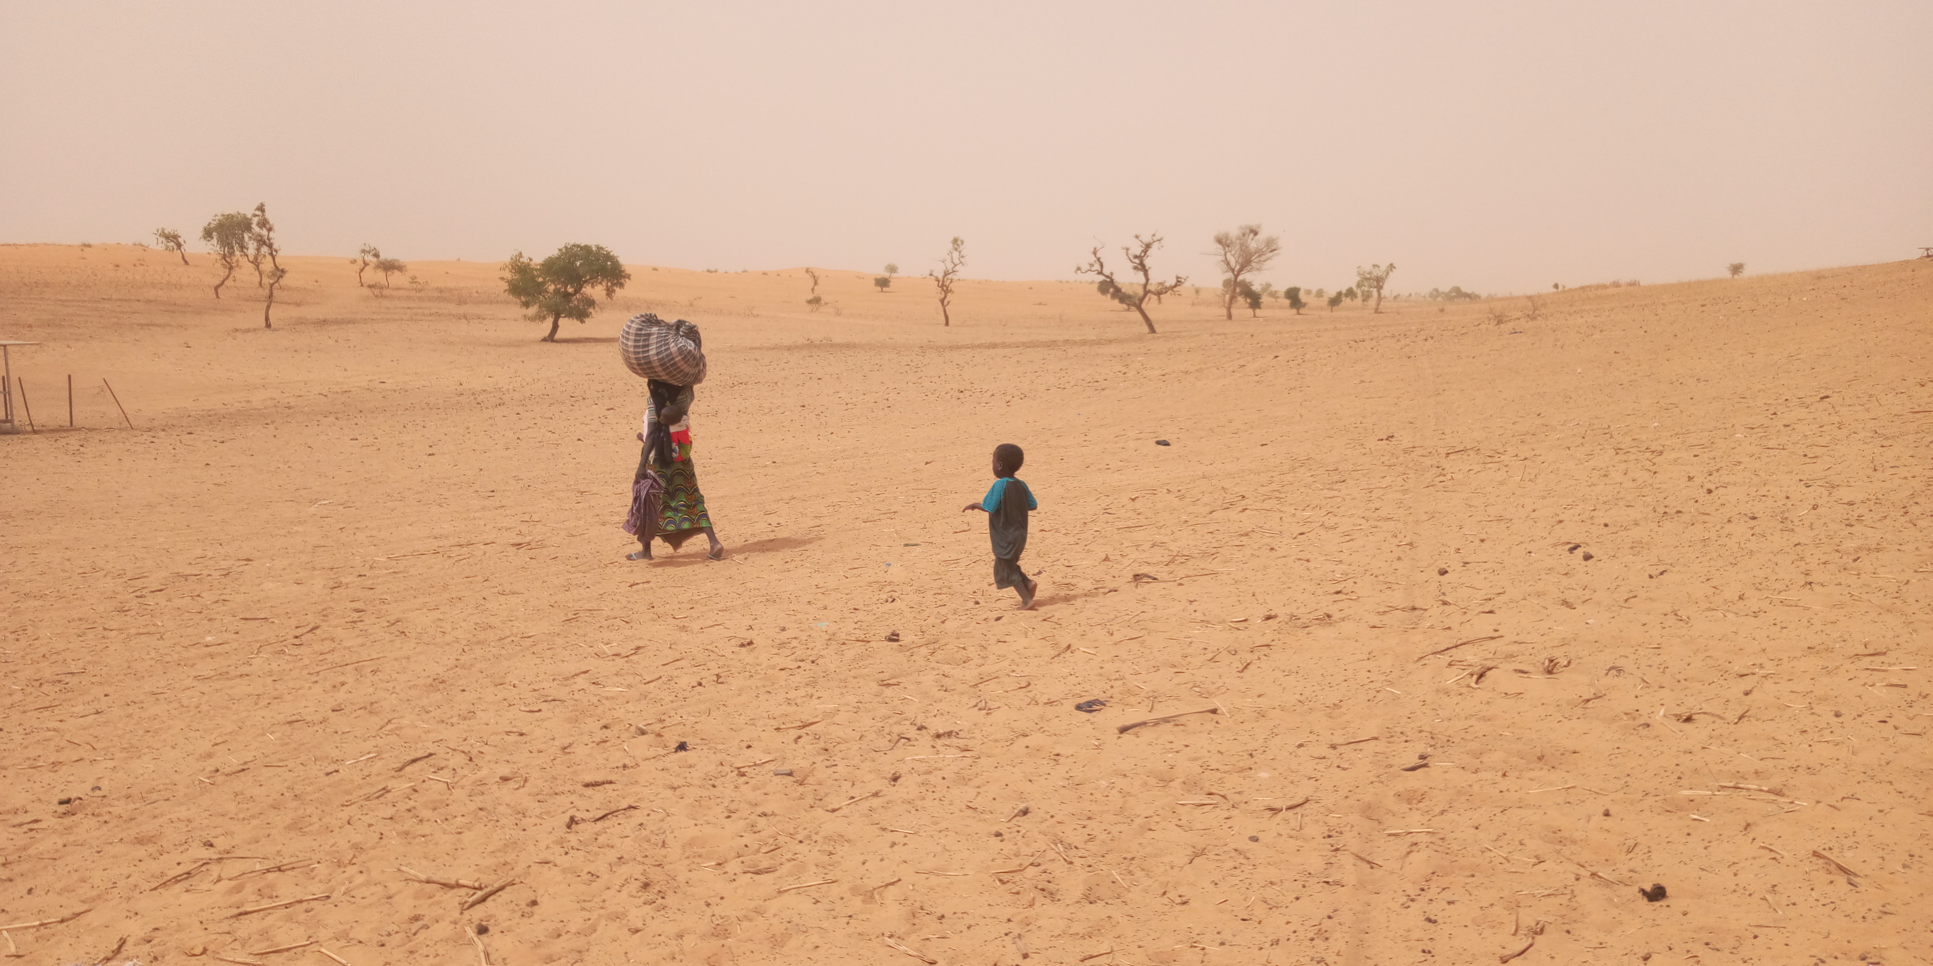
10th Station:
JESUS IS STRIPPED OF HIS GARMENTS
© Aid to the Church in Need
Islamist militant groups have seized large swathes of Mali where they have imposed the jizya Islamic tax of 25,000 CFA francs (£32) on those over 18 years of age in the Christian village Douna-Pen in Mopti Region. Some only earn 50,000 CFA francs (£64) a month in what is one of the world’s poorest countries. A source told ACN that those unable or unwilling to pay have been threatened with the closure of their churches.
.
Notes:
HOLY LAND

Slide 12
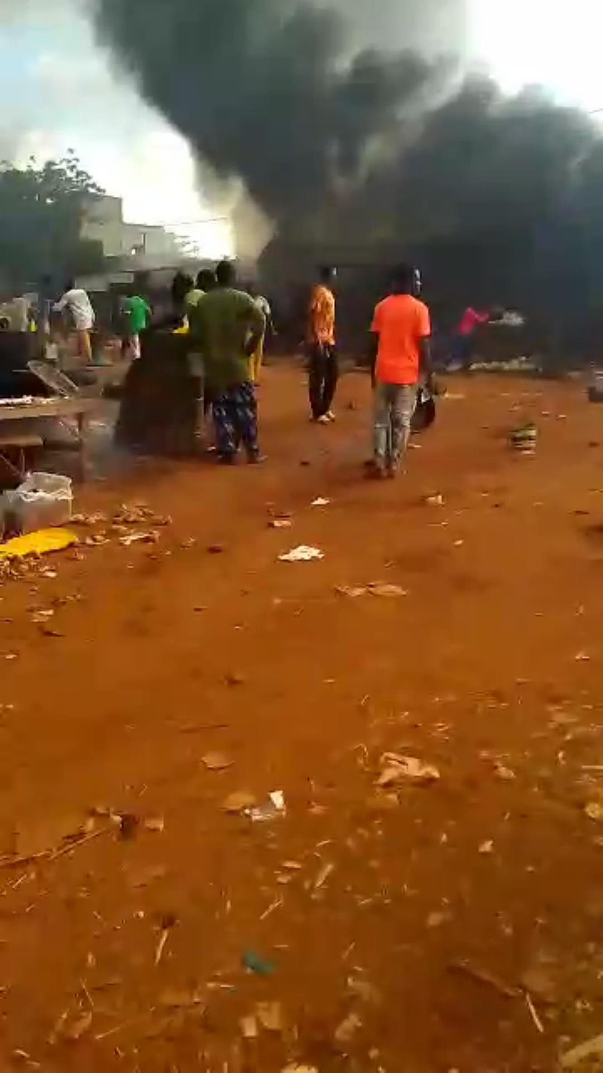
11th Station:
JESUS IS NAILED TO THE CROSS
In early October, terrorists killed at least 150 people in Manni in the northeast of Burkina Faso, many of whom were Christians. This latest massacre testifies to a cruelty and a stronger determination than ever to sow terror in the country where more than half of it is now controlled by terrorists.
© Aid to the Church in Need
Notes:
NICARAGUA

Slide 13
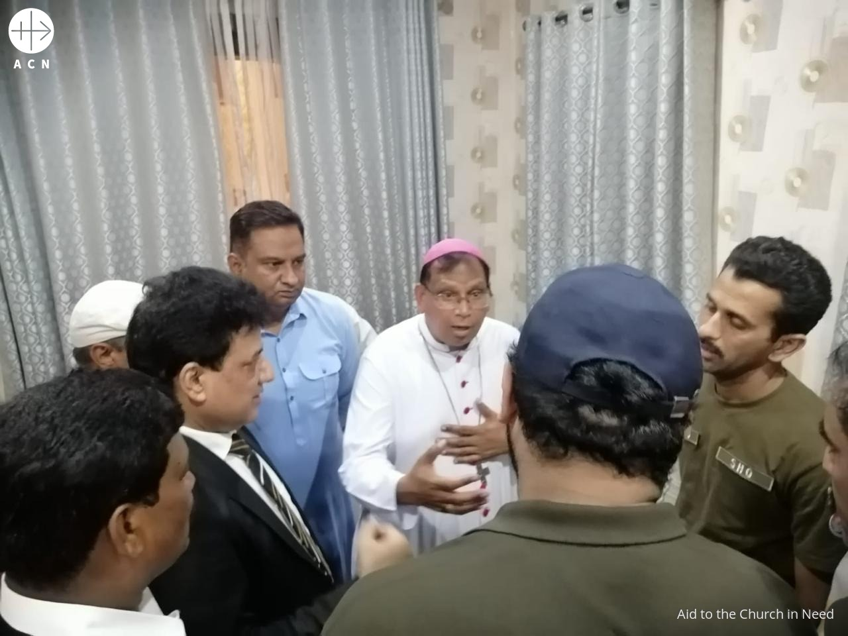
12th Station:
JESUS DIES ON THE CROSS
Archbishop Joseph Arshad of Islamabad-Rawalpindi in Pakistan and Christian Senator Tahir Khalil Sindu visited the police headquarters in Sargodha after a violent mob brutally beat Mr Nazir Gill Masih, a 70-year-old Christian shoe factory owner from Sargodha, Punjab Province, and his son on May 25, 2024 for blasphemy - they allege he burnt pages from the Qur'an. The mob also looted and set fire to Mr Masih’s home and factory. Mr Masih died from his injuries on 3rd June 2024.
Notes:
DEMOCRATIC REPUBLIC OF CONGO/UGANDA

Slide 14
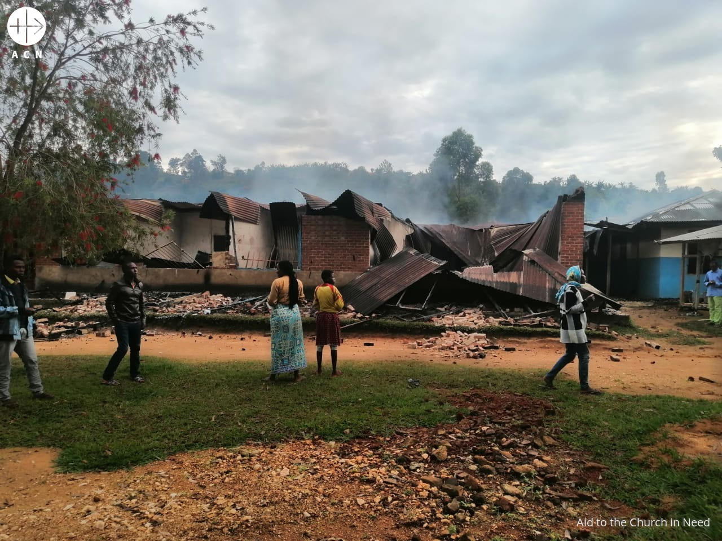
13th Station:
JESUS IS TAKEN DOWN
FROM THE CROSS
Bishop Melchisedec Sikuli Paluku of Butembo-Beni in the Democratic Republic of Congo (DRC) has called on authorities to “put an end to the plight of the Congolese people” following the massacre of around 150 people – including at least 80 Christians – by the Allied Democratic Forces (ADF) which is affiliated with Daesh (ISIS).
The terrorist group carried out the killings in villages in North Kivu Province in the eastern part of the (DRC) between 4th and 8th June. Eastern DRC – a region rich in natural resources – has been plagued by violent incursions by rebel groups since the 1990s.
.
Notes:
HAITI

Slide 15
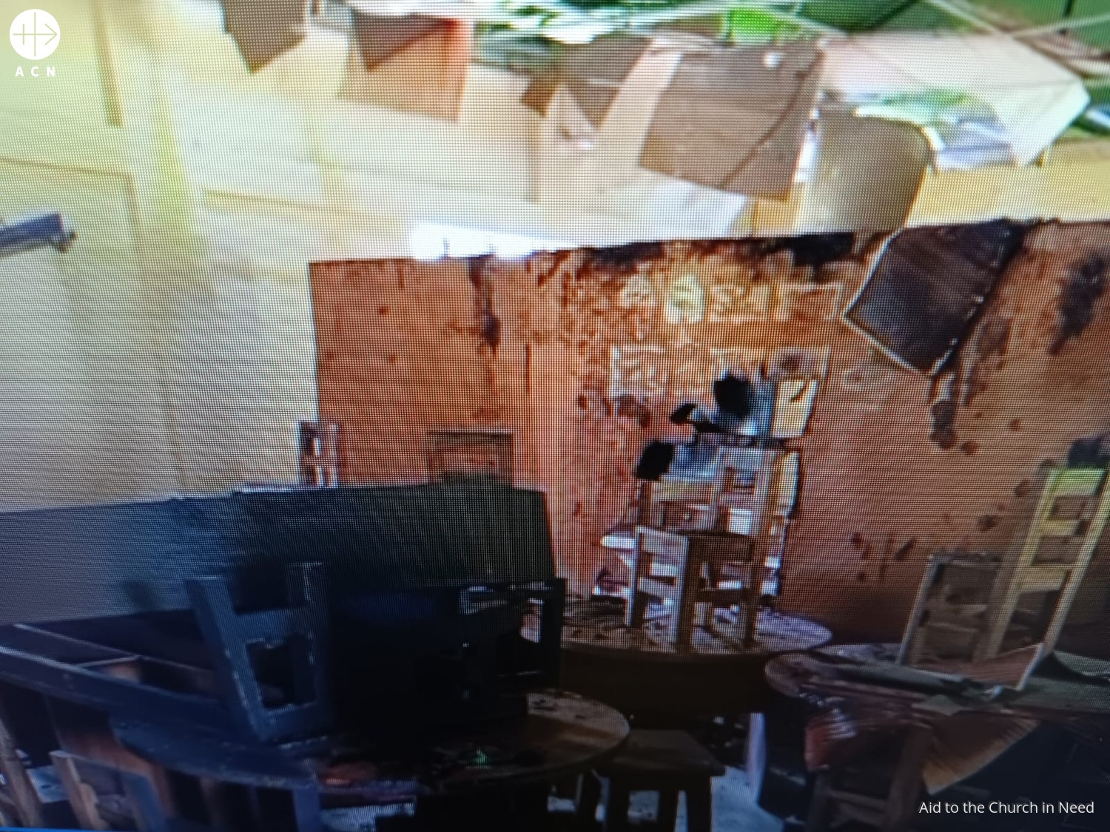
14th Station:
JESUS IS LAID IN THE TOMB
Saint Joseph School at Luxmipur District set on fire by a fundamentalist group on August 23, 2024.
In Bangladesh a well-placed ACN source said that religious freedom – despite being guaranteed by the constitution – is not being respected, and “the fundamentalist Jamaat-e-Islami party wants Islam to be the only religion in Bangladesh”. Consequently, the future of Catholic schools is under threat, Church construction projects are delayed, and Christians struggle to find work. A mob of Islamist extremists set fire to a Catholic school and completely burnt down some of the classrooms, and others have been putting increasing pressure on Catholic institutions to replace the people in charge.
Notes:
BURKINA FASO

Slide 16
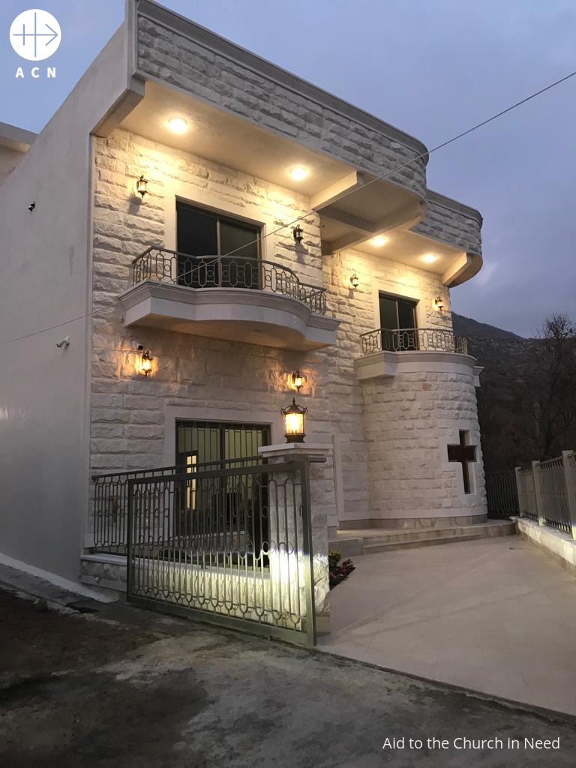
RISEN JESUS, WE PRAISE YOU!
The Daughters of the Sacred Heart of Jesus, a Chaldean order of religious Sisters, has been able to go back to the village of Araden in northern Iraq. Aid to the Church in Need (ACN) helped the order to return to its birthplace by supporting the building of a retreat centre and a shrine to the order’s founder, Father Abdul Ahad Rayes. Mother Superior Samar Mikha said: “The revitalised space will continue the mission of Father Rayes by supporting the Christian educational needs of the region."
Notes:
CAMEROON

Slide 17
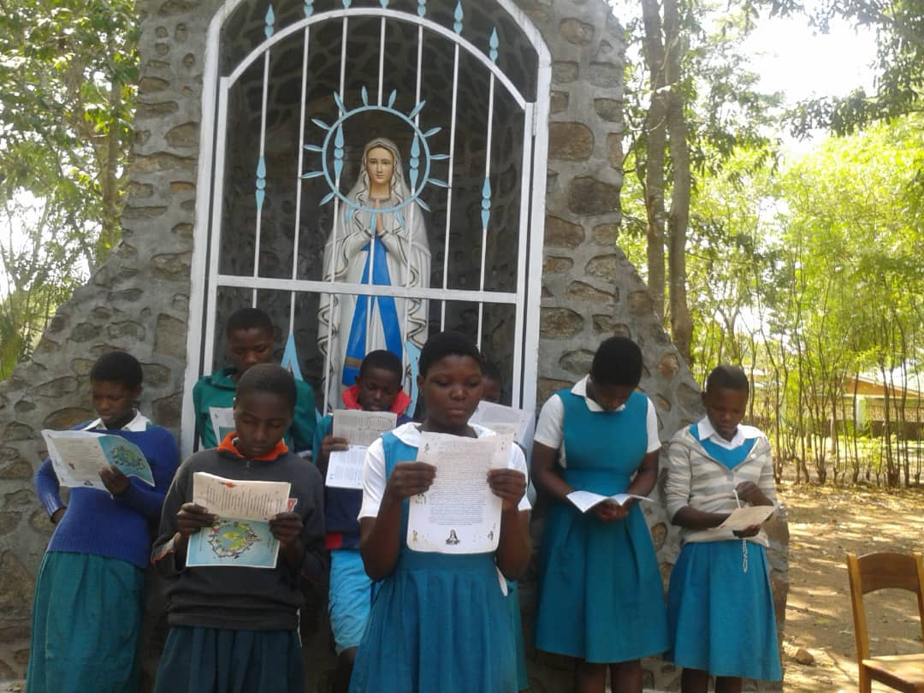
A PRAYER FOR
PERSECUTED CHRISTIANS
Loving Father, we pray that each of your precious children across the world may know of your love for them.
We pray that, where life has become very difficult,
you may make a clear path for them.
We pray for their protection, and for them to know that “...under His wings you will find refuge”. (Psalm 90(91):4 RSV-CE)
May persecuted Christians know that
with your grace, Lord God, they can do anything.
We offer our prayers for their strength and safety.
We make our prayer through Christ our Lord. Amen.
Children in the Diocese of Dedza, Malawi taking part in the ACN prayer initiative ‘One Million Children Praying the Rosary’. ©ACN
Aid to the Church in Need is a Pontifical Foundation of the Catholic Church and a registered charity in England and Wales (1097984) and in Scotland (SC040748)

